Slide 1


ATOMS, MOLECULES AND RADICALS
SUBJECT-CHEMISTRY
CHAPTER NO- 4
Molecular formula of a compound and writing a chemical formula
PERIOD-5

Slide 2

LEARNING OBJECTIVE
Students will be able to
Know about the molecular formula of a compound
Get aware of the steps of writing a chemical formula.
Can write the chemical formula using CRISS-CROSS METHOD

Slide 3
WARM UP QUESTIONS
Activate prior knowledge by asking students what do they mean by molecular formula of an element.
After listening to their responses, test their knowledge on the radicals.
Guide them to write the chemical formula of some compounds.

Slide 4
MOLECULAR FORMULA
A Molecular formula of a compound is the symbolic representation of its (one) molecule.
It shows the number of atoms of each element present in it. The atoms combine in whole numbers to form the molecules.
For Example: - A molecule of Sulphur Dioxide gas is represented by SO₂. It indicates that one molecule of SO2
contains one atom od sulphur and two atoms of oxygen

Slide 5
WRITING A CHEMICAL FORMULA OF A COMPOUND
To write the chemical formula, the following steps must be followed.
Write the Symbols
Interchange the valence number
Write the valency of the symbols.
Write the interchanged numbers at the base.
Write the formula of the compound

Slide 6
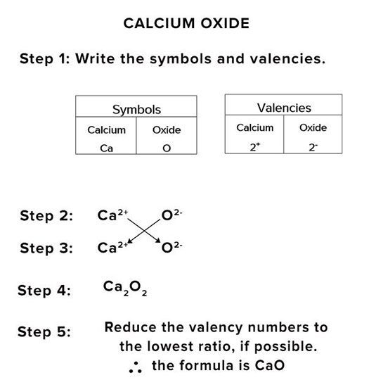
For example, the step wise method for writing the formula of CALCIUM OXIDE is given below

Slide 7
OTHER EXAMPLES OF CHEMICAL FORMULA (HOME ASSIGNMENT)
Similarly, Formulas like Magnesium oxide
Calcium nitride
zinc hydroxide
Aluminium Carbonate written by CRISS-CROSS method.
Exercise Q3 & Q4

Slide 8
THANKING YOU
ODM EDUCATIONAL GROUP

