Slide 1


TISSUES
SUBJECT- BIOLOGY
CHAPTER NO- 6
Study of structure and functions of parenchyma, Sclerenchyma , permanent slides.
PERIOD-5

Slide 2


LEARNING OBJECTIVE
Student will be able to
know the structure of parenchyma, collenchyma and sclerenchyma
familiarize with the function of all these three types of simple permanent tissues
analyze and identify the different types of simple permanent tissues.

Slide 3
Initiate children to see the permanent slide of simple permanent tissues.
https://youtu.be/7t5pn4bDlPQ
Ask them to record their observation

Slide 4
WARM UP QUESTIONS
Recapitulation of the previous topic
What do you mean by Permanent tissue?
List the types of permanent tissues
Can you name the simple permanent tissue?
What are the main functions of simple permanent tissues?

Slide 5
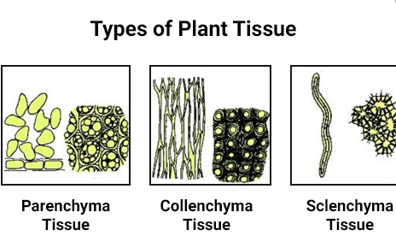

Slide 6
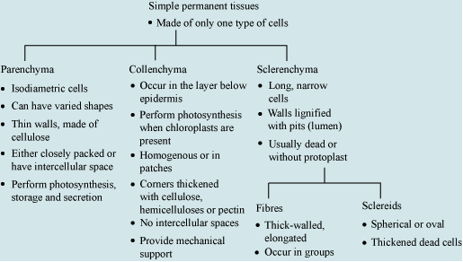

Slide 7

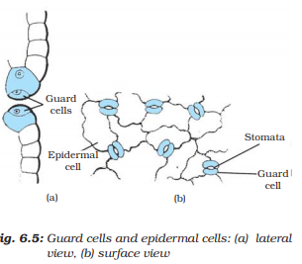
Epidermis of leaves contain stomata.
Functions of stomata
Help in gaseous exchange
Helps in transpiration

Slide 8

HOME ASSIGNMENT
Q. Why cork and epidermis are called as protective tissues in plants
Q. Explain the structure and functions of parenchyma, collenchymas and sclerenchyma
Q. Mention the types of parenchyma and their functions.

Slide 9
THANKING YOU
ODM EDUCATIONAL GROUP

