Slide 1


LIFE PROCESSES.
SUBJECT:BIOLOGY
CHAPTER:6
RESPIRATION.
PERIOD-4

Slide 2
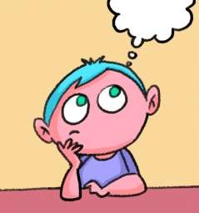
LEARNING OBJECTIVE
Student will be able to understand the meaning of aerobic and anaerobic respiration.
Student will be familiarized with the mechanism of breaking down of glucose in various organisms.
They will be able to analyze various types of respiration .
Learners will be sensitized about the difference between aerobic and anaerobic respiration.

Slide 3
WARM UP QUESTIONS
Name one organism which can live without oxygen
In which type of respiration, aerobic or anaerobic, more energy is released.
What are different types of respiration?

Slide 4
RESPIRATION
Respiration is the process by which food is burnt in the cells of the body with the help of oxygen to release energy. It takes place in the mitochondria of the cells.
The energy released during respiration is used to make ATP molecules (Adenosine tri phosphate) from ADP molecules (Adenosine di phosphate) and inorganic phosphate.
Energy
ADP + Phosphate ------------------------- ATP
from respiration
Energy is stored in the cells in the form of ATP molecules. When the cells need energy, ATP is broken down in the presence of water to form ADP and energy is released.
water
ATP -------------- ADP + Energy

Slide 5
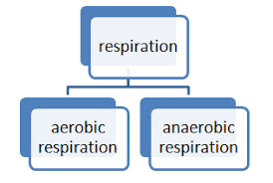
TYPES OF RESPIRATION

Slide 6
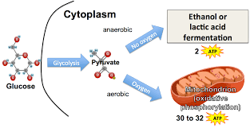
AEROBIC RESPIRATION
Aerobic Respiration: This type of respiration happens in the presence of oxygen.Pyruvic acid is converted into carbon dioxide. Energy is released and water molecule isalso formed at the end of this process.

Slide 7
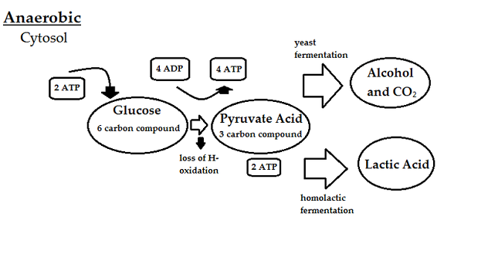
ANAEROBIC RESPIRATION.
Anaerobic Respiration: This type of respiration happens in the absence of oxygen.Pyruvic acid is either converted into ethyl alcohol or lactic acid. Ethyl alcohol is usually formed in case of anaerobic respiration in microbes; like yeast or bacteria. Lactic acid is formed in some microbes as well as in the muscle cells.

Slide 8
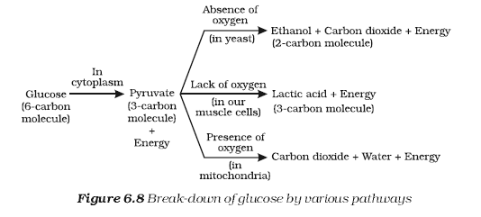
BREAK DOWN OF GLUCOSE BY VARIOUS PATHWAYS.

Slide 9
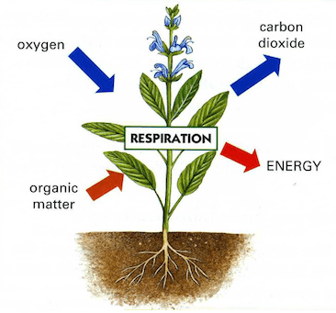
RESPIRATION IN PLANTS
It takes place in all parts of the plants like root , stem and leaves
In roots exchange of gases takes place by the process of diffusion
In woody stem exchange of gases takes place by lenticels
In leaves exchange of gases takes place through stomata

Slide 10
https://www.youtube.com/watch?v=9pSj2bgzTmM

Slide 11
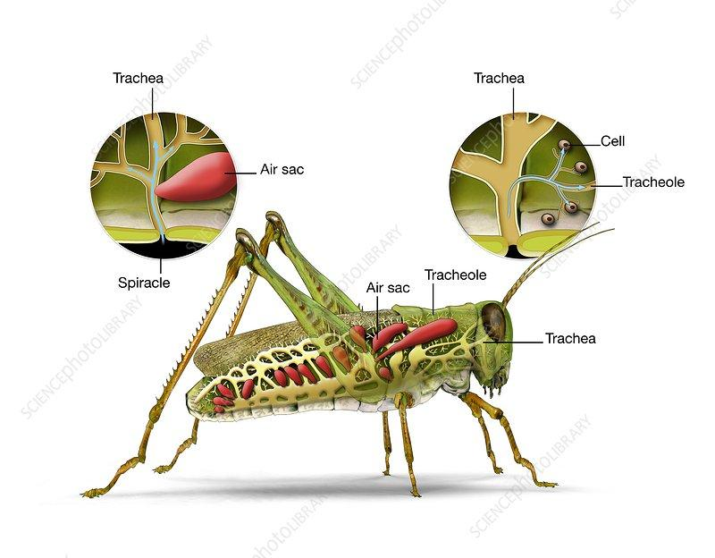
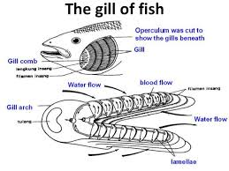
RESPIRATION IN ANIMALS
Aquatic animals have gills as respiratory organs
Land animals have lungs as respiratory organs
Insects have air tube or trachea as respiratory organs

Slide 12
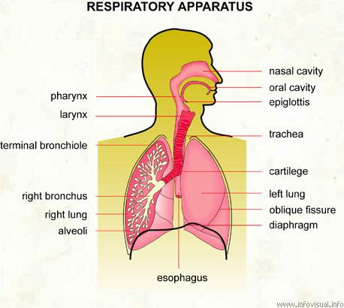
HUMAN RESPIRATORY SYSTEM:
The human respiratory system consists of
Nostrils
Nasal cavity
Pharynx
Trachea
Bronchi
Bronchioles
Alveoli

Slide 13
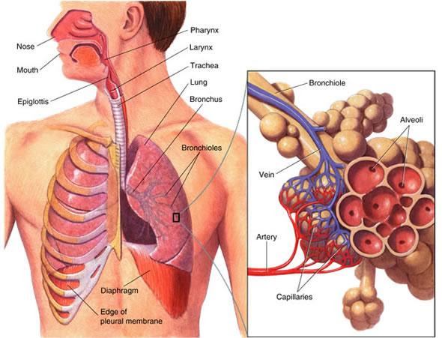
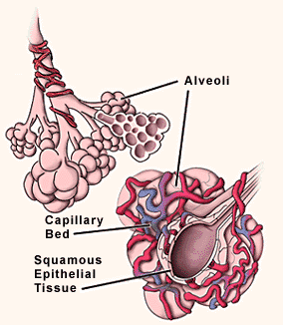
Air enter through the nostrils. The hairs and mucous traps the dust particles.
It is then passes through the phraynx, larynx, trachea, bronchi and enters the lungs.
The trachea has rings of cartilage which prevents it from collapsing when there is no air in the trachea.
The bronchi divides into smaller tubes called bronchioles which ends in tiny air sacs called alveoli.
The alveoli is supplied with blood vessels through which exchange of gases takes place. The alveoli helps to increase the surface area for the exchange of gases.

Slide 14
https://www.youtube.com/watch?v=dkAe4DjHwMM

Slide 15
HOME ASSIGNMENT
In box Question - 2 ,Pg No-105 and Exercise Question No-8

Slide 16
THANKING YOU
ODM EDUCATIONAL GROP

