Slide 1


MATTER AND IT’S COMPOSITION
SUBJECT-CHEMISTRY
CHAPTER NO- 1
States of matter
PERIOD-4

Slide 2


LEARNING OBJECTIVE
Students will be able to
Apprise 3 states of matter
Explain the different states of matter- solid, liquid and gas
Sensitize the difference in properties of three states of matter.

Slide 3
WARM UP QUESTIONS
Recapitulation of the previous topic by asking the following questions.
Explain that particles of matter have space between them by the help of an example.
How can you explain that particles of matter are always in random motion?
Give any one example to explain particles of matter attract each other.

Slide 4

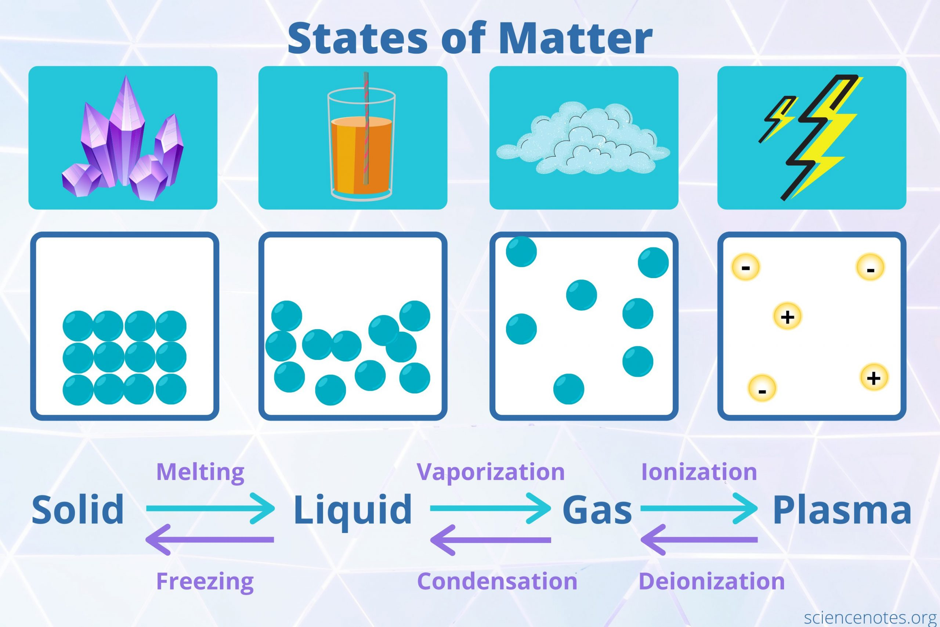
States of matter

Slide 5
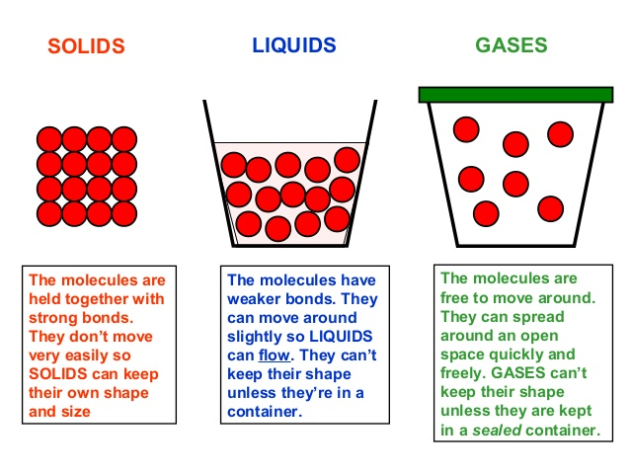

Slide 6
States of matter
https://youtu.be/o2qM4o8e_Vo

Slide 7
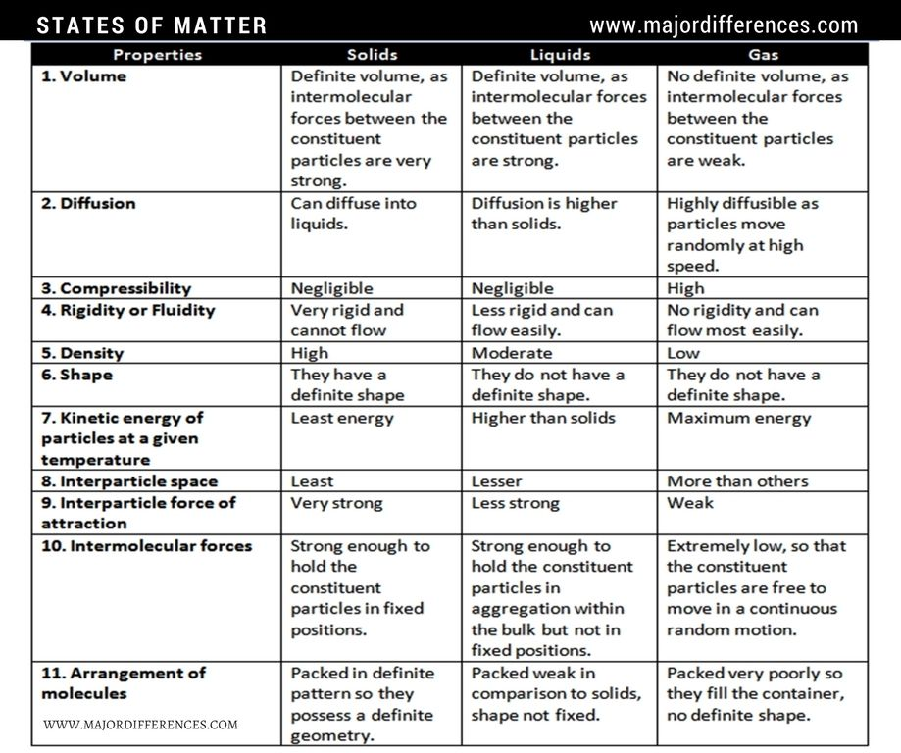
Difference in the properties of states of matter

Slide 8
Properties of states of matter
https://youtu.be/sYZ3ETjK8_Y

Slide 9
Particles of matter attract each other
https://youtu.be/_-7jrmV5Yrw

Slide 10
HOME ASSIGNMENT
Exercise-3,4
Q. What are the three states of matter?
Q. How can you differentiate solid liquid and gases based on the following properties?
a. intermolecular space
b. fluidity
c. transparency
d. volume
e. lusture
f. volume
g. effect of pressure

Slide 11
THANKING YOU
ODM EDUCATIONAL GROUP

