Slide 1


FORCE
SUBJECT-PHYSICS
CHAPTER NO- 3
Effects of friction
PERIOD-4

Slide 2


LEARNING OBJECTIVE
Students will be able to
familiarize with the effects of friction
Describe the different effects of friction with appropriate examples
Relate the effects of friction in real life situations.

Slide 3
WARM UP QUESTIONS
Recapitulate the previous topic by asking the following questions.
Q. Explain the classification of force on the basis of its application
Q. What do you mean by contact forces? Give some examples
Q. List the types of non contact forces.
Q. Define electrostatic force.

Slide 4

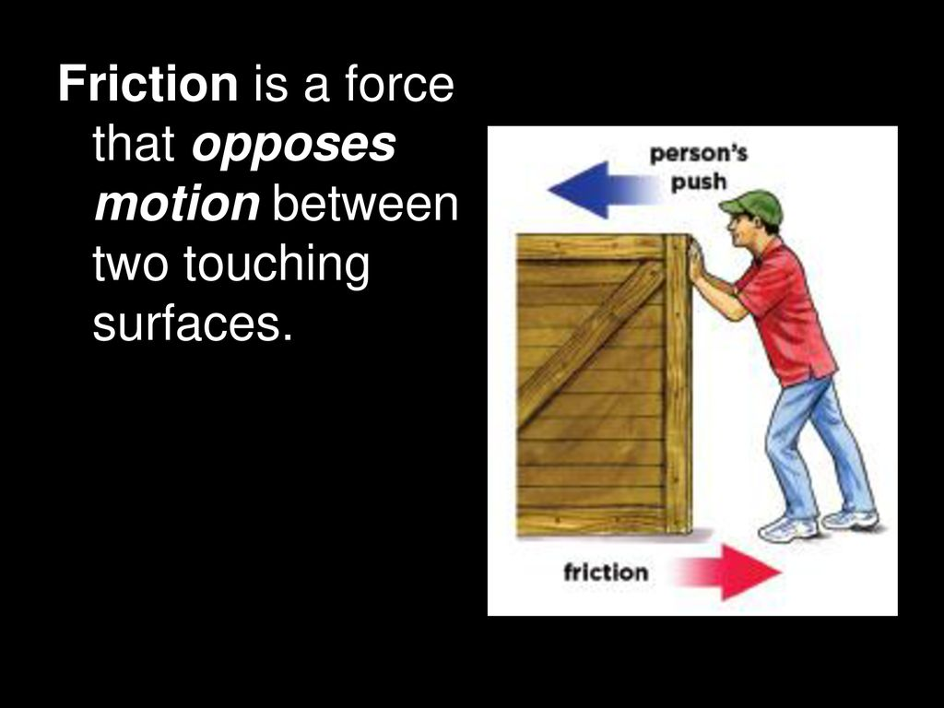
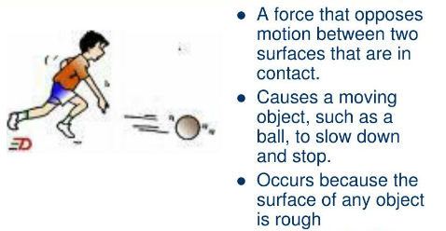
Effects of friction
Friction opposes motion-

Slide 5
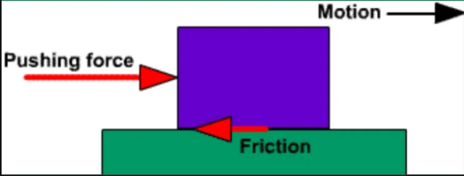
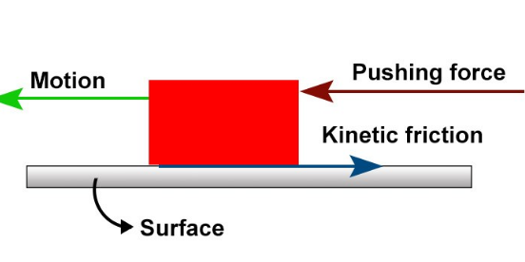
2. Friction acts in a direction opposite to the direction of motion

Slide 6

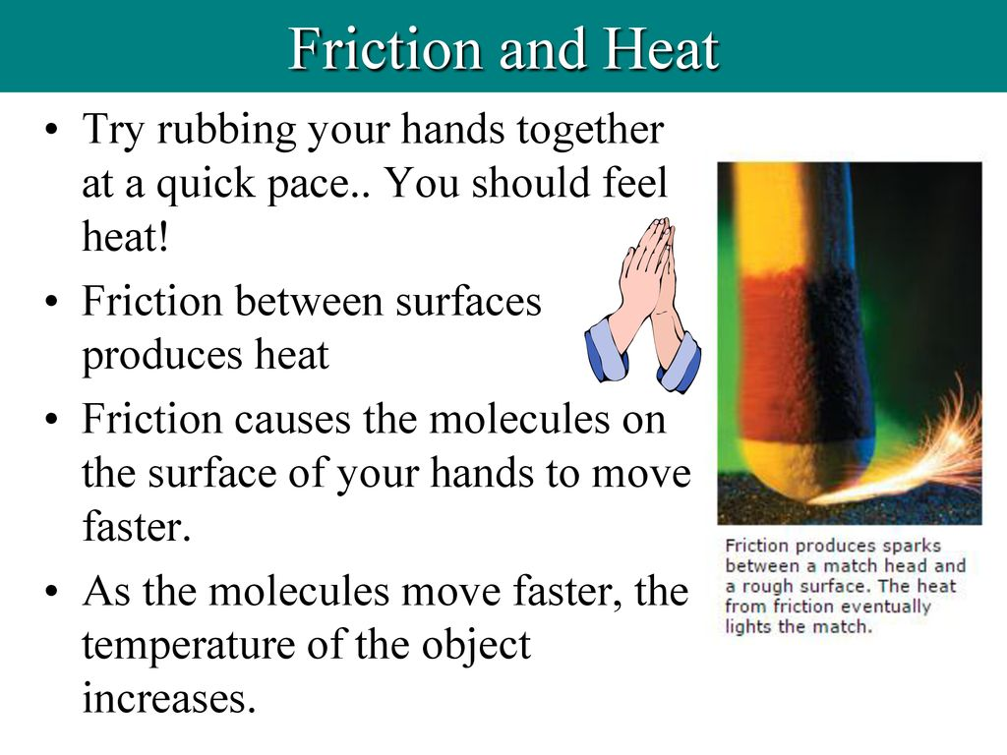
3. Friction produces heat

Slide 7

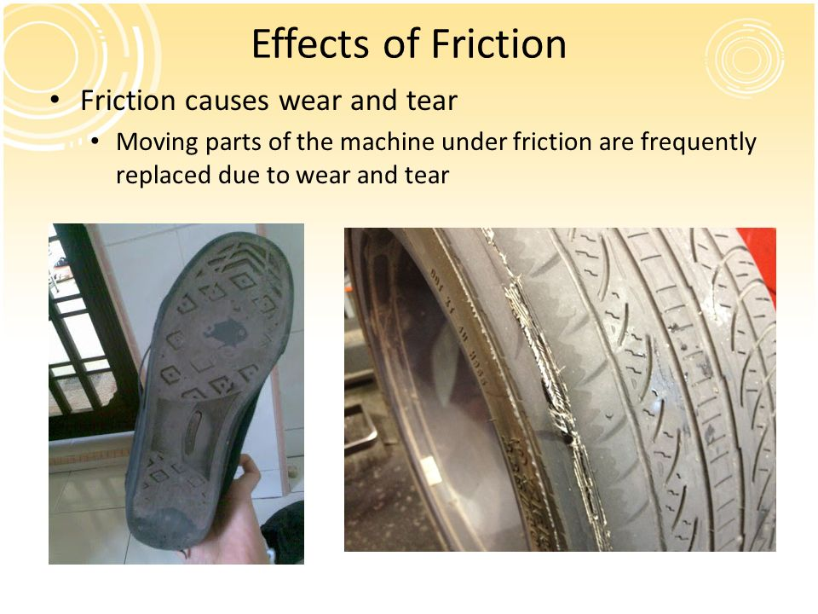
4. Friction causes wear and tear

Slide 8

FACTORS AFFECTING FORCE OF FRICTION
smoothness of the surface- Friction is more in rough surfaces and less between smooth surfaces
Nature of medium in which the body moves -
Solid-solid > solid- liquid> solid –gas
3. Weight of the moving body-
Greater the weight more is the force of friction.

Slide 9
Explain the concept by showing a video
https://youtu.be/RVoATG4OhUw

Slide 10
HOME ASSIGNMENT
Exercise- B 13,14
Q. List the effects of friction
Q. Explain with example how friction opposes motion
Q. ‘Friction always acts in a direction opposite to the direction of motion’. Justify the statement by giving an example.
Q. How can you prove friction produces heat? Give an example.

Slide 11
THANKING YOU
ODM EDUCATIONAL GROUP

