Slide 1


THE FUNDAMENTAL UNIT OF LIFE
SUBJECT- BIOLOGY
CHAPTER NO- 5
Transport across cell membrane- Diffusion and Osmosis
PERIOD-4

Slide 2

LEARNING OBJECTIVE
Student will be able to
sensitize the meaning of diffusion and osmosis.
familiarize with the mechanism of transportation of selective materials through plasma membrane.
analyze various types of solutions depending on the concentration of both solute and solvent.
sensitize the difference between osmosis and diffusion.

Slide 3
Activity
After burning an incense stick outside the classroom
Answer the following questions
can you smell the fragrance of incense sticks?
Guess how you are able to smell the fragrance?

Slide 4
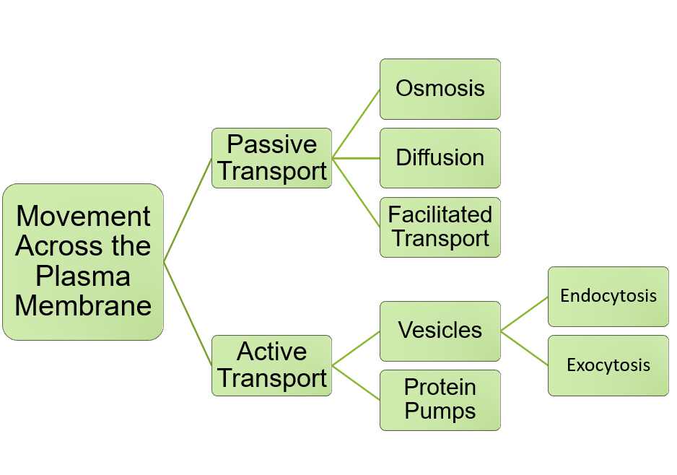

Slide 5
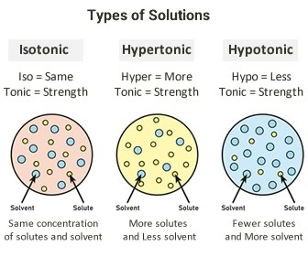
TYPES OF SOLUTION

Slide 6

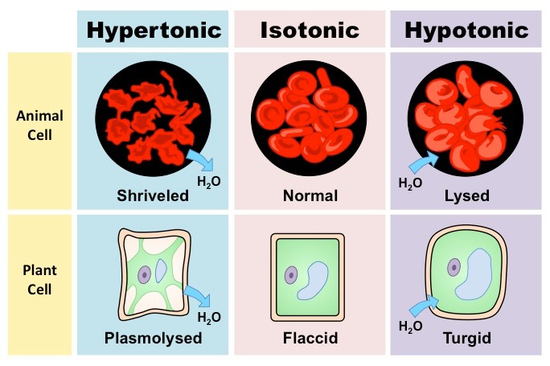

Slide 7
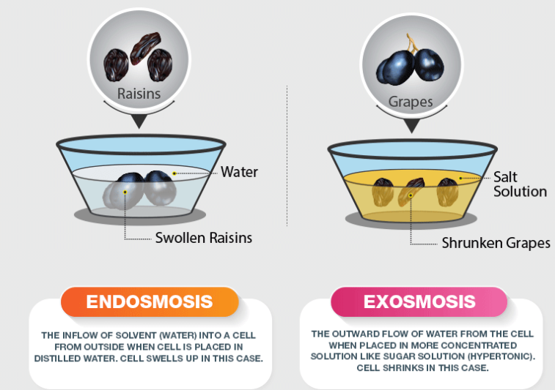
Activity- To observe the process of osmosis

Slide 8

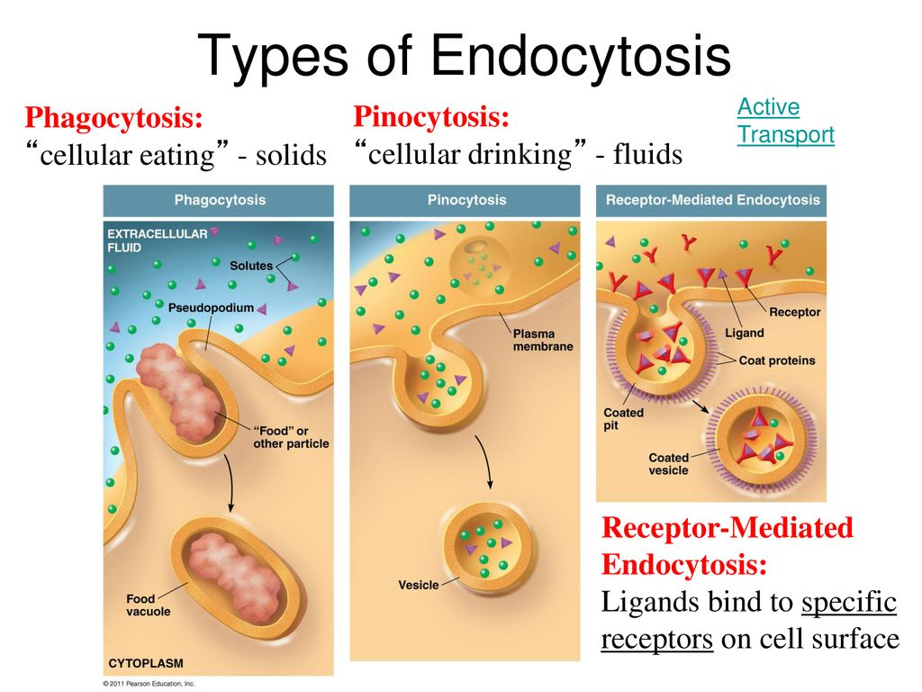
Endocytosis -The flexibility of plasma membrane enables cell to obtain food & other material from external environment.

Slide 9
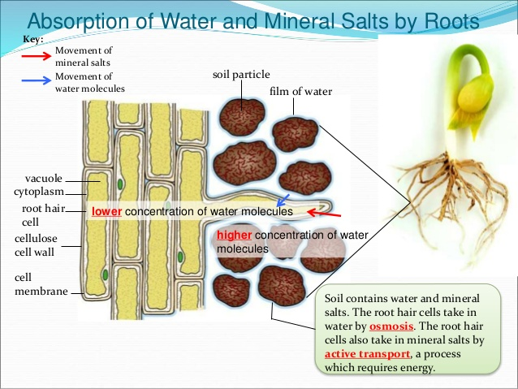

Slide 10

Detailed explanation on osmosis and diffusion
https://youtu.be/SD1AKWUazPU
https://youtu.be/MCvbfqz7ASs

Slide 11

HOME ASSIGNMENT
Q1. How do substances like carbon dioxide and water move in & out of the cells?
Q2.Why is the plasma membrane called a selectively permeable membrane?
Q3. Define isotonic, hypotonic and hypertonic solution.
Q4. Explain what happens when
a plant cell is kept in hypertonic solution
an animal cell is kept in hypotonic solution

Slide 12
THANKING YOU
ODM EDUCATIONAL GROUP

