Slide 1


ATOMS, MOLECULES AND RADICALS
SUBJECT-CHEMISTRY
CHAPTER NO- 4
Relationship between valency of elements and the Periodic table.
PERIOD-4

Slide 2

LEARNING OBJECTIVE
Students will be able to
Know about the Periodic Table.
Get aware of the valency of some elements.
Know about the Relationship of the valency of elements with the Periodic table.

Slide 3
WARM UP QUESTIONS
Activate prior knowledge by asking students what do they mean by valency.
After listening to their responses, test their knowledge on the valency of some elements.
Guide them and show the relationship of the valency of elements with the Periodic Table.

Slide 4
PERIODIC TABLE
Periodic Table is a tabular arrangement of elements in vertical columns and horizontal rows indicating the regular trends in the properties of elements.
The table consists of 118 elements known to us.
These elements are arranged in 18 vertical columns called groups and 7 horizontal rows called periods according to the IUPAC system.

Slide 5
VALENCY OF SOME ELEMENTS
NAME OF THE ELEMENT | SYMBOL | VALENCY
Hydrogen | H | 1
Helium | He | 0
Lithium | Li | 1
Beryllium | Be | 2
Boron | B | 3
Carbon | C | 4
Nitrogen | N | 3
Oxygen | O | 2
Fluorine | F | 1
Neon | Ne | 0
Sodium | Na | 1
Magnesium | Mg | 2
Aluminium | Al | 3
Silicon | Si | 4
Phosphorous | P | 3
Sulphur | S | 2
Chlorine | Cl | 1
Argon | Ar | 0
Potassium | K | 1
Calcium | Ca | 2

Slide 6
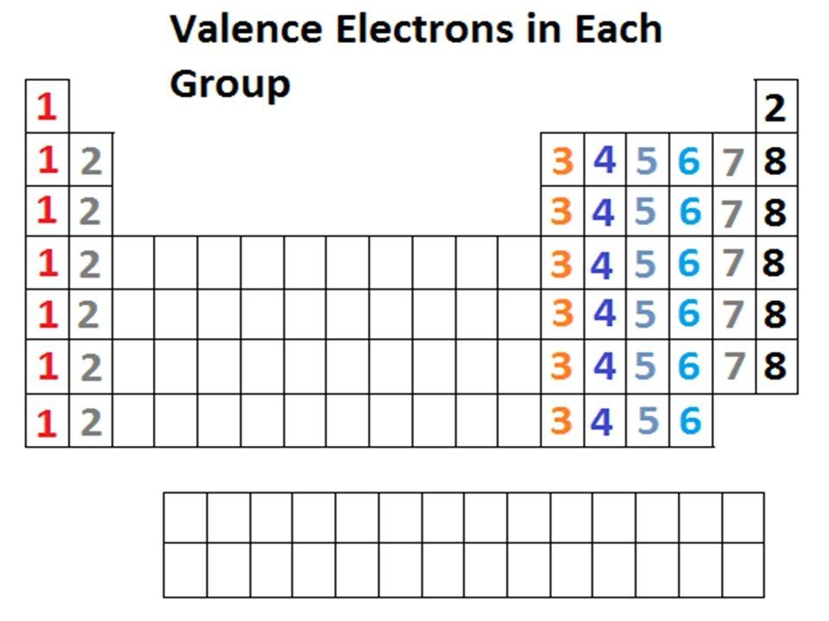
RELATIONSHIP BETWEEN VALENCY AND VALENCE ELECTRON

Slide 7
WATCH A VIDEO ON PERIODIC TABLE
https://youtu.be/rz4Dd1I_fX0

Slide 8
HOME ASSIGNMENT
Exercise Q1 (d), (e), Q6, Q12, Q13
Expand IUPAC
Define group in a periodic table.
Define a Period in the periodic table.

Slide 9
THANKING YOU
ODM EDUCATIONAL GROUP

