Slide 1


AIR AND ATMOSPHERE
CLASS-VII
SUBJECT-CHEMISTRY
CHAPTER-07
AIR QUALITY, TYPES OF POLLUTANTS IN AIR AND THEIR HARMFUL EFFECTS
PERIOD-4

Slide 2

LEARNING OBJECTIVE
Students will be able to.
Familiarize with the types of pollutants and their harmful effects.
Familiarize them with the air quality.

Slide 3
WARM UP QUESTIONS
Why air is getting contaminated?
Mention some human activities responsible for the air pollution ?
What do you mean by pollutant.

Slide 4
AIR QUALITY
Air is important for the survival of human beings.
It should be free from the impurities.
The various harmful substances present in the air is known as Air Pollutant.
The following human activities are responsible for the pollution of air :-
Burning of fossils fuel and fibres.
Cutting of forests.
Emission from the vehicles.
Increased number of industries.
Use of chemical fertilizers and insecticides.
Use of nuclear bombs and other chemical weapons.

Slide 5
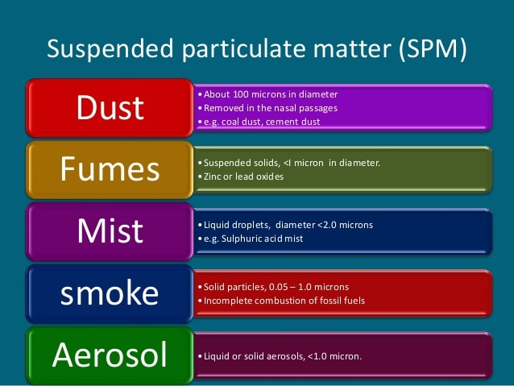
TYPES OF POLLUTANTS IN THE AIR AND THEIR HARMFUL EFFECTS
Suspended Particulate Matter (SPM)
Particles of lead oxide present in the automobile exhaust can cause brain damage in children. It also obstructs the development of blood cells.
Particles of dust, cement, ash and soot in the smoke may causes bronchitis. Asbestos fibre can cause a serious diseases called as silicosis.
Pollen grains can cause allergic reactions in human beings.

Slide 6
TYPES OF POLLUTANTS IN THE AIR AND THEIR HARMFUL EFFECTS
Oxides of carbon
Carbon monoxide combines with the haemoglobin to form a stable compound carboxyhaemoglobin from which haemoglobin cannot be recovered back.
Breathing in carbon dioxide rich air causes headache, dizziness and might cause death.
Excess carbon dioxide in the air causes global warming.

Slide 7
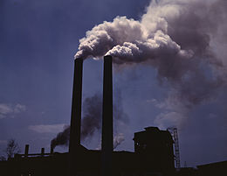
TYPES OF POLLUTANTS IN THE AIR AND THEIR HARMFUL EFFECTS
Oxides of sulphur and nitrogen
SO₂ and SO₃ are highly poisonous gases and may causes serious respiratory problems.
H₂S (Hydrogen Sulphide) is highly obnoxious and causes headache.
Oxides of nitrogen in Smog affects our eyes.
Oxides of nitrogen causes acid rain, damages the buildings and crops etc.

Slide 8
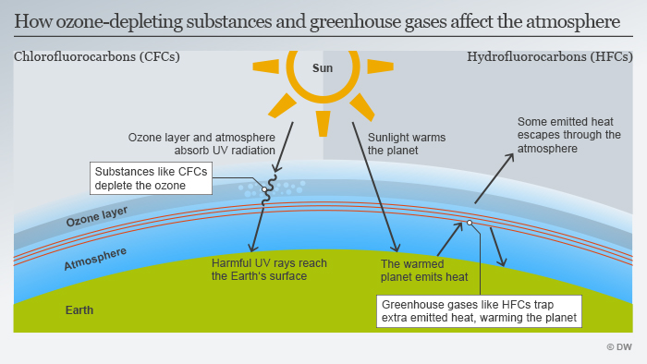
TYPES OF POLLUTANTS IN THE AIR AND THEIR HARMFUL EFFECTS
Other pollutants (CFC)
CFC (Chlorofluorocarbons) used in the refrigerators cause depletion of the ozone layer.
The UV rays falling on the body of human beings causes skin cancer.

Slide 9
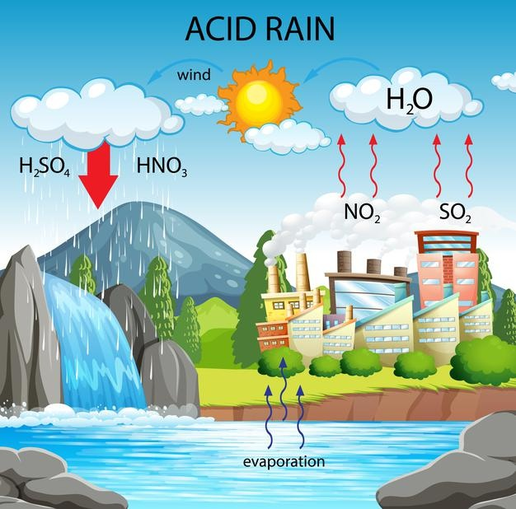
ACID RAIN
A rain which is acidic in nature is called as ACID RAIN.
The formation of acid rain can be shown by the following chemical equations: -
Sulphur dioxide + water-----------→ sulphurous acid
SO₂ + H₂O------------------→ H₂SO₃
Sulphur trioxide + water-----------→ sulphuric acid
SO₃ + H₂O------------------→ H₂SO₄
Sulphurous acid + oxygen------------→ sulphuric acid
2H₂SO₃ + O₂---------------→ 2H₂SO₄
Nitrogen dioxide + water------------→ nitrous acid + nitric acid
2NO₂ + H₂O----------------→ HNO₂ + HNO₃
Nitrogen pentoxide + water---------------→ nitric acid
N₂O₅ + H₂O-------------→ 2HNO₃

Slide 10
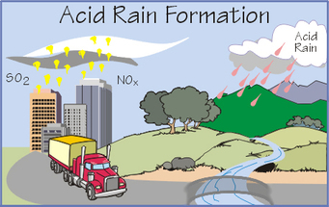
HARMFUL EFFECTS OF ACID RAIN
It damages the wildlife in the ecosystem.
It kills the aquatic animals and plants.
It makes the soil lose its fertility
It corrodes the metals and damages the buildings and monuments.
It damages the railway tracks and bridges.
It damages the nutrition levels of the leaves of the plants.

Slide 11
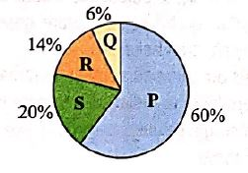
GLOBAL WARMING
The increase in the temperature of the earth due to the increase in the percentage of the gases like methane, carbon dioxide etc. is known as GLOBAL WARMING
Q=Nitrous Oxide
R=CFC
S=Methane
P=Carbon Dioxide

Slide 12
VIDEO TIME
https://youtube.com/watch?v=PqxMzKLYrZ4&feature=share

Slide 13
HOME ASSIGNMENT
Exercise-1 Q3 & Q4
Expand CFC and SPM.
Mention some of the harmful effects of acid rain.
What do you mean by Global warming. Mention some causes of it.

Slide 14
THANKING YOU
ODM EDUCATIONAL GROUP

