Slide 1


CLASS : UKG
SUBJECT : MATHS
CHAPTER : 21
TOPIC : MONEY
SUB TOPIC : NOTEBOOK WORK (MONEY)

Slide 2
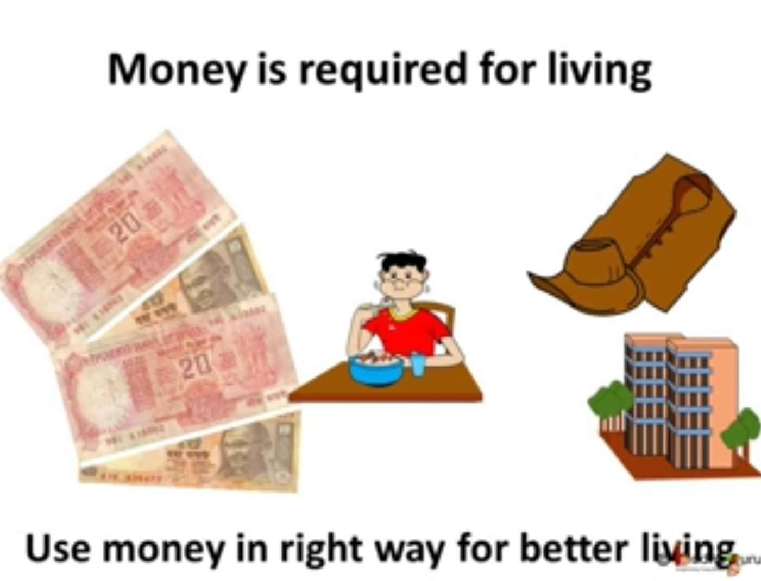
WHAT IS MONEY ?

Slide 3


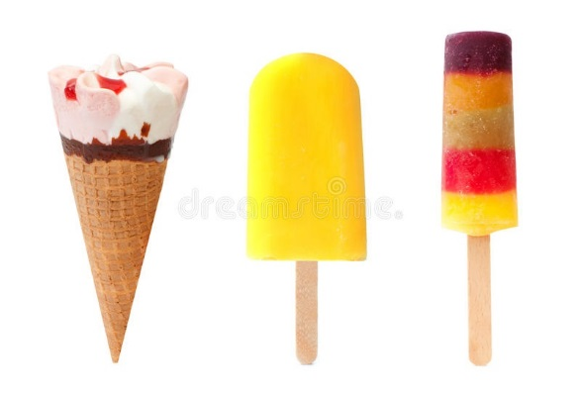
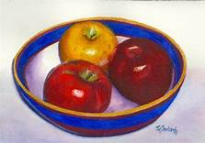

Let us know the paise and rupee
A paise or rupee are unit of measurement of money in India.
The symbol of rupee is -
We use money in term of coins and notes to purchase different things-

Slide 4
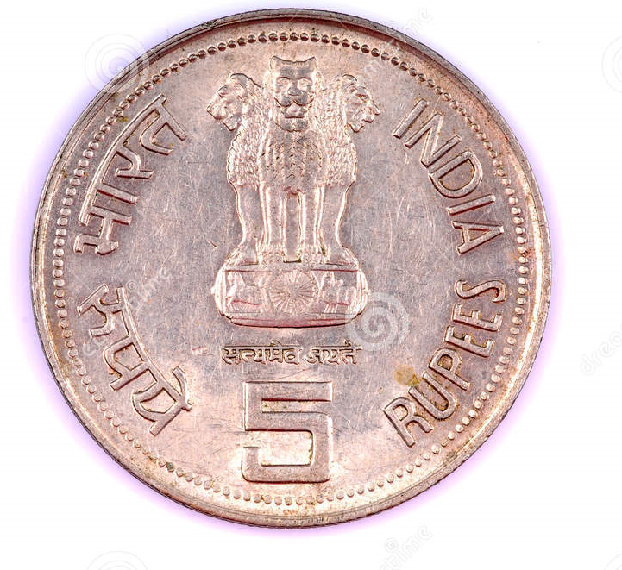
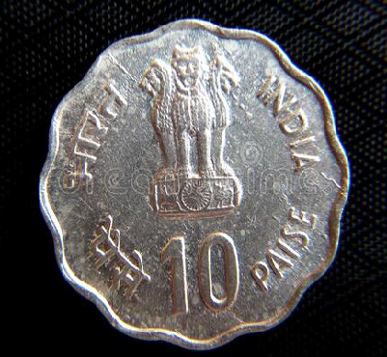
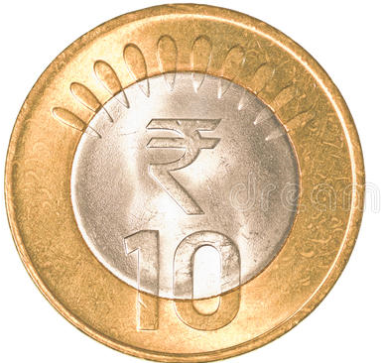
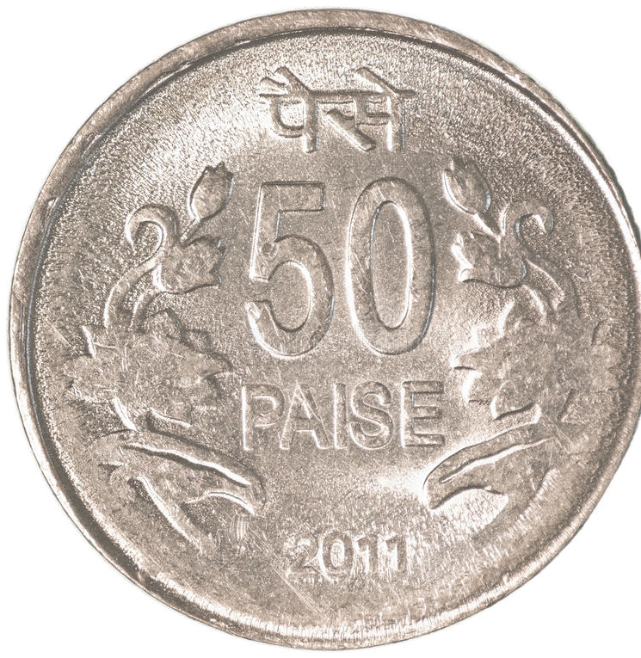
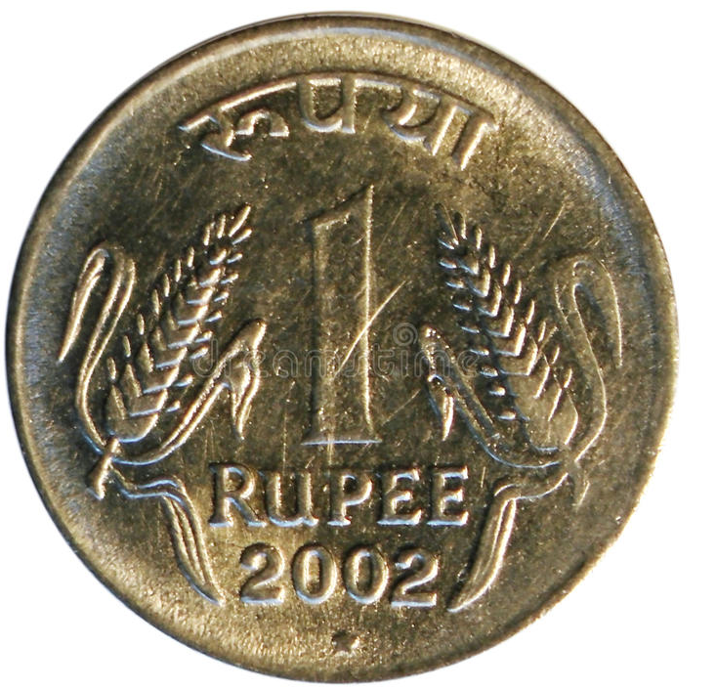
Tick the coins you have seen
c/w
4.1.22
✓
✓
✓
✓

Slide 5
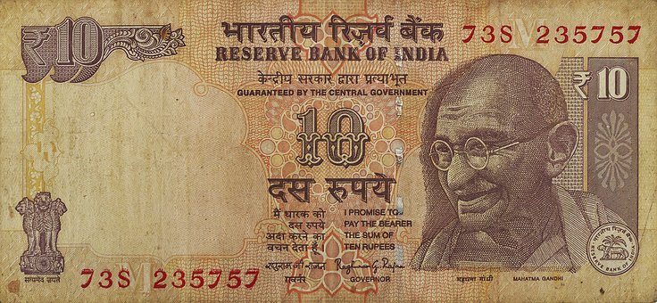
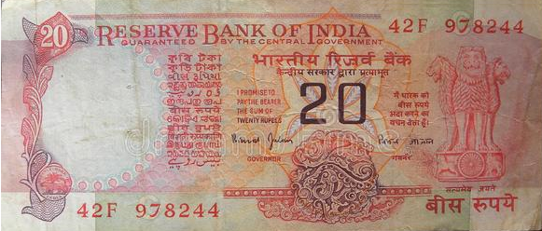
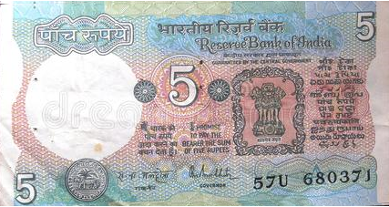
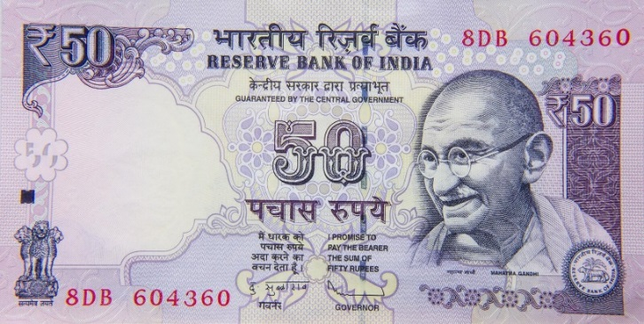
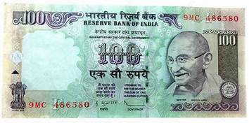
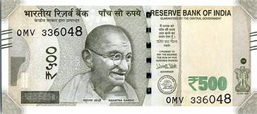
c/w
4.1.22
Colour the circles for the notes that you have seen.

Slide 6
HOME ASSIGNMENT
H/w
4.1.22
Identify the coins and notes.
Collect different denominations of money.
( from newspaper, magazine, fake notes etc.)

Slide 7
THANKING YOU
ODM EDUCATIONAL GROUP

