Slide 1


SUBJECT:BIOLOGY
CHAPTER:8
CHAPTER NAME: HOW DO ORGANISMS REPRODUCE?
PERIOD-3

Slide 2
The sexual reproduction in flowering plant involves
Pollination
Fertilisation

Slide 3
Pollination
Transfer of pollen grains from the anther to the stigma is called pollination. Pollen grains are transferred mainly by wind, water and insects. They are called as pollinating agents. Pollination is the first and important event in the development of the fruit and seed. Pollination is followed by fertilization.

Slide 4
Types of pollination
Pollination is of two types. They are
1. Self pollination
2. Cross pollination

Slide 5
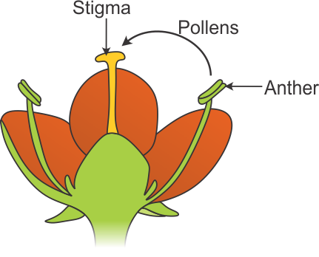
Self pollination
Self pollination is also known as autogamy. The transfer of pollen grains from the anther of a flower to the stigma of the same flower or another flower of the same plant is known as self pollination.

Slide 6
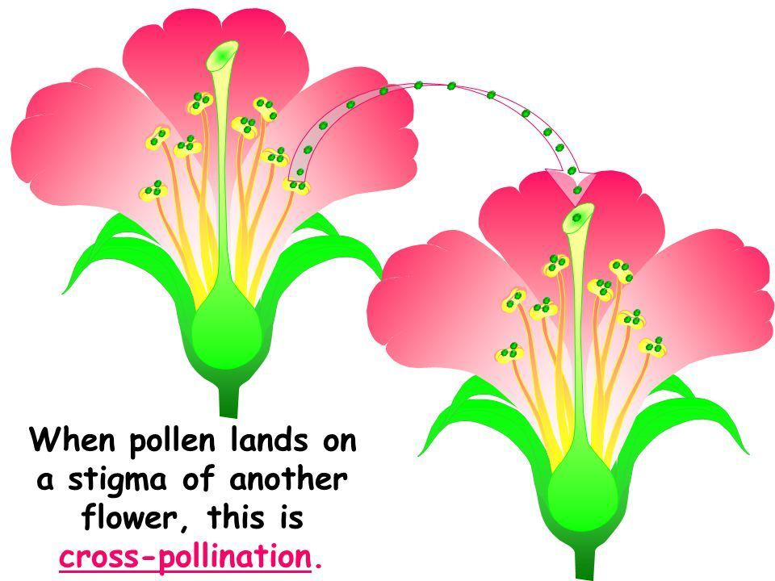
Cross pollination
The transfer of pollen grains of a flower to the stigma of another flower of a different plant of the same species is called cross pollination or allogamy.

Slide 7
AGENTS OF CROSS POLLINATION
Wind
Water
Animals

Slide 8
https://www.youtube.com/watch?v=iE8eMLbuEJs

Slide 9
FERTILIZATION
The fusion of male and female gamete is called fertilisation.
If pollen grain falls on a suitable stigma, it absorbs water and nutrients,grows a pollen tube
The pollen grain contains two male gametes

Slide 10
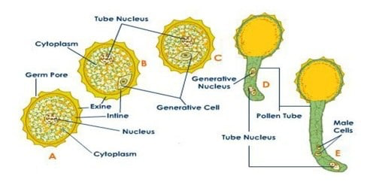
The pollen tube enters into the embryo sac through micropyle. At this time, the pollen tube bursts open, gametes released from the pollen tube and enter into the embryosac. One of the gametes fuses with the egg, and the other fuses with the secondary nucleus. The fusion of a male gamete with egg is known as fertilization. The fertilized egg is known as zygote which develops into embryo.

Slide 11
DOUBLE FERTILIZATION
The other male gamete fuses with the secondary nucleus. The secondary nucleus is diploid in nature.The fusion of this nucleus with the second male gamete is known as triple fusion. The triple fusion nucleus is called endosperm nucleus because it develops into endosperm.Endosperm is a nutritive tissue meant for the development of the embryo. The process of fusion of a male gamete with egg and the other gamete with secondary nucleus is known as double fertilization.

Slide 12
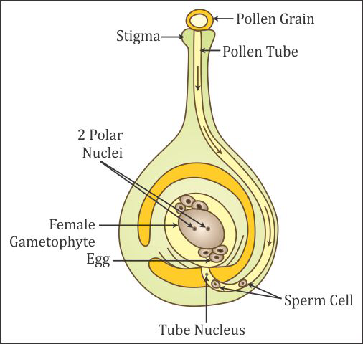
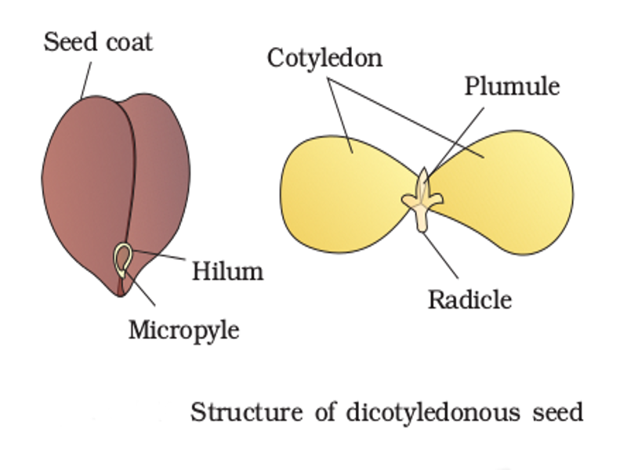

Slide 13
POST FERTILIZATION CHANGES :
The ovule develops into seed.
The integuments of the ovule develop into seed coats
The ovary enlarges and develops into fruit.

Slide 14
https://www.youtube.com/watch?v=dgFY7WUTASQ

Slide 15
THANKING YOU
ODM EDUCATIONAL GROUP.

