Slide 1


METALS AND NON-METALS
CLASS-VII
SUBJECT-CHEMISTRY
CHAPTER-06
PREVENTION FROM RUSTING
PERIOD-3

Slide 2

LEARNING OBJECTIVE
Students will be able to
Understand the methods for the prevention of rusting.
Familiarize with the process of galvanization.
Sensitize different types prevention methods by coating .
Made aware of the process of electroplating as a method to prevent rusting

Slide 3
WARM UP QUESTIONS
Activate prior knowledge by asking students whether they have witnessed the rust formation in the windows iron bars.
After listening to their responses, guide them to understand the further the methods of preventing the rusting of iron bars.
Then ask them to identify some other methods of the prevention of rusting.

Slide 4
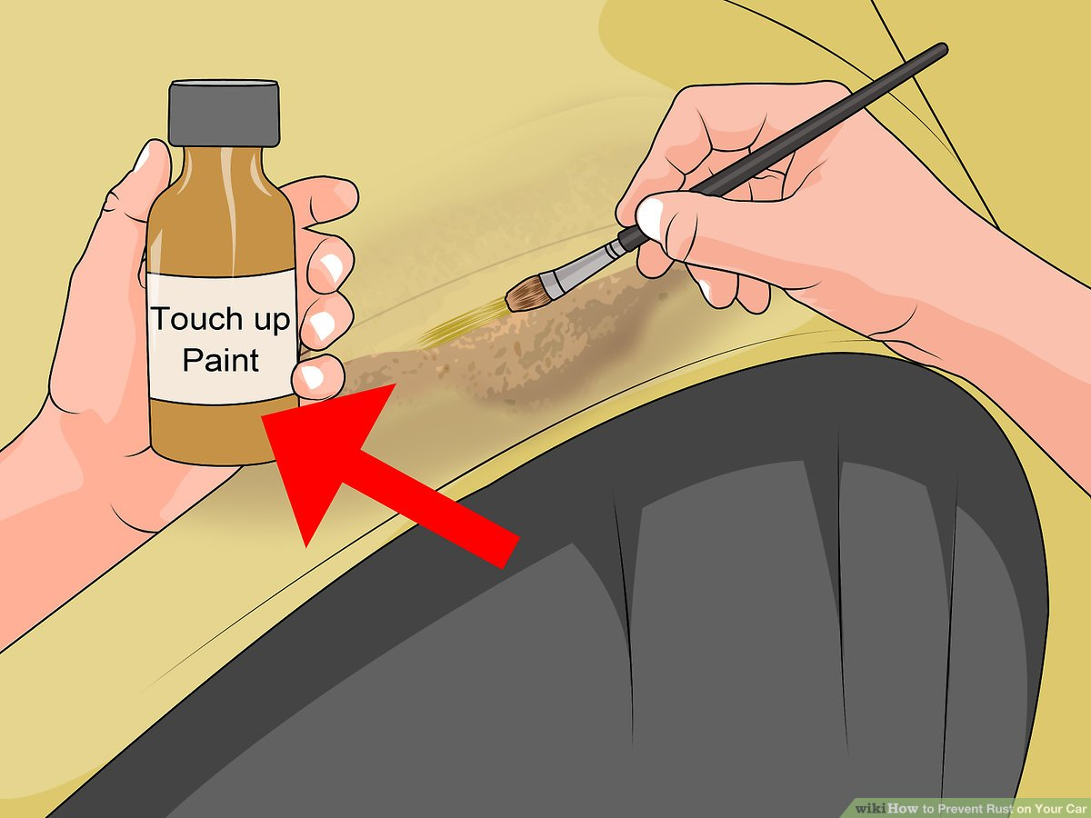
PREVENTION OF RUSTING
BY PAINTING
Painting with red lead
Oil paint
Enamel coating
Coal tar
Plastic coating
BY GREASING OR OILING

Slide 5
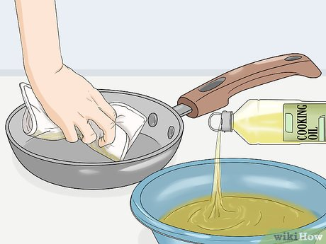
BY GREASING OR OILING

Slide 6
PREVENTION OF RUSTING
Galvanization-The process in which metals are coated with Zinc. Galvanization is used iron articles like roof sheds, buckets, and tubs etc. Water pipes after galvanization are known as G.I pipes. Galvanized steel is not used for food containers as acids present in the food reacts with zinc to form poisonous substances.
Tin Plating
Aluminium plating
Alloy formation
Electroplating-The coating of superior metal over an inferior metal by the passage of electricity is called electroplating.
The Iron Pillar near Qutab Minar is rust resistant as it is made of iron mixed with phosphorous that made it lasting since last eight hundred years without rusting

Slide 7
WATCH A VIDEO
https://youtu.be/jQoE_9x37mQ

Slide 8
HOME ASSIGNMENT
Write a short note on Galvanization.
What do you mean by Electroplating. Give an Examples.
Point out the ways in which iron can be prevented from rusting.

Slide 9
THANKING YOU
ODM EDUCATIONAL GROUP

