Slide 1


MATTER AND IT’S COMPOSITION
SUBJECT-CHEMISTRY
CHAPTER NO- 1
Characteristics of particles of matter
PERIOD-3

Slide 2


LEARNING OBJECTIVE
Students will be able to
Familiarise with the following characteristics of the particles of matter
Particles of matter have space between them
Particles of matter are always in random motion
Particles of matter attract each other.

Slide 3
WARM UP QUESTIONS
Recapitulation of the previous topic by asking the following questions.
What do you mean by atoms?
What do you mean by molecules?
A nitrogen molecule is made up of how many nitrogen atoms?
A carbon dioxide molecule is made up of how many carbon atom and oxygen atom?

Slide 4

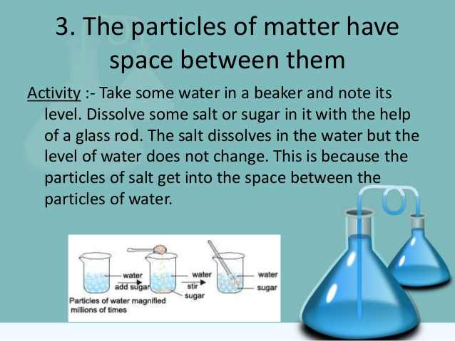
Particles of matter have space between them

Slide 5
Particles of matter have space between them
https://youtu.be/fUzKozeqDPo

Slide 6
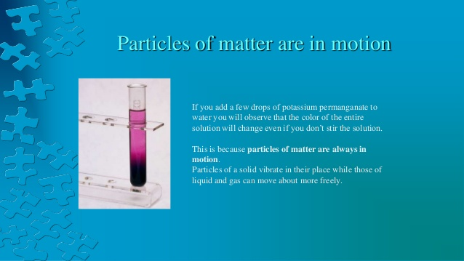
Particles of matter are always in random motion

Slide 7
Particles of matter are always in random motion
https://youtu.be/_tbgGgxA29s

Slide 8
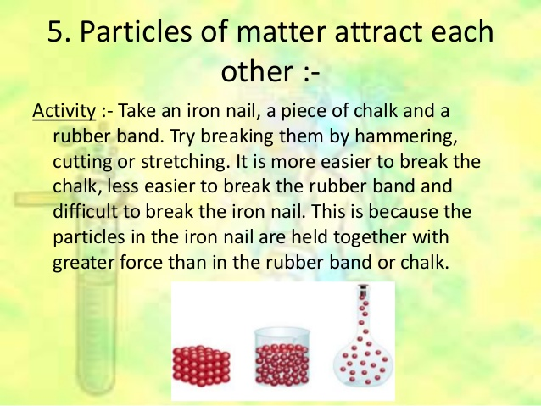
Particles of matter attract each other

Slide 9
Particles of matter attract each other
https://youtu.be/_-7jrmV5Yrw

Slide 10
HOME ASSIGNMENT
Exercise-5,6
Q. Write an activity to explain that particles of matter have space between them.
Q. How can you explain that particles of matter are always in random motion?
Q. Give any one example to explain particles of matter attract each other.

Slide 11
THANKING YOU
ODM EDUCATIONAL GROUP

