Slide 1


PHYSICAL AND CHEMICAL CHANGES
SUBJECT-CHEMISTRY
CHAPTER NO- 2
Physical and chemical changes-physical change- characteristics and examples
PERIOD-3

Slide 2


LEARNING OBJECTIVE
Students will be able to
Understand the meaning of physical change
Distinguish the two types of changes- physical and chemical changes
Familiarize with the characteristics of physical change
Sensitize different examples of physical changes

Slide 3
WARM UP QUESTIONS
Recapitulation of the previous topic by asking following questions.
Differentiate between periodic and non periodic changes. Give some example
Differentiate between desirable and non desirable changes
Differentiate between reversible and irreversible changes

Slide 4
Physical change
Physical Properties of a substance are those characteristic of a substance that describes its physical nature.
For Example color, density, shape, size and volume are some physical properties.
Physical Change is a change which occurs when there is an alteration in the physical properties of a substance.
The physical change does not result in the formation of any new substance but can alter the shape and size of the existing substance.

Slide 5

Demonstrate activity 5, 6 and 8 in the class
Show a video for better understanding of the concept
https://youtu.be/qXGGQWOmpxE

Slide 6
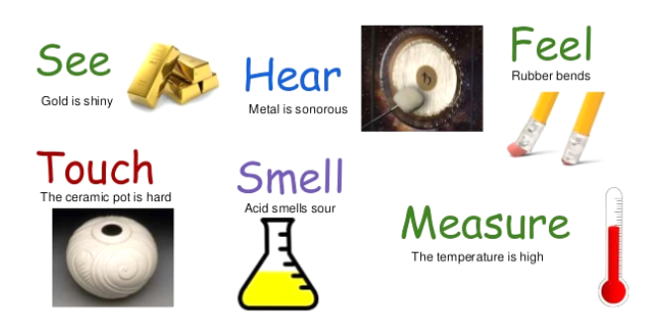
Physical properties

Slide 7
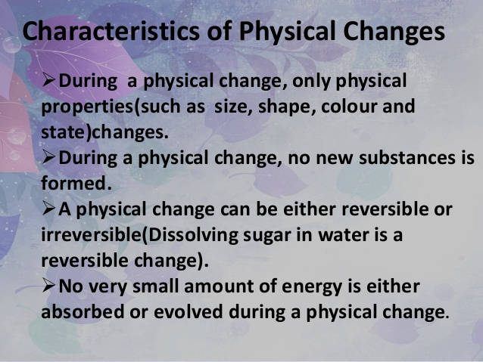
Characteristics of physical change

Slide 8
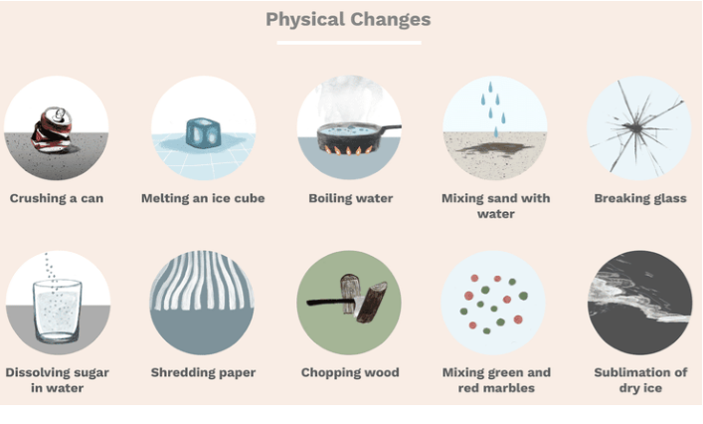
Different examples of physical changes

Slide 9
Demonstrate any one of each type of change by showing images based on real life examples- like burning of fuel for cooking, cutting of trees, floods
Show a video for better understanding of the concept
https://youtu.be/FuZKaM5X1L8

Slide 10
HOME ASSIGNMENT
Exercise-4,5
Q. Write the characteristics of physical changes
Q. Give some examples of physical changes

Slide 11
Demonstrate activity 5, 6 and 8 in the class
Show a video for better understanding of the concept
https://youtu.be/qXGGQWOmpxE

Slide 12
Demonstrate any one of each type of change by showing images based on real life examples- like burning of fuel for cooking, cutting of trees, floods
Show a video for better understanding of the concept
https://youtu.be/FuZKaM5X1L8

Slide 13
THANKING YOU
ODM EDUCATIONAL GROUP

