Slide 1


FORCE
SUBJECT-PHYSICS
CHAPTER NO- 3
Kinds of forces, force of friction
PERIOD-3

Slide 2


LEARNING OBJECTIVE
Students will be able to
familiarize with the different kinds of forces
Describe the different kinds of forces with appropriate examples
Relate different kinds of forces in real life situations.
Sensitize about the force of friction

Slide 3
WARM UP QUESTIONS
Recapitulation of the previous topic by asking the following questions.
Describe the different effects of force with appropriate examples
Explain along with examples that a force can
change the direction of motion of a moving body
change the shape or size of the body

Slide 4

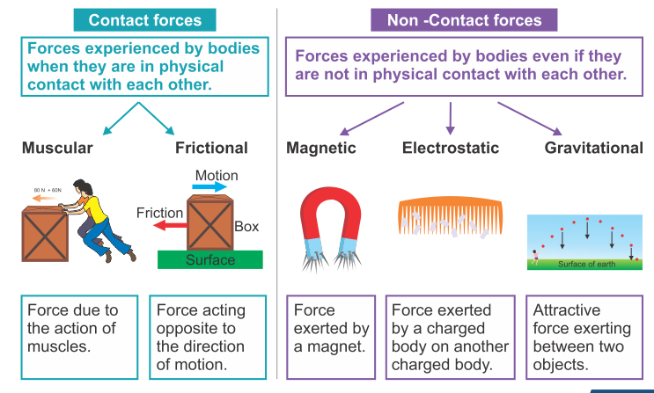
Kinds of forces

Slide 5

examples of contact forces by the help of a video
https://youtu.be/nk35aGqJ-F8

Slide 6
examples of non contact forces by the help of videos
https://youtu.be/SybIX2nEn1E
https://youtu.be/eTuiLNYz7JM

Slide 7

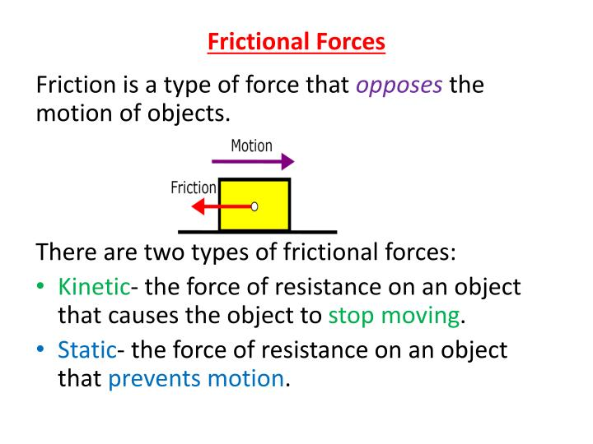
Force of friction

Slide 8

Explain force of friction by the help of a video
https://youtu.be/n2gQs1mcZHA
Real life examples of friction
https://youtu.be/V2P6CuHVWvI

Slide 9
HOME ASSIGNMENT
Exercise- B 5,6,7
Q. Explain the classification of force on the basis of its application
Q. What do you mean by contact forces? Give some examples
Q. List the types of non contact forces.
Q. Explain electrostatic force.

Slide 10
THANKING YOU
ODM EDUCATIONAL GROUP

