Slide 1


TISSUES
SUBJECT- BIOLOGY
CHAPTER NO- 6
Plant Tissues- Classification , Meristematic Tissues
PERIOD-3

Slide 2

LEARNING OBJECTIVE
Student will be familiarized with the classification of plant tissues
Student will understand the structure, function and types of meristematic tissue
Student will be able to locate the different types of meristematic tissues in plants

Slide 3
WARM UP QUESTIONS
Recapitulation of the following before initiating the topic
Describe the cellular organization in a living organism.
Differentiate between plant and animal tissue

Slide 4
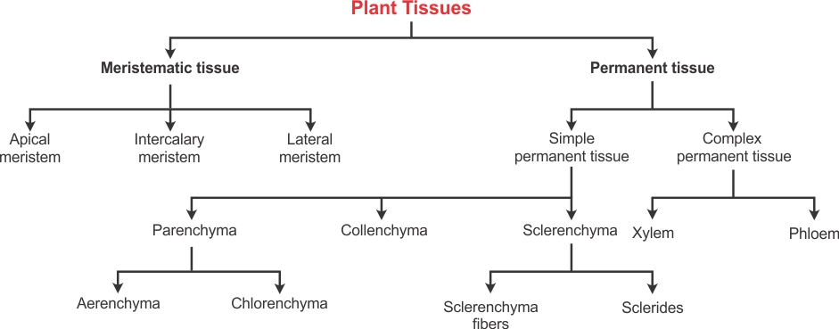
CLASSIFICATION OF PLANT TISSUES

Slide 5
ACTIVITY
Activity to show growth in onion root tip apical meristem
https://www.youtube.com/watch?v=wAGJGCFtuvM

Slide 6

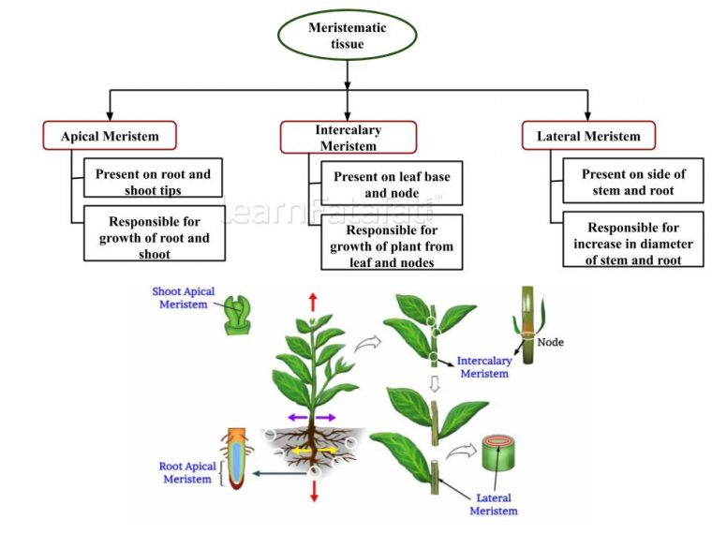
TYPES OF MERISTEMATIC TISSUES- LOCATION AND FUNCTIONS

Slide 7
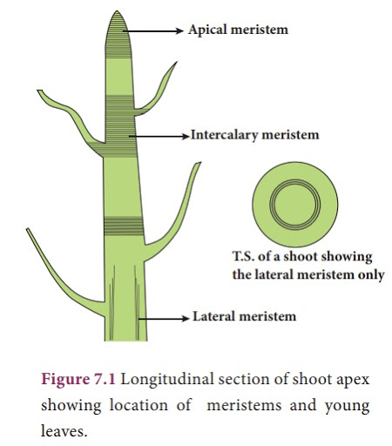

Slide 8

HOME ASSIGNMENT
Q. Classify plant tissue.
Q. Explain the structure and location of all types of meristematic tissues in plants
Q. Which type of meristematic tissue helps in increasing the girth of the plant?

Slide 9

THANKING YOU
ODM EDUCATIONAL GROUP

