Slide 1


THE FUNDAMENTAL UNIT OF LIFE
SUBJECT- BIOLOGY
CHAPTER NO- 5
Structural organization of cell - Plasma membrane- structure, composition and functions
PERIOD-3

Slide 2


LEARNING OBJECTIVE
Student will be able to understand the structural organization of cell.
Student will be familiarized with the structure and composition of plasma membrane.
They will be able to analyze various functions of plasma membrane in both plant and animal cell
Student will understand that why plasma membrane is called as selectively permeable.

Slide 3
WARM UP QUESTIONS
What are the different parts, which you have learnt from onion peel and cheek cell?
Which is the outermost covering of human cheek cell?
What do you mean by structural organization of cell?
What is the outermost covering of animal cell?

Slide 4
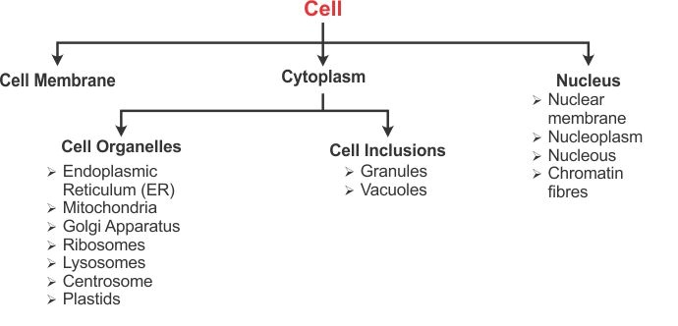

Structural organization of a cell
Plasma membrane , nucleus ,cytoplasm, cell wall(plant cell), cell organelles

Slide 5
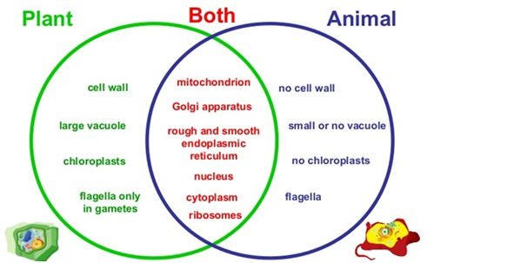

DIFFERENCE BETWEEN A PLANT CELL AND ANIMAL CELL

Slide 6
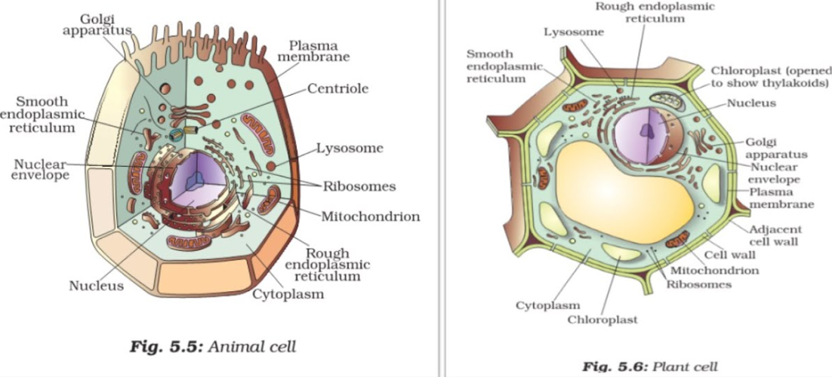

Slide 7

DIFFERENT MODELS OF PLASMA MEMBRANE
The models are:
1. Lipid and Lipid Bilayer Model- was given by Overton, Gorion and Grendel
2. Unit Membrane Model (Protein-Lipid Bilayer-Protein)- By Danielli and Davson in 1935
3. Fluid Mosaic Model- SJ Singer and G. L. Nicolson in 1972

Slide 8
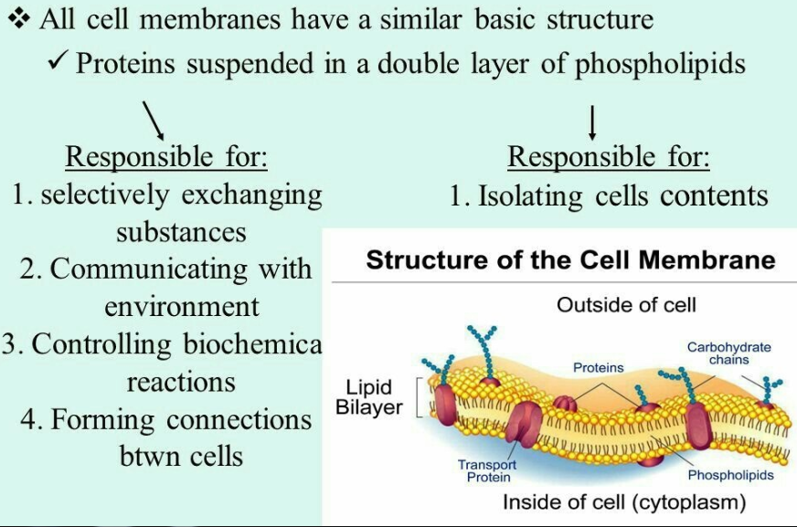

PLASMA MEMBRANE

Slide 9
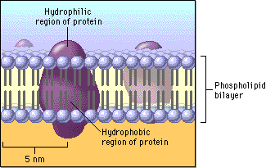

STRUCTURE OF PLASMA MEMBRANE

Slide 10

STRUCTURE AND FUNCTION OF PLASMAMEMBRANE
https://youtu.be/CNbZDcibegY

Slide 11

HOME ASSIGNMENT
Q1. What is the other name for cell membrane?
Q2. Explain the structure and function of cell membrane( diagram with label)
Q3. Which component of cell membrane maintains the flexibility of an animal cell?
Q4. What is the role of lipid bilayer in a cell membrane?

Slide 12

THANKING YOU
ODM EDUCATIONAL GROUP

