Slide 1


ATOMS, MOLECULES AND RADICALS
SUBJECT-CHEMISTRY
CHAPTER NO- 4
Concept of Radicals, Valency and Variable valency.
PERIOD-3

Slide 2
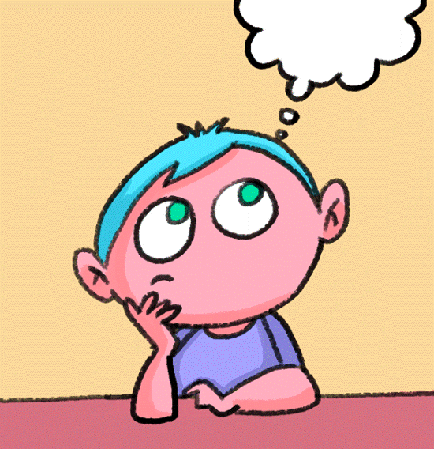
LEARNING OBJECTIVE
Students will be able to
Know about the concept of Radicals
Get aware of the concept of Valency.
Know about the Variable Valency along with some examples.

Slide 3
WARM UP QUESTIONS
Activate prior knowledge by asking students what is the Molecular formula of an element.
After listening to their responses, test their knowledge on the symbols of some elements.
Then ask them about Atomicity.
Guide them to know about the radicals and its utility in writing a chemical formula.

Slide 4
RADICALS
A Radical is an atom of an element or a group of atoms of different elements that behaves like a single unit.
Radicals are of two types: -
Basic Radical: - They have positive charge and are also called Cations.
Acid Radical: - They have negative charge and are also called Anions.

Slide 5
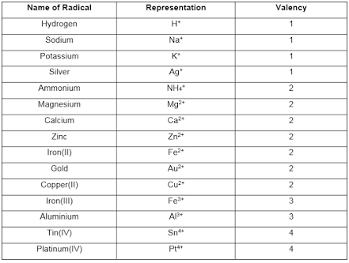
POSITIVE RADICALS

Slide 6
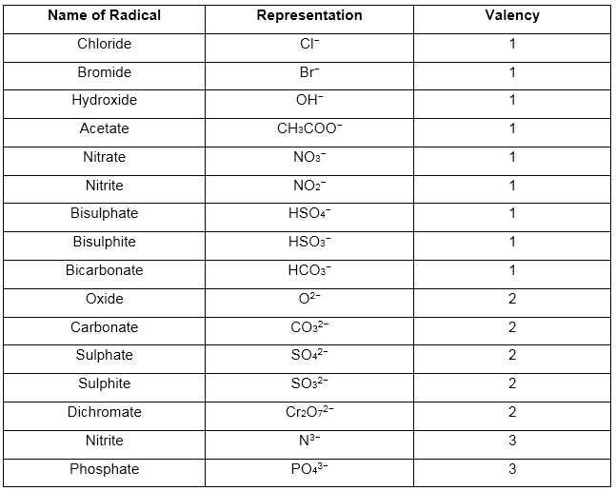
NEGATIVE RADICALS

Slide 7
CONCEPT OF VALENCY
Valency
Valence electrons are those electrons which are present in the outermost orbit of the atom.
The capacity of an atom to lose, gain or share valence electrons in order to complete its octet determines the valency of the atom.
Examples: - The valency of hydrogen is one
In hydrogen chloride molecule (HCl) one atom of chlorine combines with one atom of hydrogen, hence valency of chlorine is 1

Slide 8
CONCEPT OF VARIABLE VALENCY
Variable Valency
Some elements show more than one valency or simply variable valency.
The suffix ous is used for the lower valency and the suffix ic is used for the higher valency
For example, IRON (II) is known as Ferrous with valency 2 and IRON (III) is known as Ferric with valency 3.

Slide 9
WATCH A VIDEO ON RADICALS
https://youtu.be/h3mKX3QzrrI

Slide 10
HOME ASSIGNMENT
Exercise Q1 (d) , Q5
Define Valency.
What do you mean by variable valency. Support your answer with an example.
Mention the representation of the following Radicals a) Chloride b) Bromide c) Carbonate d) Calcium

Slide 11
THANKING YOU
ODM EDUCATIONAL GROUP

