Slide 1


METALS AND NON-METALS
CLASS-VII
SUBJECT-CHEMISTRY
CHAPTER-06
CORROSION OF METALS, RUSTING OF IRON, CONDITIONS FOR RUSTING
PERIOD-2

Slide 2

LEARNING OBJECTIVE
Students will be able to
Understand the concept of corrosion of metals.
Familiarize with the special corrosion of iron..
Sensitize different conditions required for corrosion.

Slide 3

WARM UP QUESTIONS
Activate prior knowledge by asking students what are the things that are made of metals that get damaged when exposed to moisture.
After listening to their responses, guide them to understand the reason for their damage.
Then ask them to identify the phenomena that has occurred.
Guide them to understand the concept of corrosion and rusting..

Slide 4
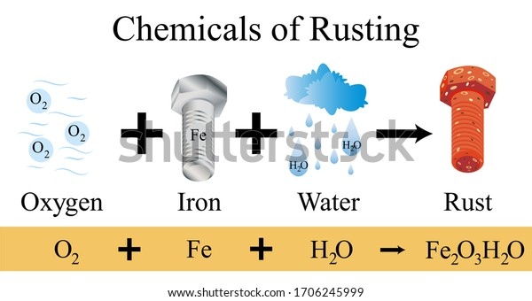
CORROSION IN METALS
Corrosion is defined as the eating away of the metal surface when exposed to moisture, air and chemicals
For example, Iron when exposed to moisture, forms a reddish-brown layer called as Rust (Fe₂O_{3.}xH₂O)
Similarly, copper when exposed to moist air form a green coating of basic copper carbonate.

Slide 5
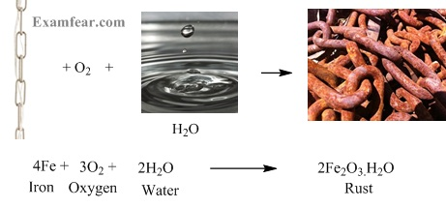
RUSTING OF IRON
Rusting of iron is a special corrosion in which iron slowly reacts with moist air to produce a reddish-brown substance called as Rust.
Rust has the formula of Fe₂O_{3.}xH₂O (Hydrated Ferric Oxide)
Rusting can be expressed in the form of chemical reaction as follows: -
Iron + Oxygen----------Moisture----------→ Hydrated Ferric Oxide
4Fe + 3O₂-------2x.H₂O--------------→ 2Fe2O₃.XH₂O
(Slow Process)

Slide 6
WATCH A VIDEO
https://youtu.be/cn_Vom--b4A

Slide 7
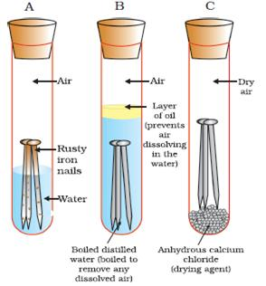
CONDITION FOR RUSTING
Air
Moisture
The presence of acidic gases like carbon dioxide, Sulphur dioxide, Sulphur trioxide and Nitrogen Dioxide

Slide 8
WATCH A VIDEO
https://youtu.be/-SzrX60xG34

Slide 9
HOME ASSIGNMENT
Objective type questions- True and False
Mention the chemical formula of Rust.
What is Rusting? Write its chemical reaction.
Mention the conditions for rusting.

Slide 10
THANKING YOU
ODM EDUCATIONAL GROUP

