Slide 1


AIR AND ATMOSPHERE
CLASS-VII
SUBJECT-CHEMISTRY
CHAPTER-07
IMPORTANCE OF NITROGEN FOR PLANTS, ANIMALS AND HUMAN BEINGS, AND NITROGEN CYCLE
PERIOD-2

Slide 2

LEARNING OBJECTIVE
Students will be able to.
Familiarize with the importance of the various components of air.
Sensitize of the importance of nitrogen for plants , animals and human beings.
Familiarize them with the Nitrogen Cycle.

Slide 3
WARM UP QUESTIONS
Why nitrogen is an essential component of air?
How nitrogen circulate in the atmosphere?
Mention the importance of Nitrogen?

Slide 4
NITROGEN
Physical properties of nitrogen
It is a colourless, odourless and tasteless gas.
It is slightly lighter than air.
It is non-poisonous.
It is not combustible
It is slightly soluble in water.

Slide 5
Uses Of Nitrogen
It controls the rate of combustion
It is used to make ammonia and nitric acid
It is an important constituent of proteins that are necessary for the growth of plants animals and human beings
It is used to make fertilizers like potassium nitrate ammonium sulphate urea
It is used to prepare explosives like trinitrotoluene (T.N.T) and nitroglycerine
For flushing food packages

Slide 6
IMPORTANCE OF NITROGEN FOR PLANTS , ANIMALS AND HUMAN BEINGS
Nitrogen is of vital importance to the plants and human beings as it provides proteins.
Nitrogen gets returned to the soil when plants and animals die and decay. In this way the amount of nitrogen is balanced in the nature.

Slide 7
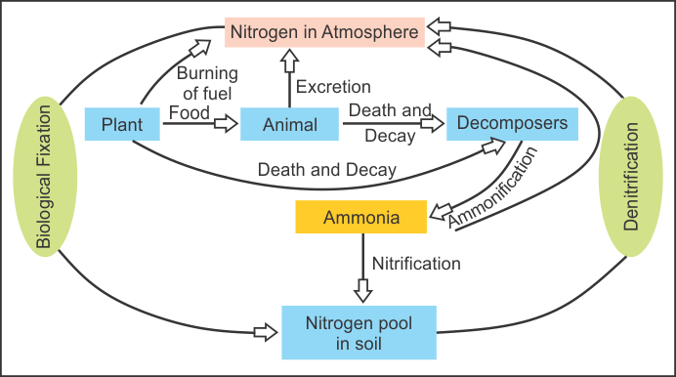
NITROGEN CYCLE
The circulation of nitrogen through the living and non-living compounds of the biosphere is called as nitrogen cycle.
The diagrammatic representation of the nitrogen cycle is as follows: -

Slide 8
VIDEO TIME
https://youtu.be/7KkX78c8fRo

Slide 9
NITROGEN FIXATION
The phenomenon by which nitrogen is converted into nitrates and nitrites and get fixed in the soil is known as Nitrogen Fixation.
TYPES OF NITROGEN FIXATION
Biological fixation
Non-Biological fixation

Slide 10
TYPES OF NITROGEN FIXATION
BIOLOGICAL FIXATION
Leguminous Plants
Root nodules---------------convert-------------- 2- Free nitrogen---(in air and soil) ------------------------→ 3-Soluable Nitrates and Nitrites------(in soil) ----------------------(converted by plants) ---------------4- Proteins
NON-BIOLOGICAL FIXATION
Nitrogen + O₂------electric spark--→ Nitric oxide + O₂----NO₂ + H₂O----HNO₃ (Nitric Acid) and Nitrous oxide-------Minerals ---------Soluble Nitrate.
Special Note: - ACID RAIN IS A BAD EFFECT OF THIS NATURAL PROCESS

Slide 11
HOME ASSIGNMENT
Explain Nitrogen Cycle with a diagram.
What do you mean by Biological Nitrogen Fixation.
Explain the Non- Biological Nitrogen Fixation.

Slide 12
THANKING YOU
ODM EDUCATIONAL GROUP

