Slide 1


MATTER AND IT’S COMPOSITION
SUBJECT-CHEMISTRY
CHAPTER NO- 1
Composition and characteristics of matter
PERIOD-2

Slide 2


LEARNING OBJECTIVE
Students will be able to
Know the composition of matter
Apprise the characteristics of matter

Slide 3
WARM UP QUESTIONS
Recapitulate the previous topic by asking the following questions.
What do you mean matter?
How can you show that matter has mass and it occupies space?

Slide 4

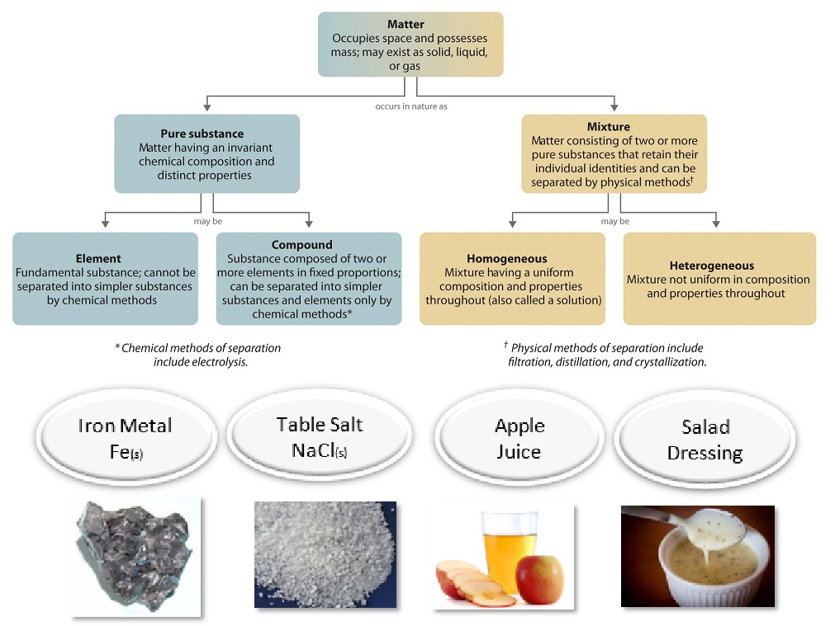
Composition of matter

Slide 5
composition of matter
https://youtu.be/CnHoohcd71o

Slide 6
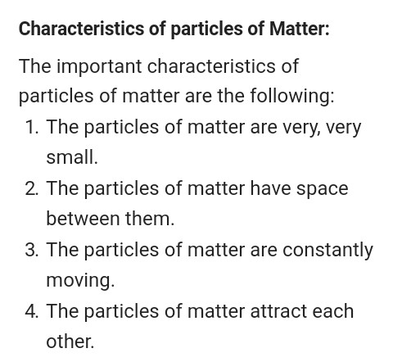
characteristics of matter

Slide 7
The characteristics of matter
https://youtu.be/JMZ7FaTua9k
https://youtu.be/3S-x18UGwDM

Slide 8
HOME ASSIGNMENT
Exercise-10, 11
Q. Elaborate the composition of matter
Q. List the characteristics of matter

Slide 9
THANKING YOU
ODM EDUCATIONAL GROUP

