Slide 1


ATOMS, MOLECULES AND RADICALS
SUBJECT-CHEMISTRY
CHAPTER NO- 4
Molecular formula of an Element, Molecules of a Compound.
PERIOD-2

Slide 2

LEARNING OBJECTIVE
Students will be able to
Know about the concept of molecular formula.
Get aware of the various symbols of elements.
Know about the atomicity, and the state of some elements.

Slide 3
WARM UP QUESTIONS
Activate prior knowledge by asking students what is atomicity?
After listening to their responses, guide them to understand the molecular formula of compounds.
Then ask them some of the symbols of some elements.
Guide them to know about the Molecules of a compound.

Slide 4
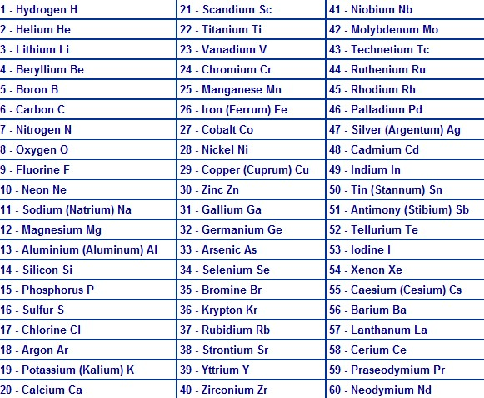
SYMBOLS OF SOME ELEMENTS

Slide 5
MOLECULAR FORMULA OF AN ELEMENT
MOLECULAR FORMULA OF AN ELEMENT
Molecular formula of an element is defined as the symbolic representation of its molecule.
For Example, Cl₂ is the molecular formula of Chlorine gas consists of two atoms of Chlorine.
For example, two atoms of Hydrogen and one atom of oxygen forms a molecule of Water (H2O)

Slide 6
SYMBOLS, ATOMICITY AND STATE OF ELEMENTS
NAME OF THE ELEMENT | SYMBOLS OF MOLECULES | ATOMICITY | STATE
Hydrogen | H₂ | 2 | Gas
Nitrogen | N₂ | 2 | Gas
Oxygen | O₂ | 2 | Gas
Fluorine | F₂ | 2 | Gas
Chlorine | Cl₂ | 2 | Gas
Bromine | Br₂ | 2 | Liquid
Iodine | I₂ | 2 | Solid
Ozone | O₃ | 3 | Gas
Phosphorous | P₄ | 4 | Solid
Sulphur | S₈ | 8 | Solid

Slide 7
WATCH A VIDEO ON ATOMICITY
https://youtu.be/eyzVBiapXtM

Slide 8
MOLECULES OF COMPOUND
MOLECULES OF COMPOUNDS
When atoms of two or more elements join together in a fixed ratio by mass, a molecule of a compound is formed.
For Example, two atoms of Hydrogen and one atom of oxygen combine to form a molecule of water.
H + O + H-------------------------------→ H2O
1atom + 1atom + 1atom------------------------------→ 1 Molecule of Water
The smallest unit of a compound is its molecule.
Molecules of different compounds show different properties. For Example, Water molecule and Sugar molecules are different from each other

Slide 9
HOME ASSIGNMENT
Exercise Q2 a, b, c, d
Mention the atomicity and the state of the following elements
a) Nitrogen
b) Oxygen
c) Fluorine
d) Sulphur
Which is the smallest unit of a compound?

Slide 10
THANKING YOU
ODM EDUCATIONAL GROUP

