Slide 1


THE FUNDAMENTAL UNIT OF LIFE
SUBJECT- BIOLOGY
CHAPTER NO- 3
Shape , Size and types of cell
PERIOD-2

Slide 2


LEARNING OBJECTIVE
Student will be familiarized with different shape of cells based on their functions.
Student will be able to categorize cell based on the organization, complexity and existence as living and non living
They will be able to analyze the difference between prokaryotic and eukaryotic cells.
Learners will be sensitized about level of organization in living organisms.

Slide 3
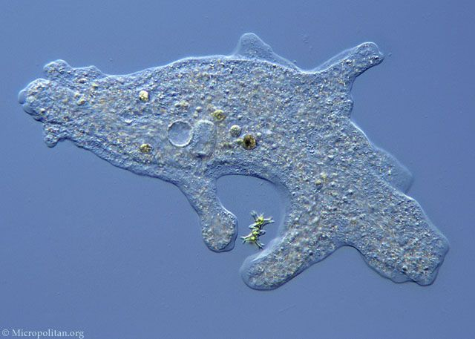
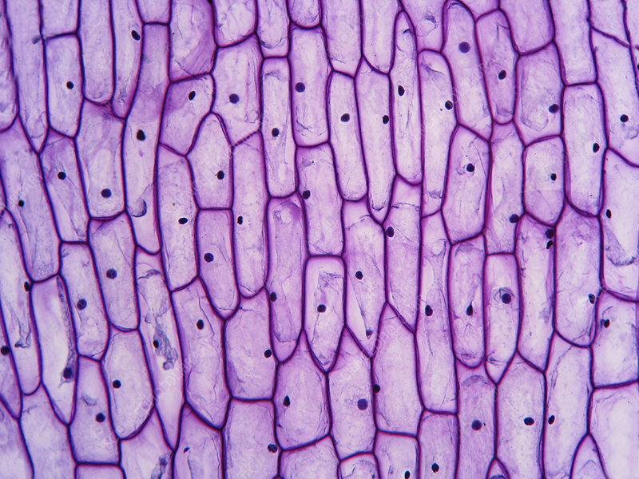
CAN YOU IDENTIFY?

Slide 4
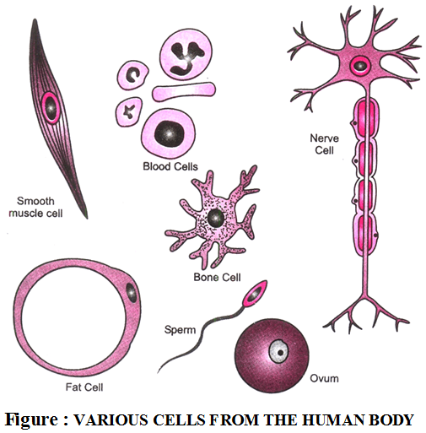

SHAPE & SIZE OF CELLS
Smallest cell- Mycoplasma or
pleuropneumonia-like organisms
(PPLO)( 0.1 µm-0.3µm)
Largest cell - Egg cell of Ostrich ( 15 cm)
Longest cell – Human nerve cell ( 90 cm)
The shape and size of cells are related to
Specific functions they perform.
Some cells have changing shapes.

Slide 5
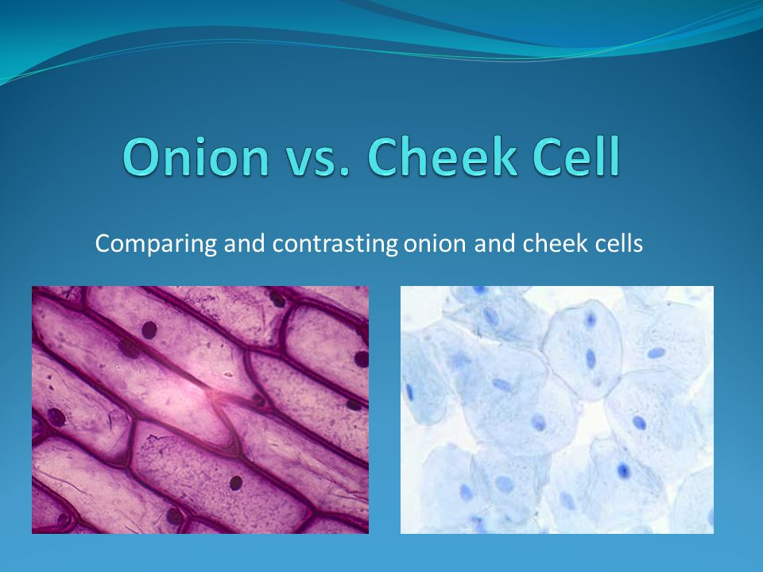


Slide 6
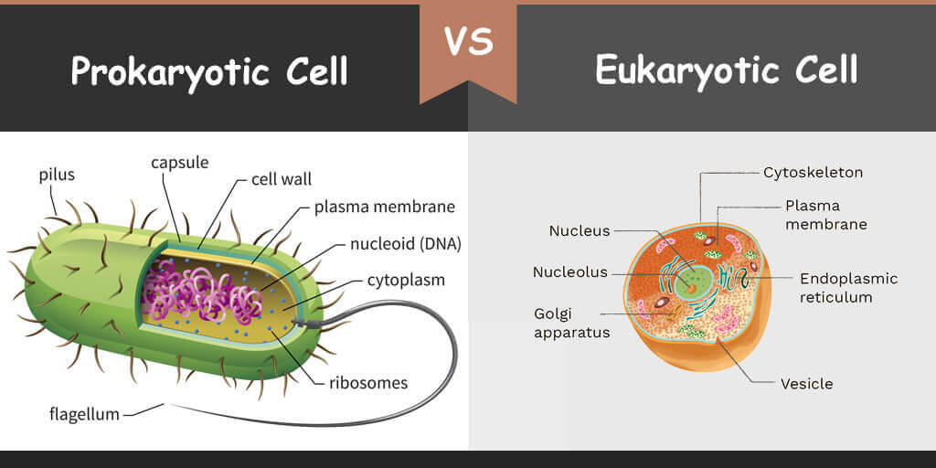


Slide 7


. | Prokaryotic cell | Eukaryotic cell
 | ‘Pro’ means primitive and ‘karyon’ means nucleus. Cells having primitive nucleus | ‘Eu’ means true and ‘karyon’ means nucleus. Cells having true nucleus.
 | Prokaryotes are always unicellular organisms. | Unicellular and multicellular
 | Nucleus is not well defined and known as nucleoid | Well defined nucleus is present
 | Membrane bound organelles such as Mitochondria, Golgi complex etc. are absent. | Membrane bound organelles, such as Mitochondria, Golgi complex etc. are also present.
 | Ribosomes are smaller and scattered randomly in the cytoplasm. | Ribosomes are bigger. They are either attached to endoplasmic reticulum or are found free.
 | The prokaryotes include archaebacteria, bacteria and cyanobacteria (blue green algae). | Eukaryotes include all living organisms, except bacteria and blue-green algae

Slide 8

HOME ASSIGNMENT
Following questions to be worked out
Q1. Differentiate between prokaryotic and eukaryotic cell
Q2. Cells vary in shape according to their functions. Justify the statement.

Slide 9
THANKING YOU
ODM EDUCATIONAL GROUP

