Slide 1


SUBJECT:BIOLOGY
CHAPTER:8
CHAPTER NAME: HOW DO ORGANISMS REPRODUCE?
PERIOD-1

Slide 2
Reproduction
Reproduction: The production of new organism from the existing organism of the same species is called reproduction. Reproduction is essential for the survival of species on this earth. Reproduction give rise to more organism with the same basic characteristics as their parents.

Slide 3

What is variations?the importance of variations
Variations are the differences present between the individuals of the same species or different species.
Variation is important because it causes evolution and is the basis of heredity. It is advantageous to a population as it enables few individuals to adapt to the environment changes thus, enabling the survival of the population.

Slide 4
Do organisms create exact copies of themselves
Yes! organisms create copies of themselves by Reproduction process. Organisms look similar because their body designs are similar. If body designs are to be similar, the blueprints for these designs should be similar.

Slide 5
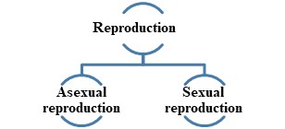
TYPES OF REPRODUCTION:

Slide 6
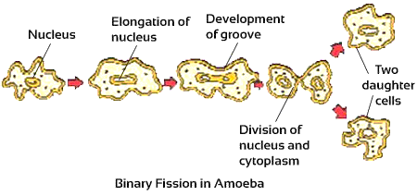
Binary fission in amoeba

Slide 7
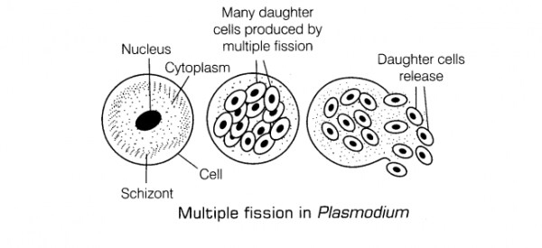
Multiple fission

Slide 8
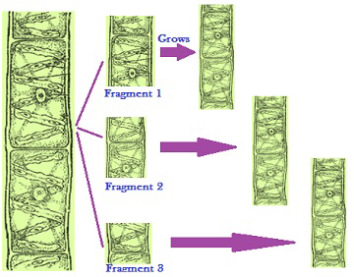
FRAGMENTATION

Slide 9
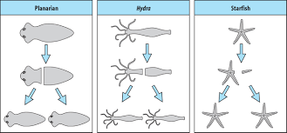
REGENERATION

Slide 10
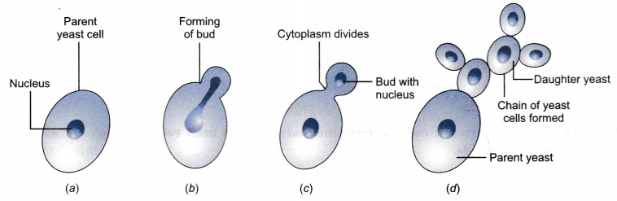
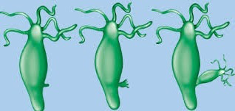
Budding

Slide 11
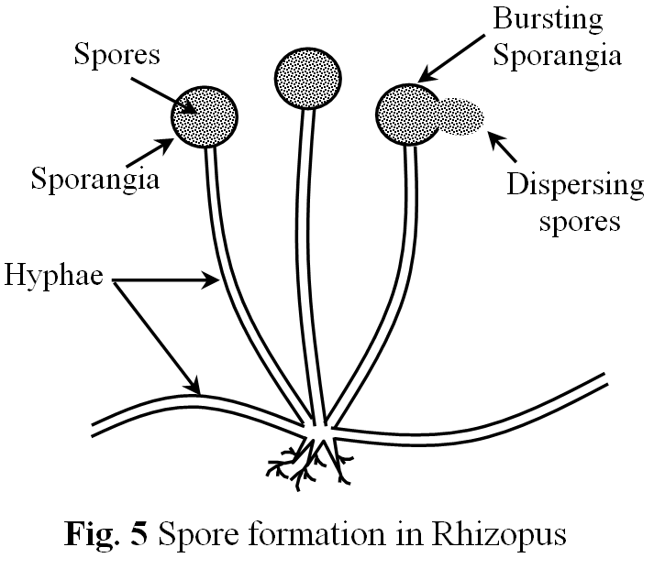
Spore formation

Slide 12
VEGETATIVE PROPAGATION
Vegetative propagation is the ability of plants to reproduce by bringing forth new plants from existing vegetative structures without sexual reproduction.Some examples of vegetative propagation are given below.

Slide 13
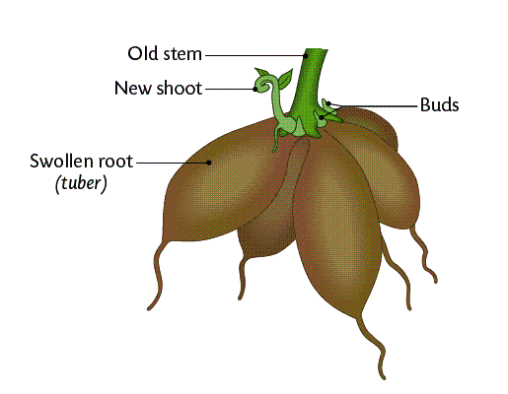
By roots
Some modified tuberous roots can be propagated vegetatively, when planted in soil. The buds present on the roots grow as leafy shoots called slips above ground and adventitious roots at their bases. Each slip gives rise to a new plant.

Slide 14
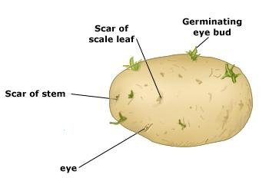
By stems
vegetative methods (cloning). Potato tubers have nodes or eyes from which the new growth begins. The new stems growing from each eye are called sprouts which giver rise to the new plant. Vegetative seed can be either a whole tuber or a cut tuber.

Slide 15
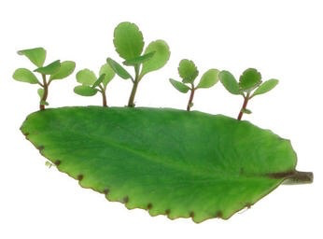
By leaves
Reproduction in Bryophyllum occurs asexually through vegetative propagation by leaves. ... These buds can give rise to new plants with adventitious roots, shoots and small leaves. The new plants then detach from the leaves and develop into a mature plant after coming in contact with the soil.

Slide 16
Artificial Vegetative Propagation
Cutting
Layerings
Grafting

Slide 17
https://www.youtube.com/watch?v=VN_p20dDrnY

Slide 18
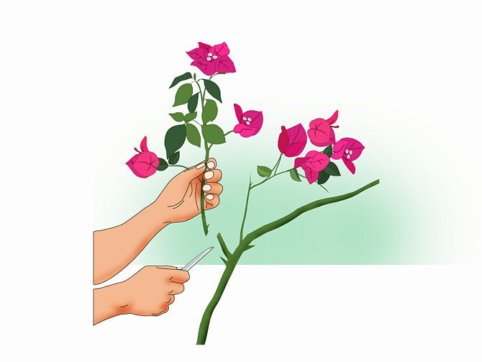
Cutting
Vegetative Propagation by Stem Cutting. Stem-cutting is another common asexual propagation technique, suited well to herbs and house plants.It involves taking a section of stem from a parent plant and manipulating it to create a new plant.

Slide 19
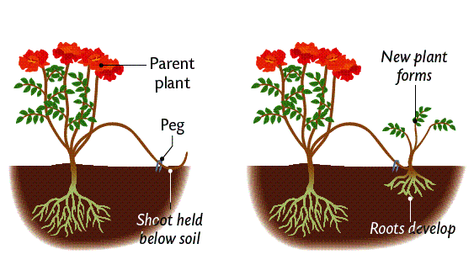
Layering
Layering is a means of plant propagation in which a portion of an above-ground stem grows roots while still attached to the parent plant and then detaches as an independent plant. Layering has evolved as a common means of vegetative propagation of numerous species in natural environments.

Slide 20
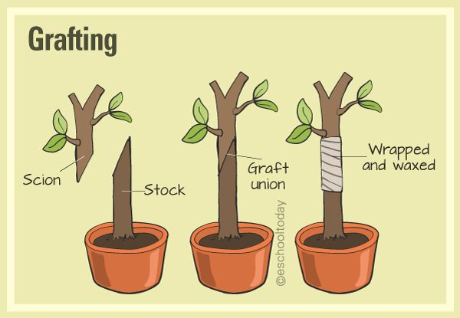
Grafting
Grafting is the act of placing a portion of one plant (bud or scion) into or on a stem, root, or branch of another (stock) in such a way that a union will be formed and the partners will continue to grow.

Slide 21
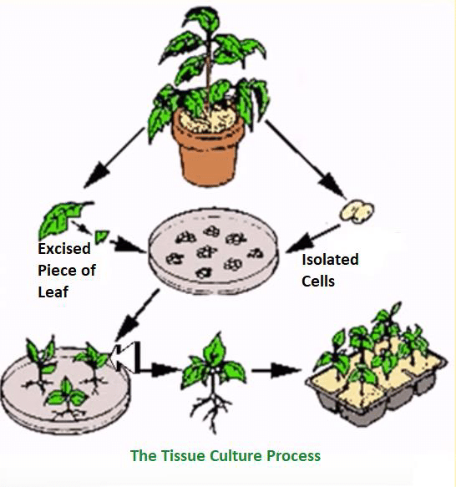
Tissue culture

Slide 22
THANKING YOU
ODM EDUCATIONAL GROUP.

