Slide 1


LIFE PROCESSES.
SUBJECT:BIOLOGY
CHAPTER:6
Unicellular and multicellular organism
PERIOD-1

Slide 2

LEARNING OBJECTIVE
Student will be able to understand the meaning of life processes.
Student will be familiarized with the mechanism of nutrition, respiration, transportation, and excretion.
They will be able to analyze various types of nutrition .
Learners will be sensitized about the difference between prokaryotes and eukaryotes.

Slide 3
WARM UP QUESTIONS
Define living and nonliving.
Categorize the single celled and multi-celled organisms.
Identify the single celled, multi-celled organisms.
list the categories of living and non-living organisms.

Slide 4




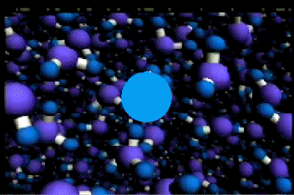
CRITERIA TO DECIDE WHETHER SOMETHING IS ALIVE
The most important criteria to decide whether something is alive is movement.
All living things move without the help of any external help. Some movements are easily visible like the movements of body parts. Some movements are not easily visible like molecular movements.
The molecular movements in cells and tissues is necessary for all life processes.

Slide 5
LIFE PROCESSES
Life processes are the basic processes in living organisms which are necessary for maintaining their life. The basic life processes are – nutrition, respiration, transportation, and excretion.
i) Nutrition :– is the process of taking food by an organism and its utilization by the body for life processes.
ii) Respiration :– is the process by which food is burnt in the cells of the body with the help of oxygen to release energy.
iii) Transportation :– is the process by which food, oxygen, water, waste products are carried from one part of the body to the other,
iv) Excretion :- is the process by which waste products are removed from the body.

Slide 6
BASIC RULES FOR BODY DESIGN IN MULTICELLULAR ORGANISMS.
Multicellular organisms have complex body designs.
They have specialised cells and tissues to perform various specialised function. In them, the cells combine to form tissues.
Tissues form organs, organs combine and form organ system and organ systems combine to form a complex designed body or organism.

Slide 7
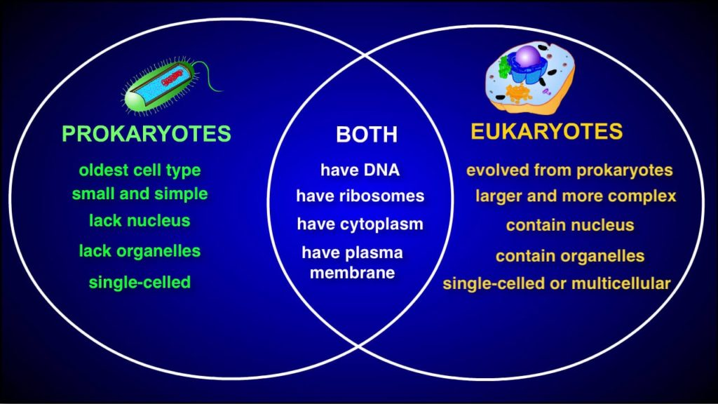
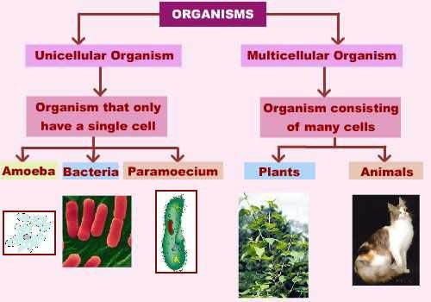
SINGLE- CELLED ORGANISM AMD MULTI-CELLED ORGANISM

Slide 8
https://www.youtube.com/watch?v=-BobUiQRhJ0

Slide 9
HOME ASSIGNMENTS
In box Question - 1,2,Pg No- 95

Slide 10
THANKING YOU
ODM EDUCATIONAL GROUP

