Slide 1


METALS AND NON-METALS
CLASS-VII
SUBJECT-CHEMISTRY
CHAPTER-06
INTRODUCTION, METALS, OCCURRENCE OF METALS, NON-METALS, OCCURRENCE OF NON-METALS
PERIOD-1

Slide 2

LEARNING OBJECTIVE
Students will be able to
Understand the concept of metals and non-metals.
Familiarize with the occurrence of metals and non-metals.
Sensitize different types of metals and non-metals.

Slide 3
WARM UP QUESTIONS
Activate prior knowledge by asking students what are the things of daily used made up of.
After listening to their responses, guide them to understand the further classification of matter.
Then ask them to identify some things made of metals and non-metals
Guide them to differentiate between metals and non-metals.

Slide 4
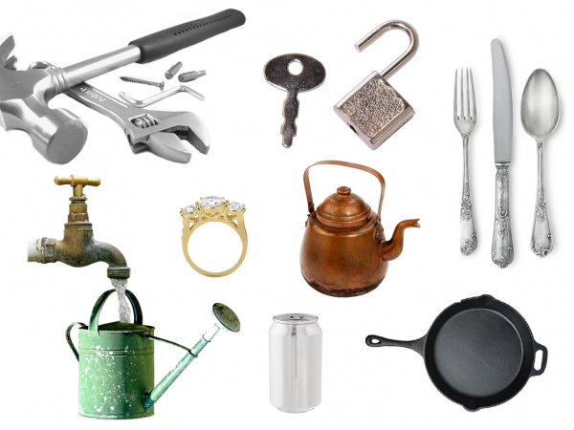
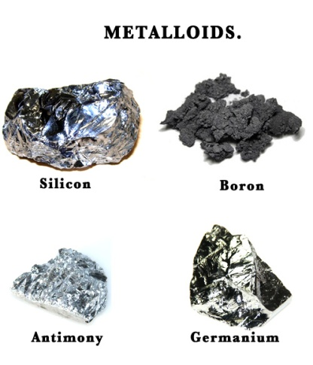
INTRODUCTION
There are millions of substances in the world that are made up of elements. For the convenience of the study, these elements are further divided into Metals, Non-Metals, Metalloids and Noble Gases based on certain properties. Metalloids shows both the properties of metals and non-metals whereas noble gases are unreactive in nature. In this chapter we would focus on Metals and Non-Metals.

Slide 5
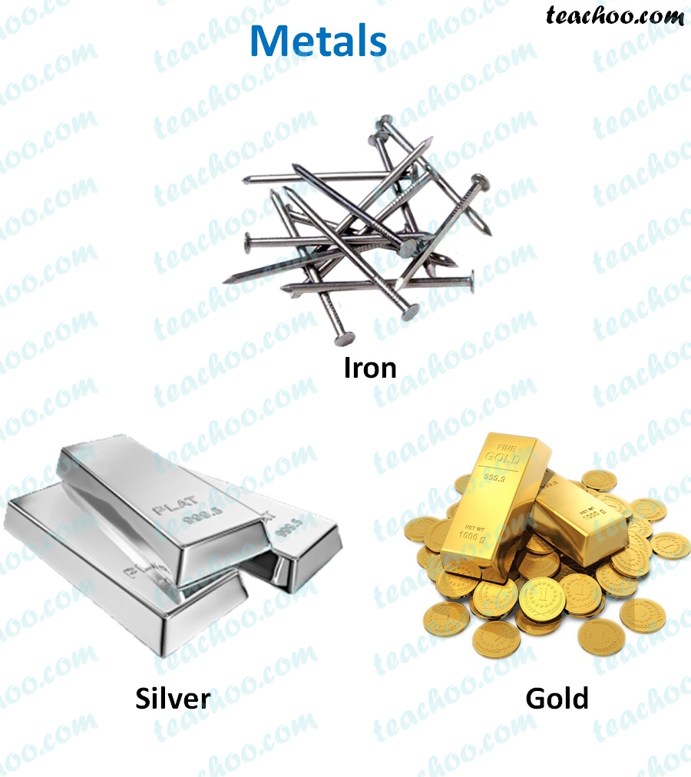
CONCEPT OF METALS
METALS
Metals are the elements that are shiny in appearance and have a significant role in our daily life.
They certainly constitute the mineral nature of a country.
Most of the metals like Iron, Gold, Silver, Aluminium and calcium etc are known to us.

Slide 6
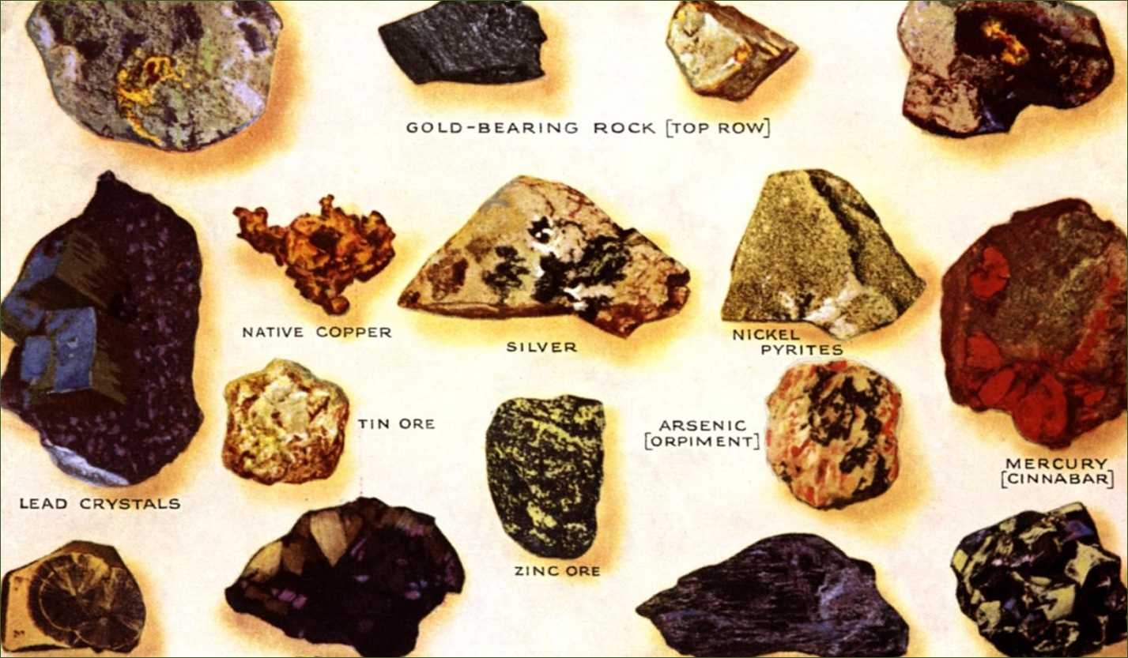
OCCURRENCE OF METALS
Metals occur in the nature in both the free and in the combined state.
Non-Reactive and low reactive metals like Gold, Silver and Copper etc. occur in the free state in the nature.
Metals like sodium, potassium and calcium etc. occur in the combined state.
Aluminium is the most abundant metal present in the Earth crust (8%)

Slide 7
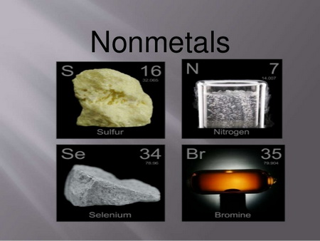
NON-METALS
Non-Metals are non-shiny in appearance and are very less in number.
Excluding the noble gases, there are only twelve non-metals known to us.
Various non-metals are Hydrogen, Oxygen, Nitrogen, fluorine, Chlorine, Bromine, Iodine, Sulphur, Carbon, Phosphorous, Selenium and astatine.
We need oxygen for breathing and for respiration. Plants need Carbon dioxide for photosynthesis

Slide 8
OCCURRENCE OF NON-METALS
Non-Metals occurs in the atmosphere both in the free state as well as in the combined state.
Oxygen and nitrogen occur in the free state. At the same time oxygen occur in carbon dioxide and water in the combined state.
Non-Metals occur in the combined state in the Earth’s crust as carbonates, oxides, sulphates and nitrates etc.
Nitrogen, the most abundant non-metals (78%) present in the free state and also in the combined state in food nutrients and proteins.

Slide 9
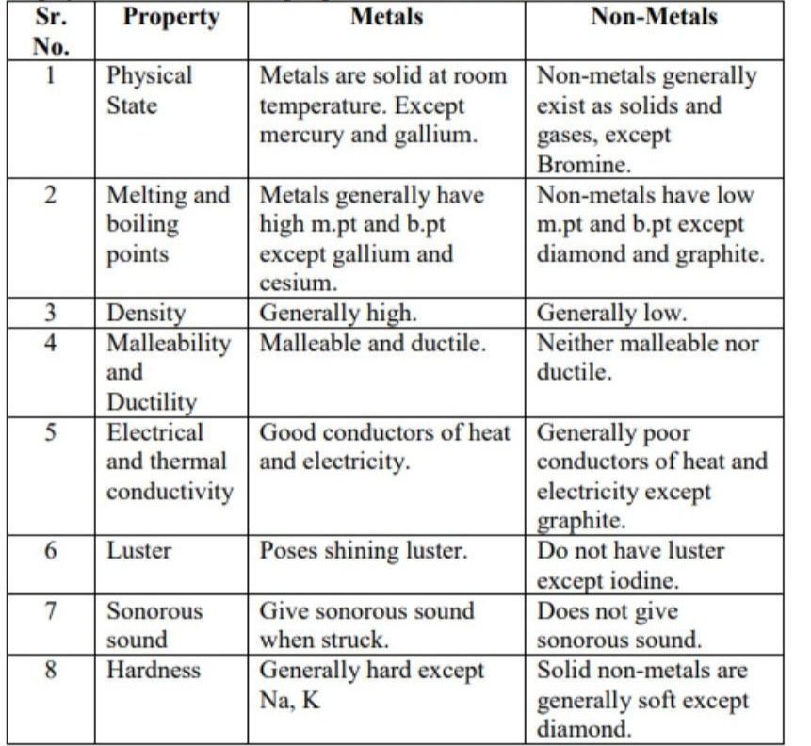
COMPARISION BETWEEN METALS AND NON-METALS

Slide 10
WATCH A VIDEO
https://youtu.be/BowQcGw9IYk

Slide 11
HOME ASSIGNMENT
Exercise – Q1, Q2, Q6 (a) , (b), (c) and (d)
Differentiate between metals and non-metals

Slide 12
THANKING YOU
ODM EDUCATIONAL GROUP

