Slide 1


AIR AND ATMOSPHERE
CLASS-VII
SUBJECT-CHEMISTRY
CHAPTER-07
INTRODUCTION, OCCURRENCE AND CONSTITUENTS OF AIR
PERIOD-1

Slide 2

LEARNING OBJECTIVE
Students will be able to.
Familiarize with the air as an important substance for the survival of life.
Sensitize of the various occurrence of air.
Familiarize them with the constituents of air.

Slide 3
WARM UP QUESTIONS
What are the essential components for the survival of life.
Do you breathe in air or not?
Mention the occurrence and composition of air.

Slide 4
INTRODUCTION
Air is the most essential substance for the survival of life.
It is used for respiration for all kinds of living beings.
Air helps in burning and producing energy.
It is invisible and transparent as it is a mixture of colourless gases.
We cannot see air, but certainly feel it.

Slide 5
OCCURRENCE OF AIR
Air occur in the atmosphere and surrounds the earth and extends about 300 Km above its surface.
It occurs in the water bodies in the dissolved state and helps in the survival of aquatic animals.

Slide 6
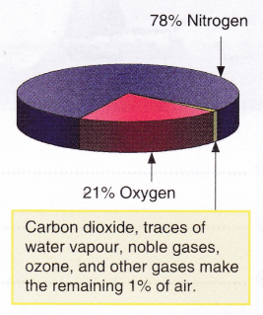
CONSTITUENTS OF AIR
The main constituents of air are nitrogen and oxygen.
The composition of air can be shown by a pie chart as given below: -

Slide 7
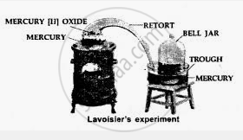
LAVOISIER’S EXPERIMENT
Lavoisier took mercury in a retort and heated it. The other end of the retort is connected to a bell jar containing air. The jar was kept in an inverted position over mercury contained in a trough.
Observation: -
A red layer of mercuric oxide was formed on the hot surface of mercury in the retort.
The level of mercury in the trough rose by 1/5 the of the total volume of the bell jar.
Conclusion: -
The 1/5th portion of the air used up by mercury to form red oxide is the active air. Lavoisier named this part as “OXYGEN”
The remaining 4/5th part of the air does not support burning and was named as “azote” meaning unsuitable for life. Later on, Lavoisier named it “NITROGEN”
It was concluded that nitrogen and oxygen are the two main constituents of air present in the ratio 4: 1.

Slide 8
HOME ASSIGNMENT
Exercise –1, Give one use of the Inert gases.
Explain the constituent of air with a chart.

Slide 9
VIDEO TIME
https://youtu.be/PMenuLJmV0I

Slide 10
THANKING YOU
ODME EDUCATIONAL GROUP

