Slide 1


MATTER AND IT’S COMPOSITION
SUBJECT-CHEMISTRY
CHAPTER NO- 1
Introduction, matter has mass and occupies space
PERIOD-1

Slide 2


LEARNING OBJECTIVE
Students will be able to
Familiarise with the definition of matter
Sensitize all the examples of matter
Understand matter has mass and it occupies space.

Slide 3
WARM UP QUESTIONS
Discuss the previous knowledge with the students.
What are the things around us like water, soil, plants, minerals, animals etc called?

Slide 4
What do you mean by matter?
Matter is anything that occupies space and has mass. All physical objects are composed of matter, and an easily observed property of matter is its state or phase. The classical states of matter are solid, liquid and gas.

Slide 5
Panchatatva
(panch + tatva) means five elements or the "panchamahabhutas". These are: Prithvi(Earth), Jal (Water), Agni (Fire), Vayu (Air) and Akash (Space). The entire universe is created by these five elements

Slide 6
Each of the five elements represents a state of matter in nature
Solid matter is classified as the 'earth' element,
water as liquid,
air as everything that is gas and
fire that transforms one state of matter into another,
and space is the mother of all other elements

Slide 7
Explain the concept of matter by showing a video.
https://youtu.be/QQsybALJoew

Slide 8
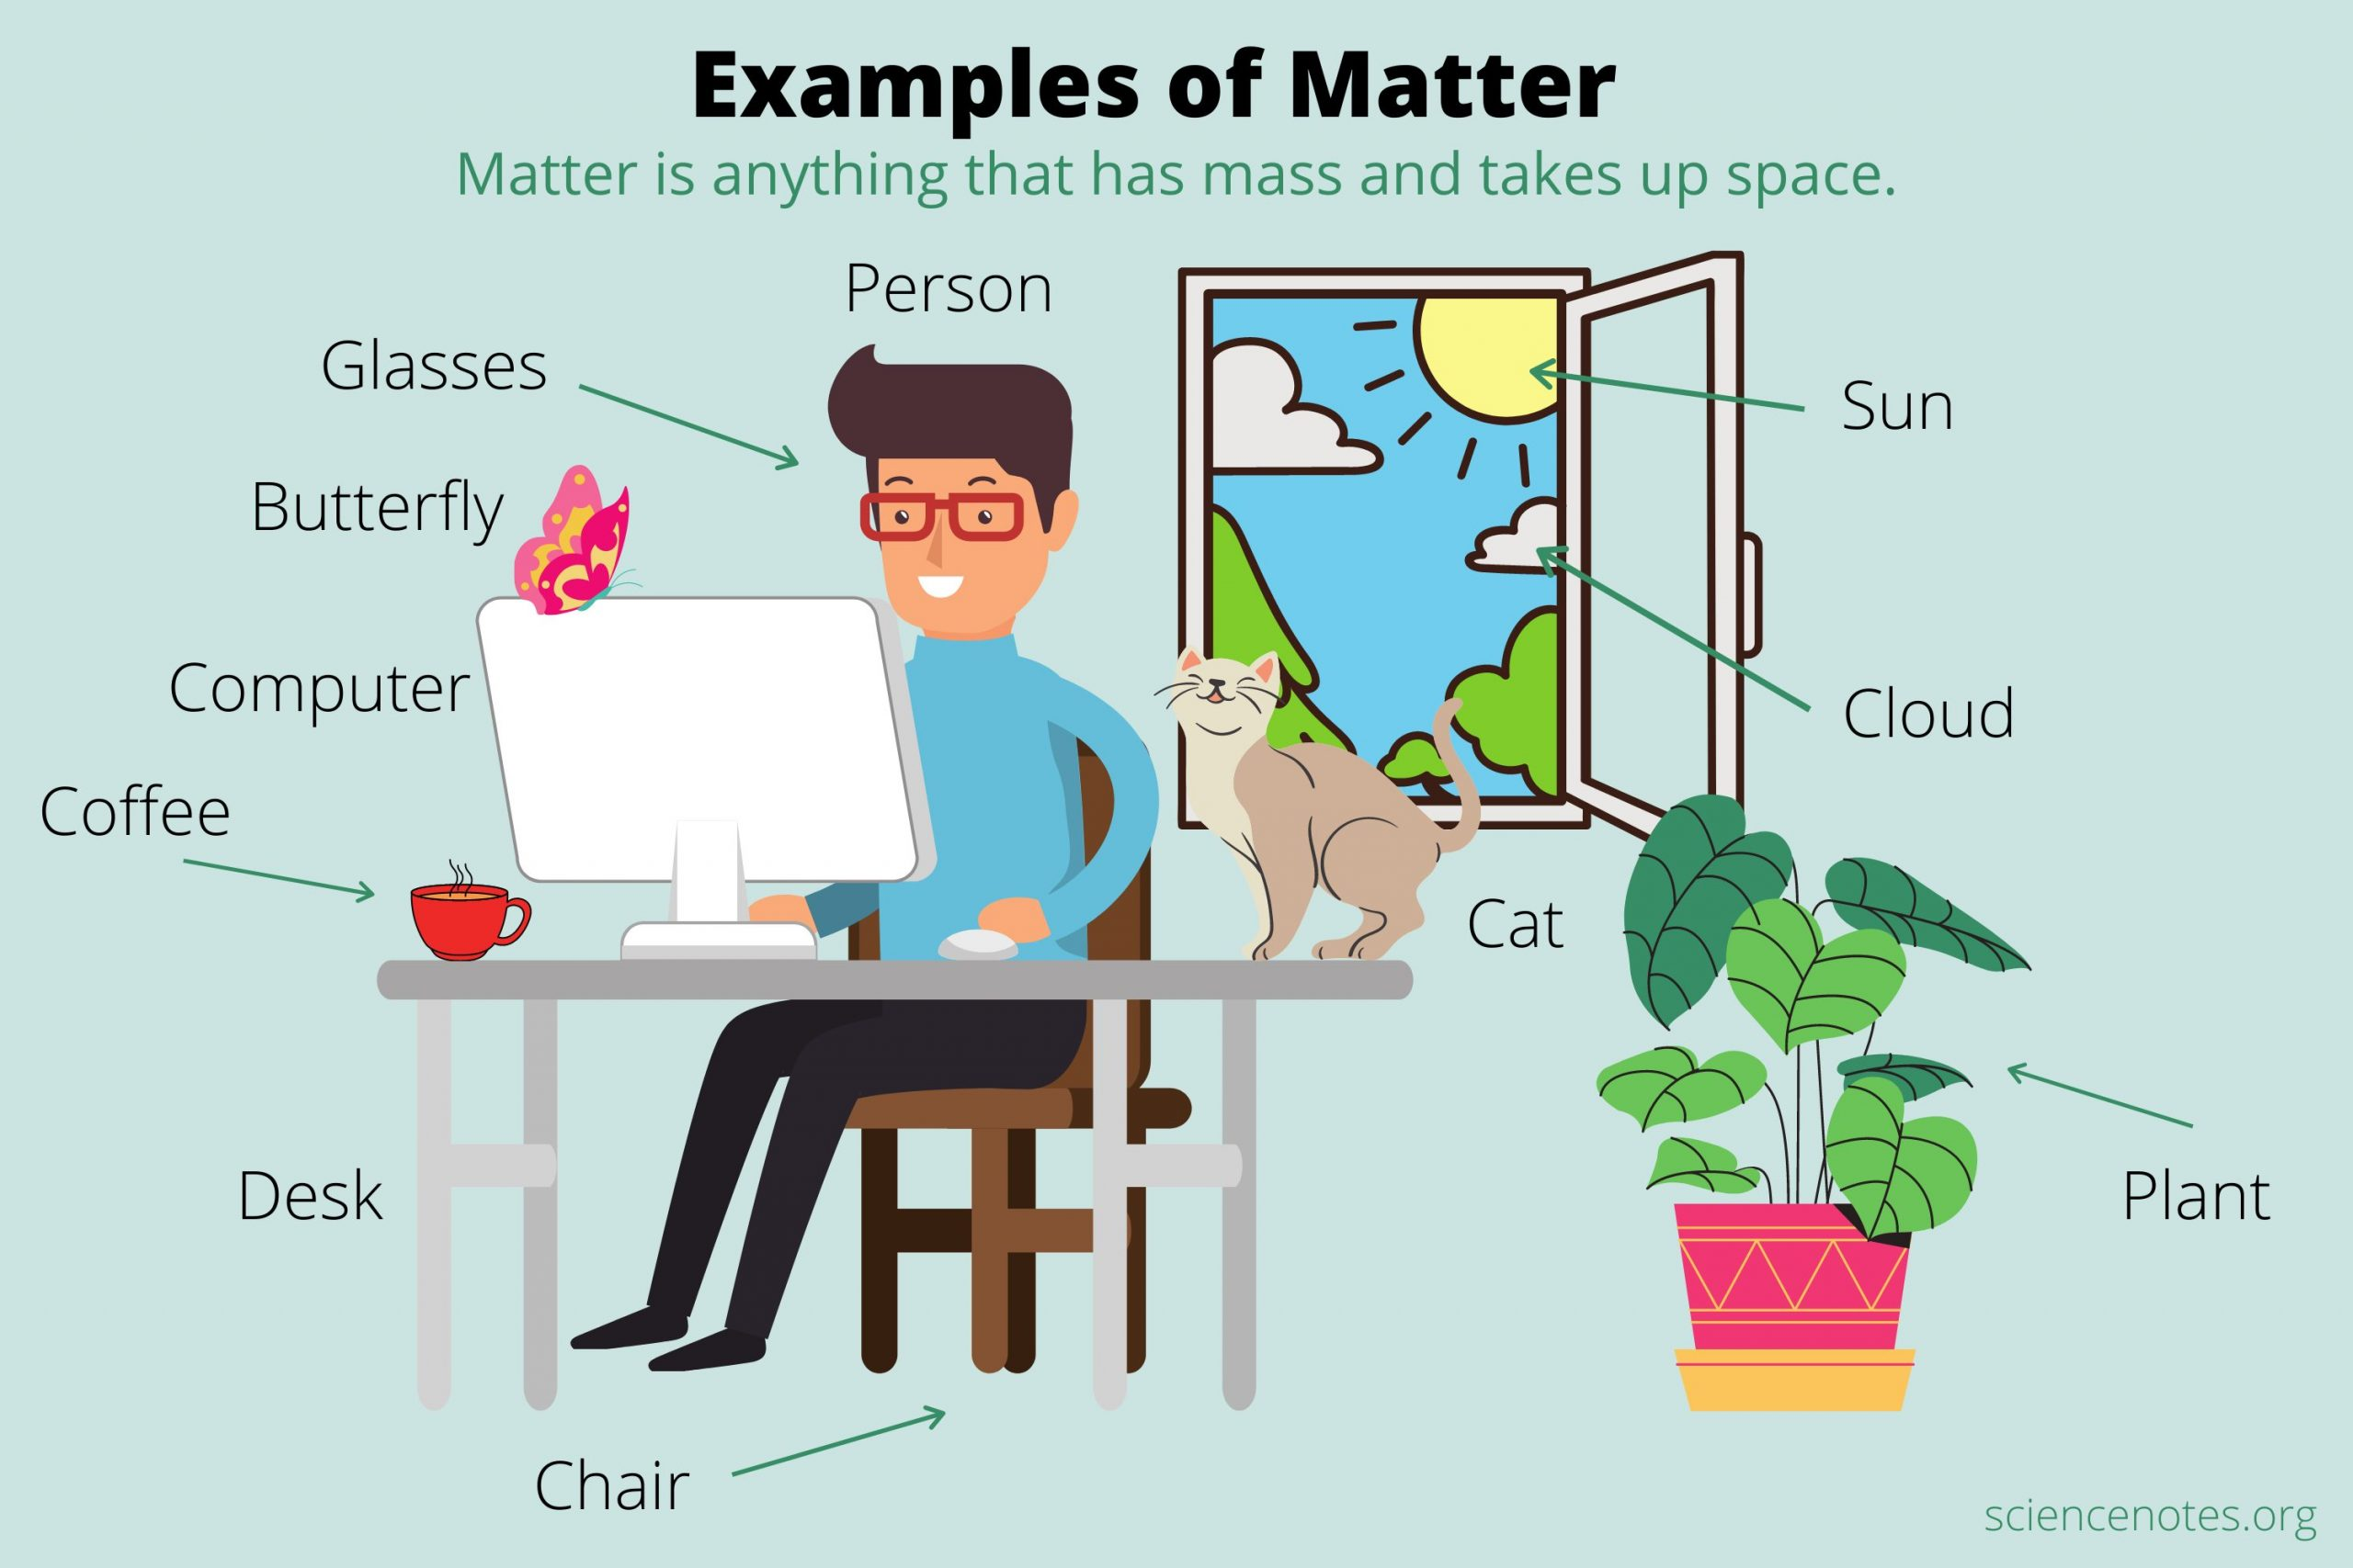

Slide 9
Matter has mass and occupies space
https://youtu.be/FxS-pzysJJA

Slide 10
HOME ASSIGNMENT
Exercise-1,2
Q. What do you mean matter?
Q. How can you show that matter has mass and it occupies space?

Slide 11
THANKING YOU
ODM EDUCATIONAL GROUP

