Slide 1


ATOMS, MOLECULES AND RADICALS
SUBJECT-CHEMISTRY
CHAPTER NO- 4
Introduction to Atoms and Molecules, Characteristics of Atoms, Types of molecules and atomicity.
PERIOD-1

Slide 2
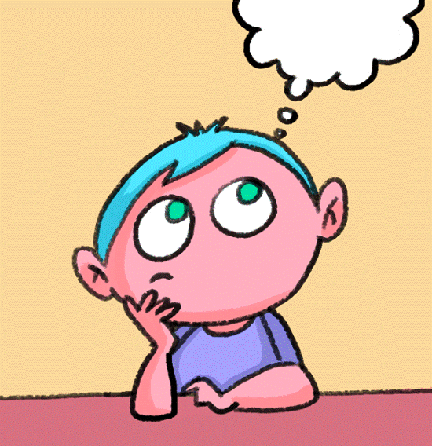
LEARNING OBJECTIVE
Students will be able to
Know about the concept of atoms and molecules
Get aware of the types of molecules.
know about the Characteristics of atoms as suggested by John Dalton.
Know about the Atomicity and distinguish the molecules based on the atomicity.

Slide 3
WARM UP QUESTIONS
Activate prior knowledge by asking students what is the composition of matter.
After listening to their responses, guide them to understand that the matter is composed of atoms or molecules
Then ask them what they know about the characteristics of atoms.
Guide them to know about the Atomicity and Types of Molecules based on Atomicity.

Slide 4
CONCEPT OF ATOMS
INTRODUCTION
Every matter is made up of very tiny particles called atoms. Molecules are formed from atoms. Atoms and molecules are too small to be seen through naked eye. They can only be seen through a powerful microscope. Let us know about atoms and molecules in details.
AN ATOM
The word atom comes from the word “Atomos” meaning ‘indivisible’ coined by a Greek philosopher Democritus.
John Dalton in the year 1808 suggested that an atom is the basic unit of matter.
An atom is defined as the smallest particle of an element that may or may not exist independently but still shows all the properties of that element and takes part in every chemical reaction.
For Example:
On crushing a zinc piece, even the smallest piece of the Zinc metal shows the properties of the zinc.
In other words, “An Atom is the smallest possible unit of an element”

Slide 5
CHARACTERISTICS OF ATOM AS SUGGESTED BY JOHN DALTON
An atom is the smallest particle of matter which cannot be divided further into smaller particles.
Atoms of the same element are identical but they differ from the atoms of the other elements.
An atom of an element exhibits all the properties of that element.
Atoms can neither be created nor destroyed.
Atoms may or may not have independent existence but they can take part in chemical reaction.

Slide 6
WATCH A VIDEO
https://youtu.be/eyzVBiapXtM

Slide 7
MOLECULE AND ITS TYPES
A molecule is the smallest particle of an element or compound which exist independently and exhibits all the properties of that element or compound.
Molecule can also be defined as the group of two or more atoms that are chemically bonded together by attractive forces.
Molecules are of two types: -
Molecule of an Element
Molecule of a Compound

Slide 8
ATOMICITY
ATOMICITY
Atomicity is defined as the number of atoms of an element join together to form a molecule is known as the Atomicity of that molecule.
Depending on the Atomicity, the molecule of elements can be divided into: -
Monoatomic Molecules
Diatomic Molecules
Triatomic Molecules
Polyatomic Molecules

Slide 9
TYPES OF MOLECULES BASED ON ATOMICITY
MONOATOMIC MOLECULE
The molecule that contains only one atom are Monoatomic molecule.
Examples of Monoatomic Molecules are: - Na, Zn, Mg, and Noble gases like He, Ne, Ar, and Xe etc.
DIATOMIC MOLECULE
The molecule that contains two atoms are Diatomic molecule.
Examples of Diatomic Molecules are: - H₂, N₂, O₂, Cl₂ etc.
TRIATOMIC MOLECULE
The molecule that contains three atoms are Triatomic molecule.
Examples of Triatomic Molecules are: - O₃ (ozone)
POLYATOMIC MOLECULE
The molecule that contains more than three atoms are Polyatomic molecule.
Examples of Polyatomic Molecules are: - P₄ (Phosphorus) and S₈ (Sulphur)

Slide 10
WATCH A VIDEO
https://youtu.be/eyzVBiapXtM

Slide 11
HOME ASSIGNMENT
EXERCISE- Q1 (a) & (b)
Define atomicity.
What are the characteristics of an atom as suggested by Dalton.
Define the following:-
(a) Atom
(b) Molecule

Slide 12
THANKING YOU
ODM EDUCATIONAL GROUP

