Slide 1

PHYSICAL AND CHEMICAL CHANGES
SUBJECT-CHEMISTRY
CHAPTER NO- 2
Introduction, types of changes- slow and fast changes, natural and man-made changes.
PERIOD-1

Slide 2


LEARNING OBJECTIVE
Students will be able to
Know about different types of changes occurring in our day today life
Distinguish the two types of changes- slow and fast changes
Distinguish the two types of changes- natural and manmade changes.

Slide 3

WARM UP QUESTIONS
Activate prior knowledge by asking students what happens to a snowman on a warm day?
After listening to their responses, guide them to understand that the snowman changes shape, but it is still made from the same material, which is water.
Then ask them what happens to a log in the fireplace if it is set on fire.
Guide them to recognize that sometimes changes cause objects to turn into new materials, like wood to ash.

Slide 4

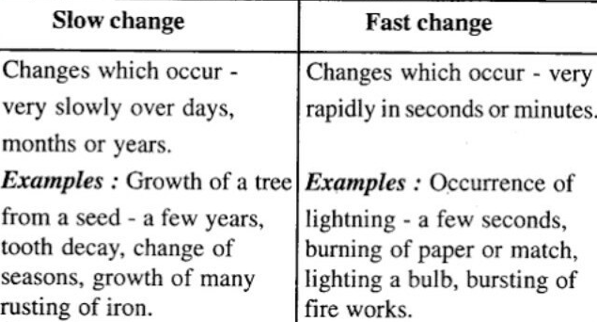
Slow and fast changes

Slide 5
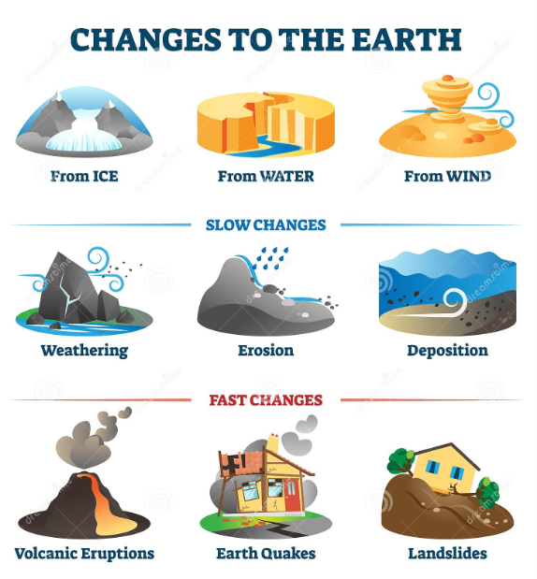

Slide 6
Demonstrate any one of each type of change by showing real life examples- like rusting of iron, bursting of an inflated balloon, lighting of electric bulb, ripening of mango
Show a video on slow and fast changes for better understanding of the concept
https://youtu.be/oJ8WoHbdz1U

Slide 7
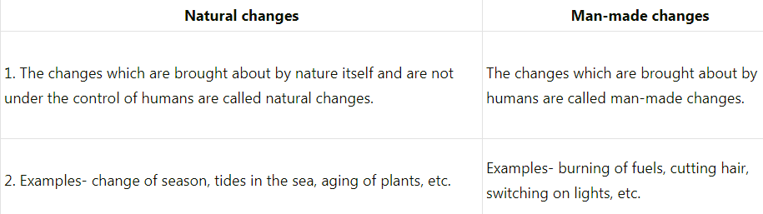
Natural and manmade changes

Slide 8
Demonstrate any one of each type of change by showing real life examples- ripening of mango, germination of seeds, and preparation of chapattis.
Show a video for better understanding of the concept
https://youtu.be/FKfLArLpkIs

Slide 9
HOME ASSIGNMENT
Exercise-1(a), ( c)
Q. Differentiate between slow and fast changes
Q. Differentiate between natural and manmade changes
Q. Ripening of mango is slow or fast change? Explain
Q. Bursting of an inflated balloon is slow or fast change? Explain

Slide 10

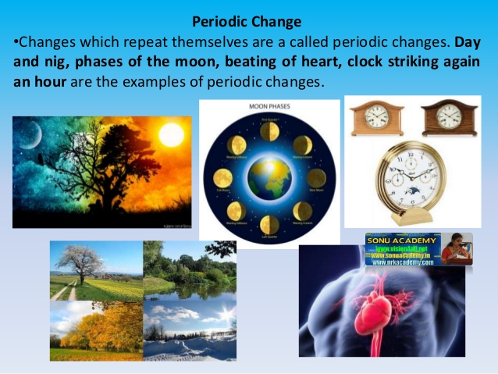
PERIODIC AND NON PERIODIC CHANGES
Changes that repeat at regular intervals are called periodic changes.

Slide 11
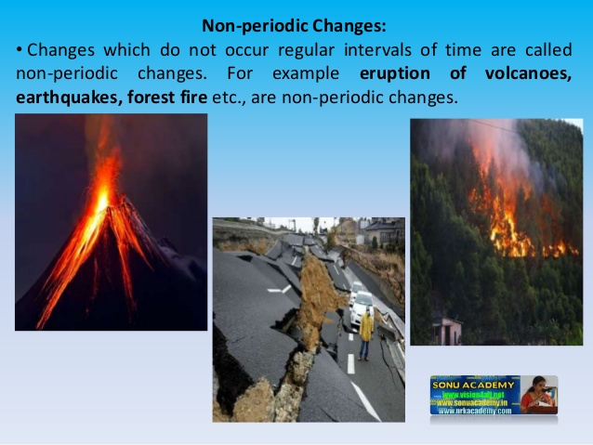
Certain changes that do not repeat themselves at regular intervals of time, and such changes are called non-periodic changes.

Slide 12
THANKING YOU
ODM EDUCATIONAL GROUP

