Slide 1


FORCE
SUBJECT-PHYSICS
CHAPTER NO- 3
Force as push and pull
PERIOD-1

Slide 2


LEARNING OBJECTIVE
Students will be able to
Clarify their doubts and form a correct concept of force.
Understand that forces are due to an interaction like push or pull
Understand the concept of force as a stretch and force as a squeeze.
Relate and apply their knowledge about force in real life situations.

Slide 3
WARM UP
The teacher will introduce the topic by showing a video.
https://youtu.be/IJWEtCRWGvI

Slide 4
FORCE
Explain force by showing a video.
https://youtu.be/B6mi1-YoRT4
https://youtu.be/9tg3csrFVJw

Slide 5
FORCE AS PUSH AND PULL
Explain force as push by giving some real life examples.
Show a video for better understanding of concept
https://youtu.be/qQi667U_Mig

Slide 6
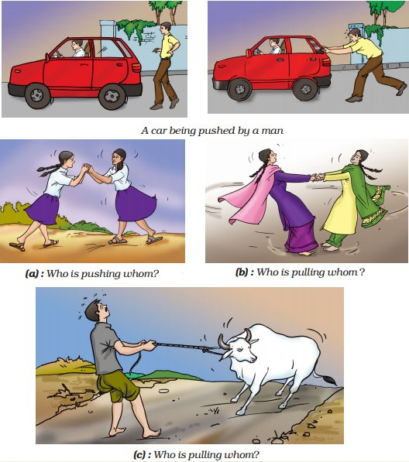

Slide 7

Try to identify action involved in each case as a push and/or a pull and record your observations.
S.No | Description of the situation
1 | Moving a book placed on a table
2 | Opening or shutting a door
3 | Drawing a bucket of water from a well
4 | A football player taking a penalty kick
5 | A cricket ball hit by a batsman
6 | Moving a loaded cart
7 | Opening a drawer

Slide 8
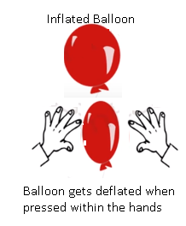

FORCE AS STRECH AND SQUEEZE
Explain force as stretch by demonstrating an activity with the help of a spring.
Explain force as squeeze by demonstrating an activity with the help of a toothpaste tube or an inflated balloon

Slide 9
HOME ASSIGNMENT
Exercise- B 1,2
Q. Define force
Q. Give an example of force as push and pull
Q. Explain force as stretch with the help of an example.

Slide 10
THANKING YOU
ODM EDUCATIONAL GROUP

