Slide 1


TISSUES
SUBJECT- BIOLOGY
CHAPTER NO- 6
Introduction: Definition, Importance of tissues
PERIOD-1

Slide 2


LEARNING OBJECTIVE
Student will be able to define tissues and state its function.
Student will be familiarized with the importance of tissues in a complex organism

Slide 3
WARM UP QUESTIONS
Teacher should initiate the discussion on following topics by
Asking them to share their previous knowledge about cellular organization of living organisms.
Show them the picture of cellular organization of living organisms and discuss that the complexity and size increases as we move from atoms to organisms

Slide 4

WHAT DO YOU MEAN BY TISSUES?
The English word "tissue" derives from the French word "tissu", the past participle of the verb tisser, "to weave".
A group of cells that are similar in structure and/or work together to achieve a particular function forms a tissue.
https://youtu.be/fNQ92ZGWpOA

Slide 5

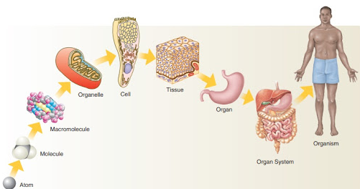
LEVELS OF ORGANIZATION

Slide 6
What is the utility of tissues in multi-cellular organisms?
This cluster of cells, called a tissue, is arranged and designed so as to give the highest possible efficiency of function. Blood, phloem and muscle are all examples of tissues. The Human body works with the principle of division of labor.

Slide 7
IMPORTANCE OF TISSUES
It protects the organs from injury or shocks.
It also connects many body parts such as ligament connects bones to another bones.
It also provides nutrition to our body such as blood also transport nutrients to many parts of the body.
It fights against many infectious pathogens.

Slide 8
HOME ASSIGNMENT
Following questions to be worked out
Q. write the importance of tissues in a living organism
Q. explain the cellular organization in a multicellular organism

Slide 9

THANKING YOU
ODM EDUCATIONAL GROUP

