Slide 1


THE FUNDAMENTAL UNIT OF LIFE
SUBJECT- BIOLOGY
CHAPTER NO- 3
Discovery of cell and cell theory
PERIOD-1

Slide 2


LEARNING OBJECTIVE
Student will be able to
sequence the timeline associated with the discovery of Microscope, parts of microscope and their function.
sequence the timeline associated with the discovery of cell
Get familiarized with the cell theory
Learners will be sensitized about the difference between unicellular and multicellular organisms.

Slide 3

WARM UP QUESTIONS
Is cork cell living or non living?
Amoeba and Paramecium are not visible through naked eye. Why?
Can you differentiate between simple and compound microscope?
Can you differentiate between plant and animal cell?

Slide 4
Cell-Cells are the basic structural and functional units of all living organisms.

Slide 5
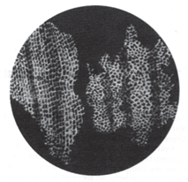
DISCOVERY OF CELL
Cell is derived from a Latin term which means – ‘a little room’
Basic structural and functional unit of life
Discovery of cell- First discovered by Robert Hooke from dead cork cells (1665)
obtained from bark of a tree by a
self designed microscope

Slide 6
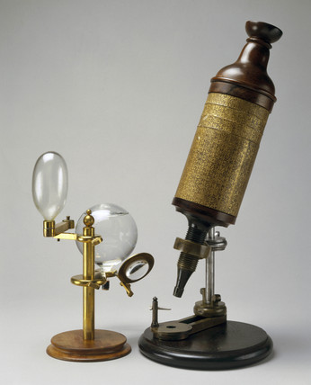
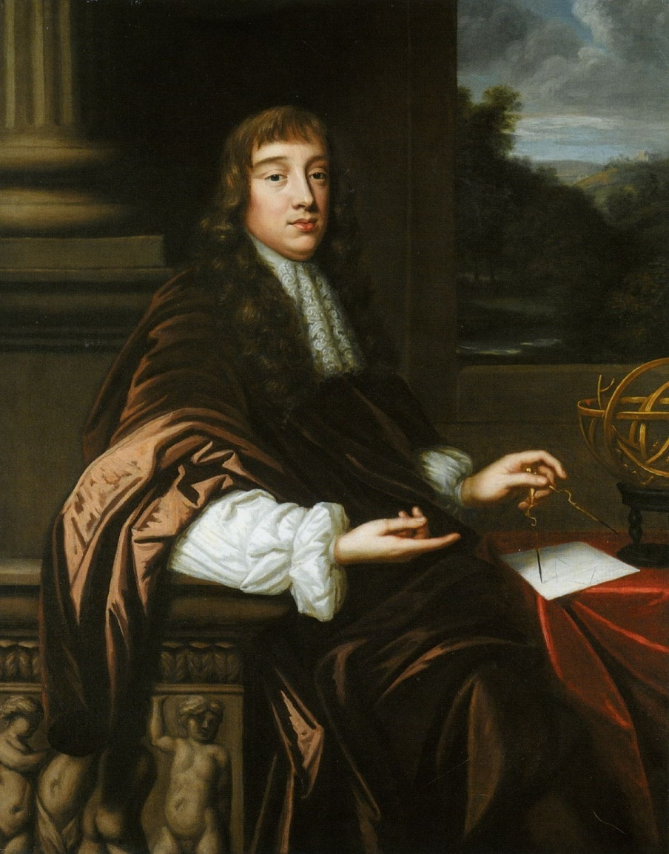

SELF DESIGNED MICROSCOPE BY ROBERT HOOKE

Slide 7
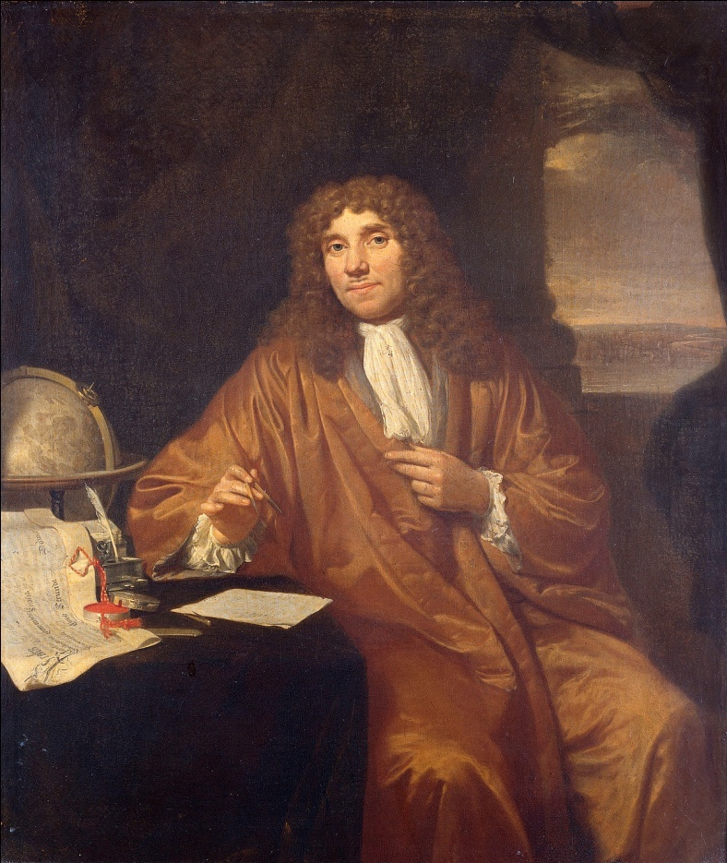
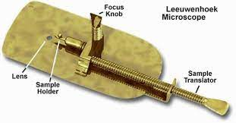

LEEUWENHOEK MICROSCOPE

Slide 8

MICROSCOPES
A microscope is an instrument that makes an enlarged image of a small object, thus revealing details of the object which cannot be seen by our naked eyes.
Simple microscope
Compound microscope
Electron microscope

Slide 9
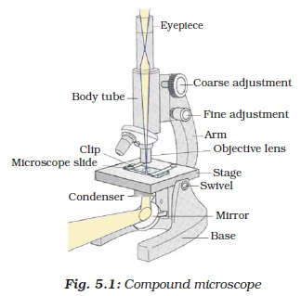

COMPOUND MICROSCOPE

Slide 10
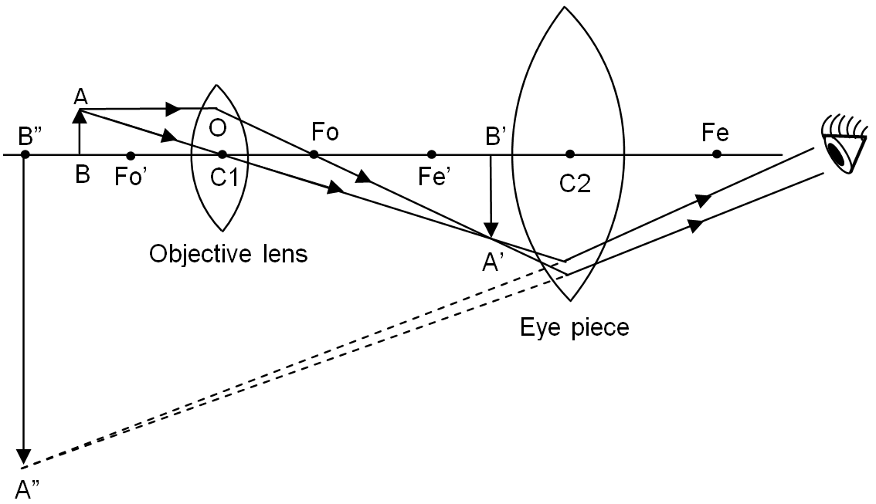

IMAGE FORMED BY A COMPOUND MICROSCOPE

Slide 11
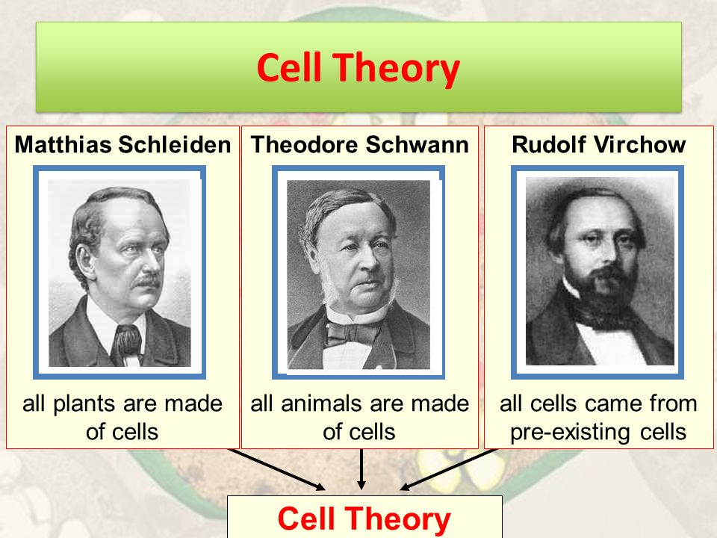
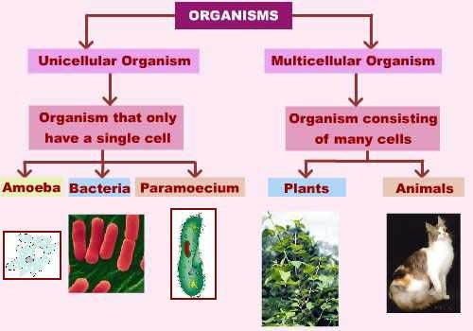

On the basis on number of cells present in different organisms , they are classified into two types-

Slide 12

CELL THEORY
Cell Theory was formulated by M J Schleiden (1838) and Theodore Schwann (1839).
The main principles of the theory are
All living organisms are composed of cells .
Cell is the basic unit of life
All cells arise from pre-existing cells.

Slide 13

HOME ASSIGNMENT
Following questions to be worked out
Q. Who discovered cell and in which year?
Q. Name the scientists who proposed cell theory and give the postulates.

Slide 14
THANKING YOU
ODM EDUCATIONAL GROUP

