Slide 1


LIFE PROCESSES.
SUBJECT:BIOLOGY
CHAPTER:6.
EXCRETION IN PLANTS
PERIOD-12

Slide 2

LEARNING OBJECTIVE
Student will be able to apprise the importance of excretion in plants .
Student will be able to analyze the deferent excretory product of plants .

Slide 3

WARM UP QUESTIONS
1.What are the methods used by plants to get rid of excretory products?
2. Name the waste products stored in the old xylem of many plants.
3. Name any two waste products produced by the plants.

Slide 4
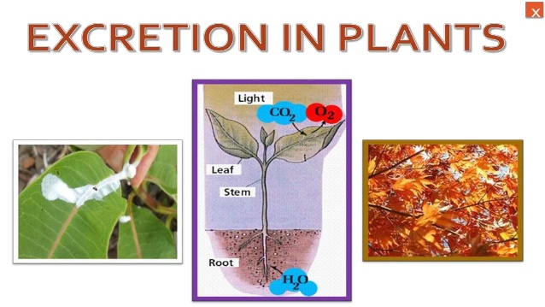
The gaseous wastes, oxygen, carbon dioxide and water vapour are removed through stomata of leaves and lenticels of stems.Some waste products collect in the leaves and bark of trees. When the leaves and bark are shed, the wastes are eliminated.
Some waste products are rendered harmless and then stored in the plant body as solid bodies. Raphides, tannins, resins, gum, rubber and essential oils are some such wastes.

Slide 5
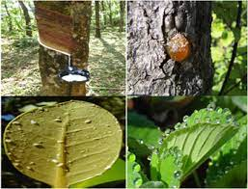

Slide 6
https://www.youtube.com/watch?v=7xDe2K8UFGM

Slide 7
HOME ASSIGNMENT
In box Question - 2 Pg No-112 .

Slide 8
THANKING YOU
ODM EDUCATIONAL GROUP.

