Slide 1


LIFE PROCESSES.
SUBJECT:BIOLOGY
CHAPTER:6.
EXCRETION IN HUMAN BEINGS
PERIOD-10

Slide 2

LEARNING OBJECTIVE
Student will be able to know the structural and functional unit of kidney.
Student will be familiarized with the function of kidney.
Learners will be sensitized about the composition of dirty blood.

Slide 3

WARM UP QUESTIONS
1.why should ammonia be excreted as soon as it is formed?
2.Name two organisms which excrete urea.
3.How do most of the unicellular organisms excrete?

Slide 4
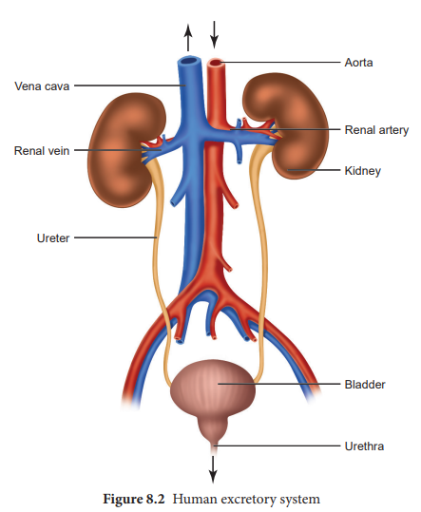
EXCRETORY SYSTEM
Removal of harmful waste from the body is called excretion. Many wastes are produced during various metabolic activities. These need to be removed in time because their accumulation in the body can be harmful and even lethal for an organism.

Slide 5
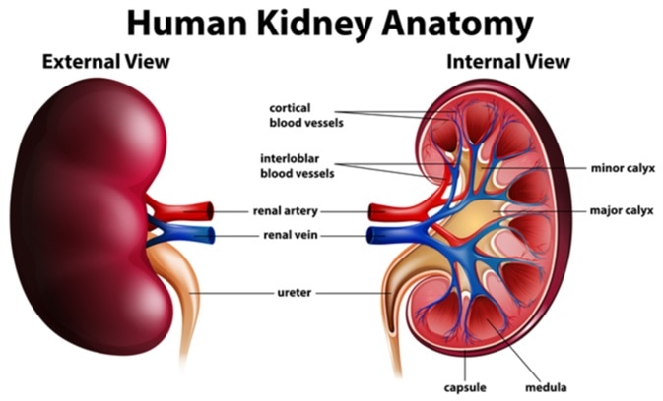
KIDNEY
Kidney is a bean-shaped organ which lies near the vertebral column in the abdominal cavity. The kidney is composed of manyfiltering units; called nephrons. Nephronis called the functional unit of kidney.

Slide 6
https://www.youtube.com/watch?v=EhnRhfFLyOg

Slide 7
HOME ASSIGNMENT
In box Question - 1Pg No- 112 .

Slide 8
THANKING YOU
ODM EDUCATIONAL GROUP.

