Slide 1


THE FUNDAMENTAL UNIT OF LIFE
SUBJECT- BIOLOGY
CHAPTER NO- 5
Cell Organelles- plastids, vacuoles and centrosome
PERIOD-10

Slide 2


LEARNING OBJECTIVE
Student will be able to
sensitize the structure and location of plastids, vacuoles and centrosome in a living cell
be familiarized with the functions of plastids, vacuoles and centrosome in a living cell.
sensitize the types and importance of plastids in plants.

Slide 3

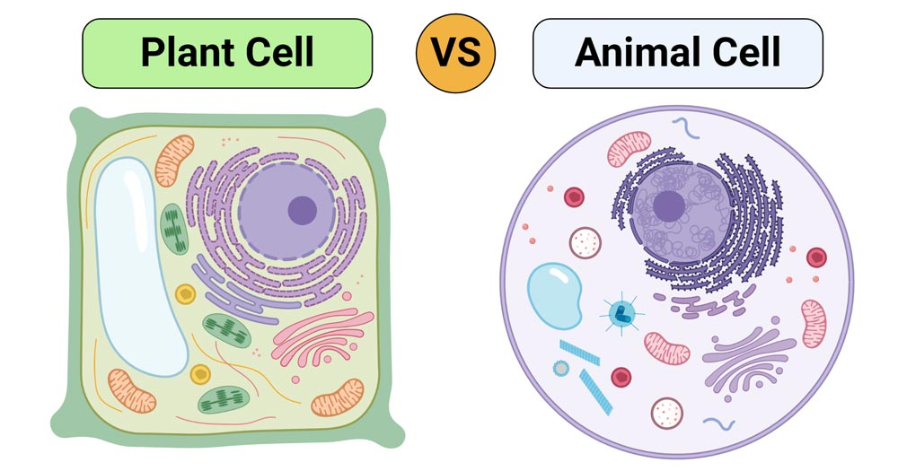
WARM UP QUESTIONS BASED ON PREVIOUS KNOWLEDGE
By looking into the chart/ image of both plant and animal cells, what differences do you observe?

Slide 4
Recapitulation of the previous portions
Ask students about previous knowledge on cell organelles
What is the role of chlorophyll in plants?
Why chlorophyll is only present in plants?

Slide 5
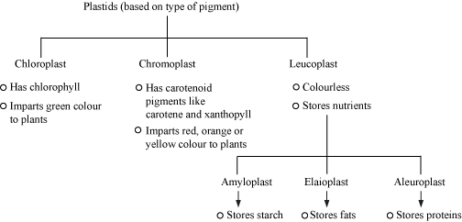
PLASTIDS

Slide 6
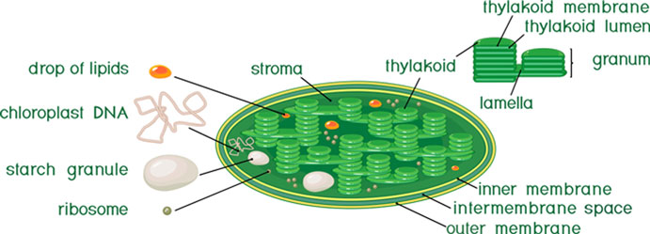
Chloroplast( Kitchen of the cell)

Slide 7
Detailed types and functions of each type of plastids in a plant cell
https://youtu.be/yyvfBFtyF8c

Slide 8
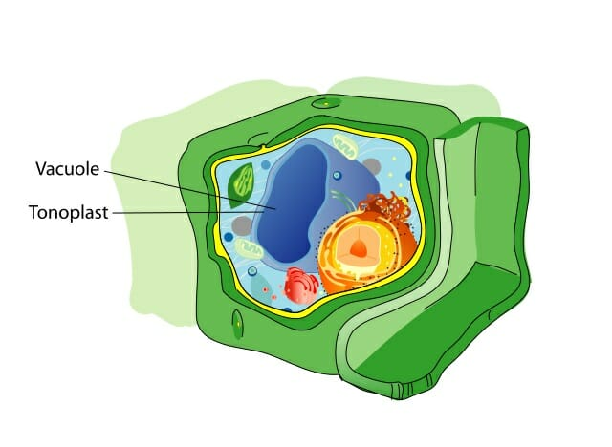
VACUOLES
Vacuole discovered by Dujardin. It is unit membrane-bound structure which is selectively permeable. Approx.90% of the volume of many plant cells is occupied by it. It Is surrounding membrane is known as Tonoplast
Below is a plant cell showing vacuole-

Slide 9
Types of vacuoles
(1) Sap vacuoles (central vacuoles)
(2) Contractive vacuole
(3) Food Vacuoles
(4)Air vacuoles ( Pseudo vacuoles, or Gas Vacuoles)

Slide 10
Detailed structure and function of vacuoles https://youtu.be/AqNkXA8dog8

Slide 11
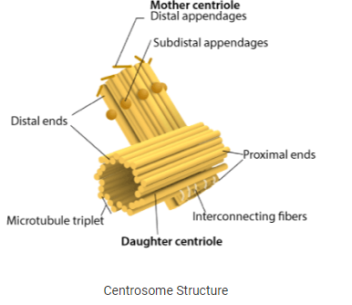
CENTROSOME

Slide 12
Centrosome Function
The centrosomes help in cell division.
They maintain the chromosome number during cell division.
They also stimulate the changes in the shape of the cell membrane by phagocytosis.
Facilitates changes in the shapes of the membranes of the animal cell.

Slide 13
Detailed structure and functions of centrosome
https://youtu.be/yyvfBFtyF8c

Slide 14
HOME ASSIGNMENT
Q. Discuss the type of plastids and their respective functions.
Q. Explain the role of centrosome in cell division of an animal cell.
Q. Elaborate the role of vacuole in plant cell.

Slide 15
THANKING YOU
ODM EDUCATIONAL GROUP

