Slide 1


PERIOD-8
MATHEMATICS
CHAPTER NUMBER :~ 2
CHAPTER NAME :~ POLYNOMIALS
SUB TOPIC :~ APPLICATIONS OF ALGEBRAIC IDENTITIES

Slide 2
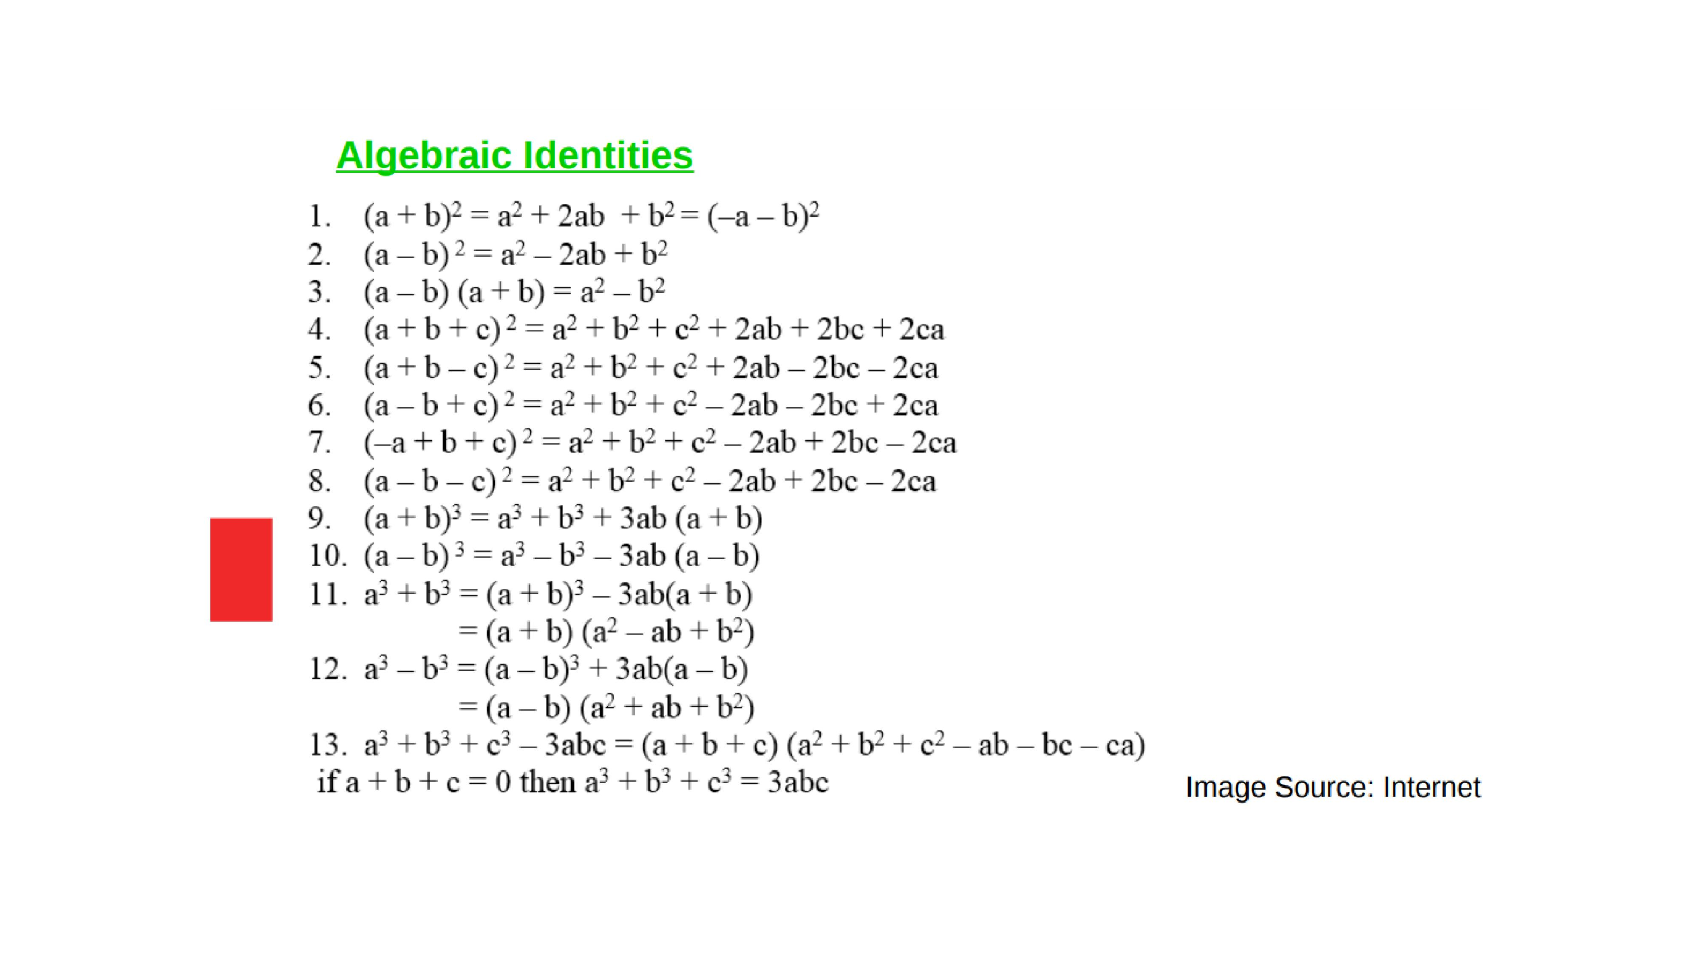
PREVIOUS KNOWLEDGE TEST

Slide 3
LEARNING OUTCOME:-
Students will learn
a)Applications of Algebraic identities.

Slide 4
EXERCISE-2.5
Question 1.
Use suitable identities to find the following products
(i) (x + 4)(x + 10)
(ii) (x+8) (x -10)
(iii) (3x + 4) (3x – 5)
Solution:
(i) We have, (x+ 4) (x + 10)
Using identity,
(x+ a) (x+ b) = x² + (a + b) x+ ab.
We have, (x + 4) (x + 10) = x²+(4 + 10) x + (4 x 10)
= x² + 14x+40

Slide 5
(ii) We have, (x+ 8) (x -10)
Using identity,
(x + a) (x + b) = x² + (a + b) x + ab
We have, (x + 8) (x – 10) = x² + [8 + (-10)] x + (8) (- 10)
= x² – 2x – 80
(iii) We have, (3x + 4) (3x – 5)
Using identity,
(x + a) (x + b) = x² + (a + b) x + ab
We have, (3x + 4) (3x – 5) = (3x)² + (4 – 5) x + (4) (- 5)
= 9x² – x – 20

Slide 6
Question 2.
Evaluate the following products without multiplying directly
(i) 103 x 107
(ii) 95 x 96
(iii) 104 x 96
Solution:
(i)We have, 103 x 107 = (100 + 3) (100 + 7)
= ( 100)² + (3 + 7) (100)+ (3 x 7)
[Using (x + a)(x + b) = x² + (a + b)x + ab]
= 10000 + (10) x 100 + 21
= 10000 + 1000 + 21=11021

Slide 7
(ii) We have, 95 x 96 = (100 – 5) (100 – 4)
= ( 100)² + [(- 5) + (- 4)] 100 + (- 5 x – 4)
[Using (x + a)(x + b) = x² + (a + b)x + ab]
= 10000 + (-9) + 20 = 9120
= 10000 + (-900) + 20 = 9120
(iii) We have 104 x 96 = (100 + 4) (100 – 4)
= (100)²-4²
[Using (a + b)(a -b) = a²– b²]
= 10000 – 16 = 9984

Slide 8
Question 3.
Factorise the following using appropriate identities
(i) 9x² + 6xy + y²
(ii) 4y²-4y + 1
(iii) x² – y2100
Solution:
(i) We have, 9x² + 6xy + y²
= (3x)² + 2(3x)(y) + (y)²
= (3x + y)²
[Using a² + 2ab + b² = (a + b)²]
= (3x + y)(3x + y)
(ii) We have, 4y² – 4y + 1²
= (2y)² + 2(2y)(1) + (1)²
= (2y -1)²
[Using a² – 2ab + b² = (a- b)²]
= (2y – 1)(2y – 1 )

Slide 9
Question 4.
Expand each of the following, using suitable identity
(i) (x+2y+ 4z)²
(ii) (2x – y + z)²
(iii) (- 2x + 3y + 2z)²
(iv) (3a -7b – c)^{z}
(v) (- 2x + 5y – 3z)²
Solution:
We know that
(x + y + z)² = x² + y² + z² + 2xy + 2yz + 2zx
(i) (x + 2y + 4z)²
= x² + (2y)² + (4z)² + 2 (x) (2y) + 2 (2y) (4z) + 2(4z) (x)
= x² + 4y² + 16z² + 4xy + 16yz + 8 zx

Slide 10
(ii) (2x – y + z)² = (2x)² + (- y)² + z² + 2 (2x) (- y)+ 2 (- y) (z) + 2 (z) (2x)
= 4x² + y² + z² – 4xy – 2yz + 4zx
(iii) (- 2x + 3y + 2z)² = (- 2x)² + (3y)² + (2z)² + 2 (- 2x) (3y)+ 2 (3y) (2z) + 2 (2z) (- 2x)
= 4x² + 9y² + 4z² – 12xy + 12yz – 8zx
(iv) (3a -7b- c)² = (3a)² + (- 7b)² + (- c)² + 2 (3a) (- 7b) + 2 (- 7b) (- c) + 2 (- c) (3a)
= 9a² + 49b² + c² – 42ab + 14bc – 6ac
(v)(- 2x + 5y- 3z)² = (- 2x)² + (5y)² + (- 3z)² + 2 (- 2x) (5y) + 2 (5y) (- 3z) + 2 (- 3z) (- 2x)
= 4x² + 25y² + 9z² – 20xy – 30yz + 12zx

Slide 11
Question 5.
Factorise
(i) 4 x² + 9y² + 16z² + 12xy – 24yz – 16xz
(ii) 2x² + y² + 8z² – 2√2xy + 4√2yz – 8xz
Solution:
(i) 4x² + 9y² + 16z² + 12xy – 24yz – 16xz
= (2x)² + (3y)² + (- 4z)² + 2 (2x) (3y) + 2 (3y) (- 4z) + 2 (- 4z) (2x)
= (2x + 3y – 4z)² = (2x + 3y + 4z) (2x + 3y – 4z)
(ii) 2x² + y² + 8z² – 2√2xy + 4√2yz – 8xz
= (- √2x)² + (y)² + (2 √2z)²y + 2(- √2x) (y)+ 2 (y) (2√2z) + 2 (2√2z) (- √2x)
= (- √2x + y + 2 √2z)²
= (- √2x + y + 2 √2z) (- √2x + y + 2 √2z)

Slide 12
Question 6.
Write the following cubes in expanded form
Solution:
We have, (x + y)³ = x³ + y³ + 3xy(x + y) …(1)
and (x – y)³ = x³ – y³ – 3xy(x – y) …(2)
(2x + 1)³ = (2x)³ + (1)³ + 3(2x)(1)(2x + 1) [By (1)]
= 8x³ + 1 + 6x(2x + 1)
= 8x³ + 12x² + 6x + 1
(ii) (2a – 3b)³ = (2a)³ – (3b)³ – 3(2a)(3b)(2a – 3b) [By (2)]
= 8a³ – 27b³ – 18ab(2a – 3b)
= 8a³ – 27b³ – 36a²b + 54ab²

Slide 13
Question 7.
Evaluate the following using suitable identities
(i) (99)³
(ii) (102)³
(iii) (998)³
Solution:
(i) We have, 99 = (100 -1)
∴ 99³ = (100 – 1)³
= (100)³ – 1³ – 3(100)(1)(100 -1)
[Using (a – b)³ = a³ – b³ – 3ab (a – b)]
= 1000000 – 1 – 300(100 – 1)
= 1000000 -1 – 30000 + 300
= 1000300 – 30001 = 970299

Slide 14
(ii) We have, 102 =100 + 2
∴ 102³ = (100 + 2)³
= (100)³ + (2)³ + 3(100)(2)(100 + 2)
[Using (a + b)³ = a³ + b³ + 3ab (a + b)]
= 1000000 + 8 + 600(100 + 2)
= 1000000 + 8 + 60000 + 1200 = 1061208
(iii) We have, 998 = 1000 – 2
∴ (998)³ = (1000-2)³
= (1000)³– (2)³ – 3(1000)(2)(1000 – 2)
[Using (a – b)³ = a³ – b³ – 3ab (a – b)]
= 1000000000 – 8 – 6000(1000 – 2)
= 1000000000 – 8 – 6000000 +12000
= 994011992

Slide 15
https://www.youtube.com/watch?v=C46fQQeHgQE
“As great a genius as Archimedes could not invent analytical geometry, for the algebraic knowledge necessary for such as achievement was not available in his time…”
-Nathan A. Court…

Slide 16
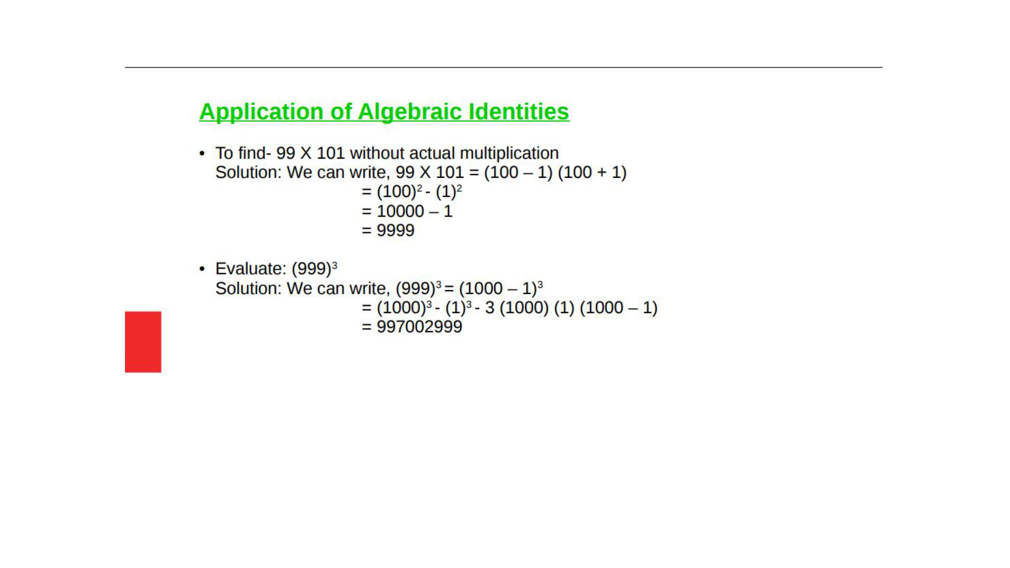

Slide 17

Evaluation:-
1. Factorize: 8$x^{3}$+27y³+36x²y+54xy².

Slide 18
Homework:-
Exercise - 2.5
QUESTION NUMBER-8 to 16

Slide 19
AHA:-
1.a+b+c=6, ab+bc+ca=11,
Find a³+b³+c³–3abc.
2.x+1/x=3, Find x²+1/x².

Slide 20
THANKING YOU
ODM EDUCATIONAL GROUP

