Slide 1


MODEL LESSON
MATHEMATICS
CHAPTER NUMBER :~ 2
CHAPTER NAME :~ POLYNOMIALS
SUB TOPIC :~ ALGEBRAIC IDENTITIES

Slide 2

PREVIOUS KNOWLEDGE TEST
Without actual division , prove that $2x^{4}−5x^{3}+2x^{2}−x+2$ is actually divisible by $x^{2}−3x+2.$

Slide 3
LEARNING OUTCOME:-
Students will learn
a)algebraic identities.

Slide 4
Question 4. Factorise (i) 12x² – 7x +1 (ii) 2x² + 7x + 3 (iii) 6x² + 5x – 6 (iv) 3x² – x – 4 Solution:
(i) We have, 12x² – 7x + 1 = 12x² – 4x- 3x + 1 = 4x (3x – 1 ) -1 (3x – 1) = (3x -1) (4x -1) Thus, 12x² -7x + 3 = (2x – 1) (x + 3)
(ii) We have, 2x² + 7x + 3 = 2x² + x + 6x + 3 = x(2x + 1) + 3(2x + 1) = (2x + 1)(x + 3) Thus, 2×2 + 7x + 3 = (2x + 1)(x + 3)

Slide 5
(iii) We have, 6x² + 5x – 6 = 6x² + 9x – 4x – 6 = 3x(2x + 3) – 2(2x + 3) = (2x + 3)(3x – 2) Thus, 6x² + 5x – 6 = (2x + 3)(3x – 2)
(iv) We have, 3x² – x – 4 = 3x² – 4x + 3x – 4 = x(3x – 4) + 1(3x – 4) = (3x – 4)(x + 1) Thus, 3x² – x – 4 = (3x – 4)(x + 1)

Slide 6
Question 5.
Factorise (i) x³ – 2x² – x + 2 (ii) x³ – 3x² – 9x – 5 (iii) x³ + 13x² + 32x + 20 (iv) 2y³ + y² – 2y – 1
Solution:
(i) We have, x³ – 2x² – x + 2 Rearranging the terms, we have x³ – x – 2x² + 2 = x(x² – 1) – 2(x² -1) = (x² – 1)(x – 2) = [(x)² – (1)²](x – 2) = (x – 1)(x + 1)(x – 2) [∵ (a² – b²) = (a + b)(a-b)] Thus, x³ – 2x² – x + 2 = (x – 1)(x + 1)(x – 2)

Slide 7
(ii) We have, x³ – 3x² – 9x – 5 = x³ + x² – 4x² – 4x – 5x – 5 , = x² (x + 1) – 4x(x + 1) – 5(x + 1) = (x + 1)(x² – 4x – 5) = (x + 1)(x² – 5x + x – 5) = (x + 1)[x(x – 5) + 1(x – 5)] = (x + 1)(x – 5)(x + 1) Thus, x³ – 3x² – 9x – 5 = (x + 1)(x – 5)(x +1)

Slide 8
(iii) We have, x³ + 13x² + 32x + 20 = x³ + x² + 12x² + 12x + 20x + 20 = x²(x + 1) + 12x(x +1) + 20(x + 1) = (x + 1)(x² + 12x + 20) = (x + 1)(x² + 2x + 10x + 20) = (x + 1)[x(x + 2) + 10(x + 2)] = (x + 1)(x + 2)(x + 10) Thus, x³ + 13x² + 32x + 20 = (x + 1)(x + 2)(x + 10)

Slide 9
(iv) We have, 2y³ + y² – 2y – 1 = 2y³ – 2y² + 3y² – 3y + y – 1 = 2y²(y – 1) + 3y(y – 1) + 1(y – 1) = (y – 1)(2y² + 3y + 1) = (y – 1)(2y² + 2y + y + 1) = (y – 1)[2y(y + 1) + 1(y + 1)] = (y – 1)(y + 1)(2y + 1) Thus, 2y³ + y² – 2y – 1 = (y – 1)(y + 1)(2y +1)

Slide 10
https://www.youtube.com/watch?v=_IUCfKBHAl0
“As great a genius as Archimedes could not invent analytical geometry, for the algebraic knowledge necessary for such as achievement was not available in his time…”
-Nathan A. Court…

Slide 11
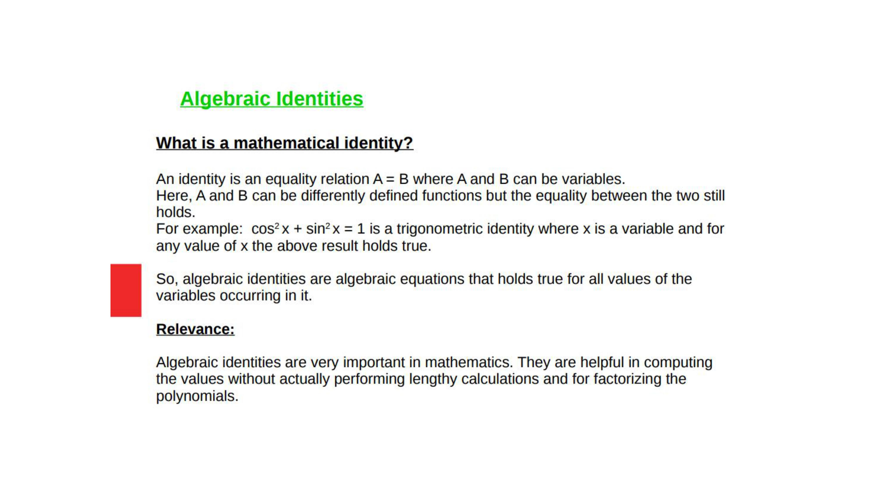

Slide 12
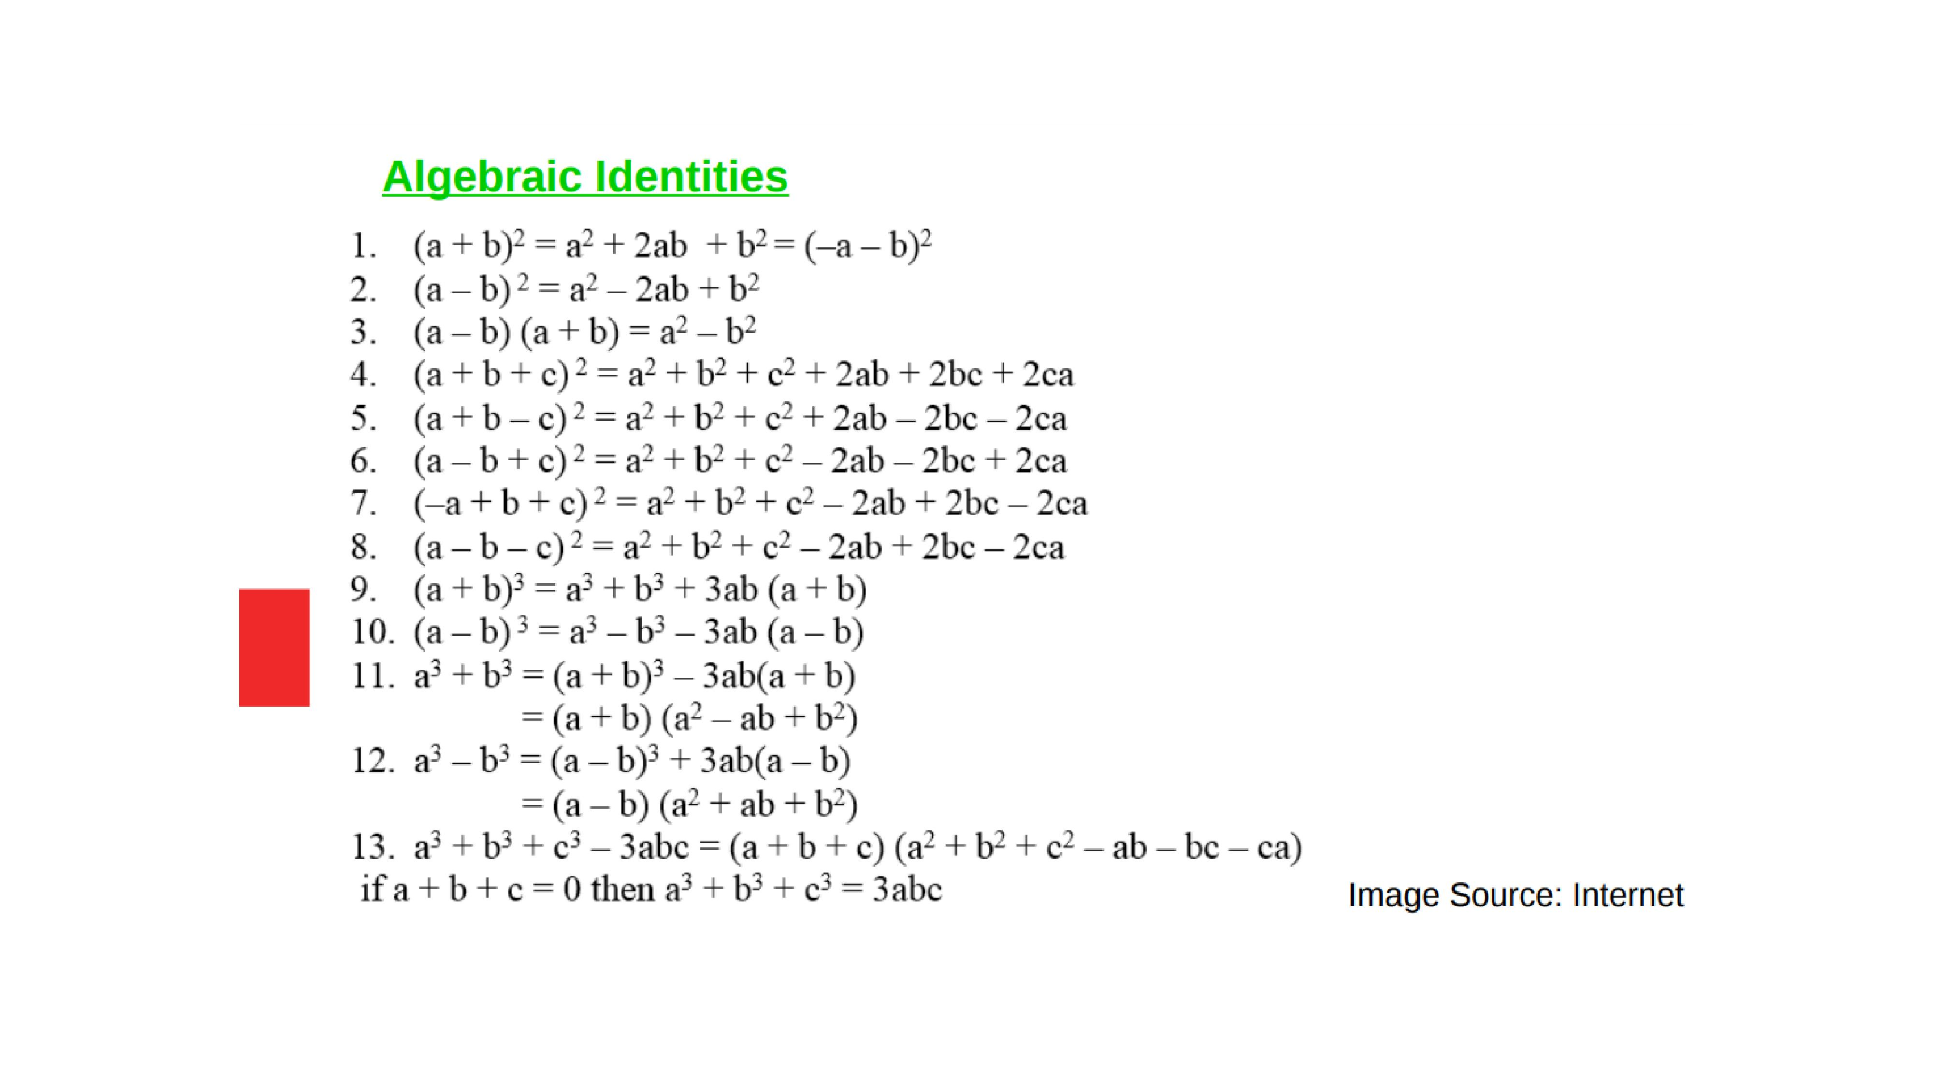




Slide 13
Evaluation:-
1. Write in expanded form(3a+4b)³.
2. Evaluate:-(999)³.

Slide 14
Homework:-
Exercise - 2.5
QUESTION NUMBER-1 to 7

Slide 15

AHA:-
1.x+y=12, xy=27 find $x^{3}+y^{3}.$
2. $x^{4}+\frac{1}{x^{4}}=47,$ find $x^{3}+\frac{1}{x^{3}}.$

Slide 16
THANKING YOU
ODM EDUCATIONAL GROUP

