Slide 1


MODEL LESSON
MATHEMATICS
CHAPTER NUMBER :~ 2
CHAPTER NAME :~ POLYNOMIALS
SUB TOPIC :~ FACTOR THEOREM AND REMAINDER THEOREM

Slide 2

PREVIOUS KNOWLEDGE TEST
Factorize $6x^{2}+17x+5$ by splitting the middle term and by using factor theorem.

Slide 3
LEARNING OUTCOME:-
Students will learn
a) factor theorem and remainder theorem.

Slide 4
EXERCISE-2.4
Question 1. Determine which of the following polynomials has (x +1) a factor.
(i) x³+x²+x +1 (ii) x⁴ + x³ + x² + x + 1 (iii) x⁴ + 3x³ + 3x² + x + 1 (iv) x³ – x² – (2 +√2 )x + √2
Solution:
The zero of x + 1 is -1. (i) Let p (x) = x³ + x² + x + 1 ∴ p (-1) = (-1)³ + (-1)² + (-1) + 1 . = -1 + 1 – 1 + 1 ⇒ p (- 1) = 0 So, (x+ 1) is a factor of x³ + x² + x + 1.

Slide 5
(ii) Let p (x) = x⁴ + x³ + x² + x + 1 ∴ P(-1) = (-1)⁴ + (-1)³ + (-1)² + (-1)+1 = 1 – 1 + 1 – 1 + 1 ⇒ P (-1) ≠ 1 So, (x + 1) is not a factor of x⁴ + x³ + x² + x+ 1.
(iii) Let p (x) = x⁴ + 3x³ + 3x² + x + 1 . ∴ p (-1)= (-1)⁴ + 3 (-1)³ + 3 (-1)² + (- 1) + 1 = 1 – 3 + 3 – 1 + 1 = 1 ⇒ p (-1) ≠ 0 So, (x + 1) is not a factor of x⁴ + 3x³ + 3x² + x+ 1.
(iv) Let p (x) = x³ – x² – (2 + √2) x + √2 ∴ p (- 1) =(- 1)3- (-1)2 – (2 + √2)(-1) + √2 = -1 – 1 + 2 + √2 + √2 = 2√2 ⇒ p (-1) ≠ 0 So, (x + 1) is not a factor of x³ – x² – (2 + √2) x + √2.

Slide 6
Question 2. Use the Factor Theorem to determine whether g (x) is a factor of p (x) in each of the following cases (i) p (x)= 2x³ + x² – 2x – 1, g (x) = x + 1 (ii) p(x)= x³ + 3x² + 3x + 1, g (x) = x + 2 (iii) p (x) = x³ – 4x² + x + 6, g (x) = x – 3
Solution:
(i) We have, p (x)= 2x³ + x² – 2x – 1 and g (x) = x + 1 ∴ p(-1) = 2(-1)³ + (-1)² – 2(-1) – 1 = 2(-1) + 1 + 2 – 1 = -2 + 1 + 2 -1 = 0 ⇒ p(-1) = 0, so g(x) is a factor of p(x).

Slide 7
(ii) We have, p(x) x³ + 3x² + 3x + 1 and g(x) = x + 2 ∴ p(-2) = (-2)³ + 3(-2)²+ 3(-2) + 1 = -8 + 12 – 6 + 1 = -14 + 13 = -1 ⇒ p(-2) ≠ 0, so g(x) is not a factor of p(x).
(iii) We have, = x³ – 4x² + x + 6 and g (x) = x – 3 ∴ p(3) = (3)³ – 4(3)² + 3 + 6 = 27 – 4(9) + 3 + 6 = 27 – 36 + 3 + 6 = 0 ⇒ p(3) = 0, so g(x) is a factor of p(x).

Slide 8
Question 3.
Find the value of k, if x – 1 is a factor of p (x) in each of the following cases
(i) p (x) = x² + x + k
(ii) p (x) = 2x² + kx + √2
(iii) p (x) = kx² – √2 x + 1
(iv) p (x) = kx² – 3x + k
Solution:
For (x – 1) to be a factor of p(x), p(1) should be equal to 0.
(i) Here, p(x) = x² + x + k Since, p(1) = (1)² +1 + k ⇒ p(1) = k + 2 = 0 ⇒ k = -2.

Slide 9
(ii) Here, p (x) = 2x² + kx + √2 Since, p(1) = 2(1)² + k(1) + √2 = 2 + k + √2 =0 k = -2 – √2 = -(2 + √2)
(iii) Here, p (x) = kx² – √2 x + 1 Since, p(1) = k(1)² – (1) + 1 = k – √2 + 1 = 0 ⇒ k = √2 -1
(iv) Here, p(x) = kx² – 3x + k p(1) = k(1)² – 3(1) + k = k – 3 + k = 2k – 3 = 0 ⇒ k = 34

Slide 10
https://www.youtube.com/watch?v=M0YifLWM-4M
“As great a genius as Archimedes could not invent analytical geometry, for the algebraic knowledge necessary for such as achievement was not available in his time…”
-Nathan A. Court…

Slide 11
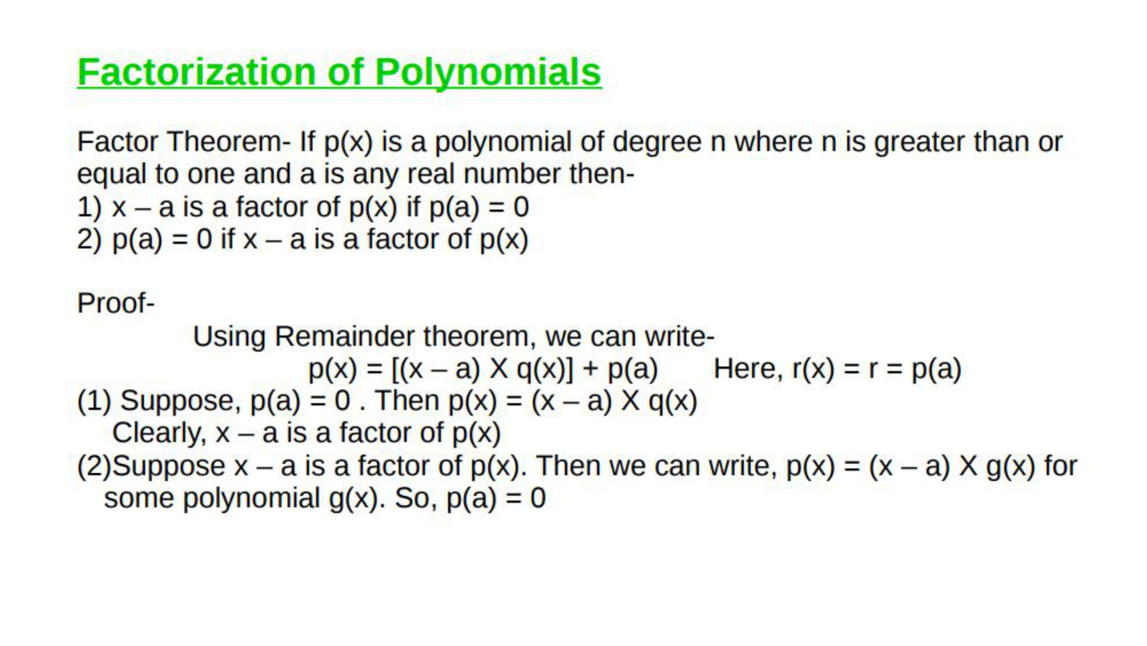

Slide 12
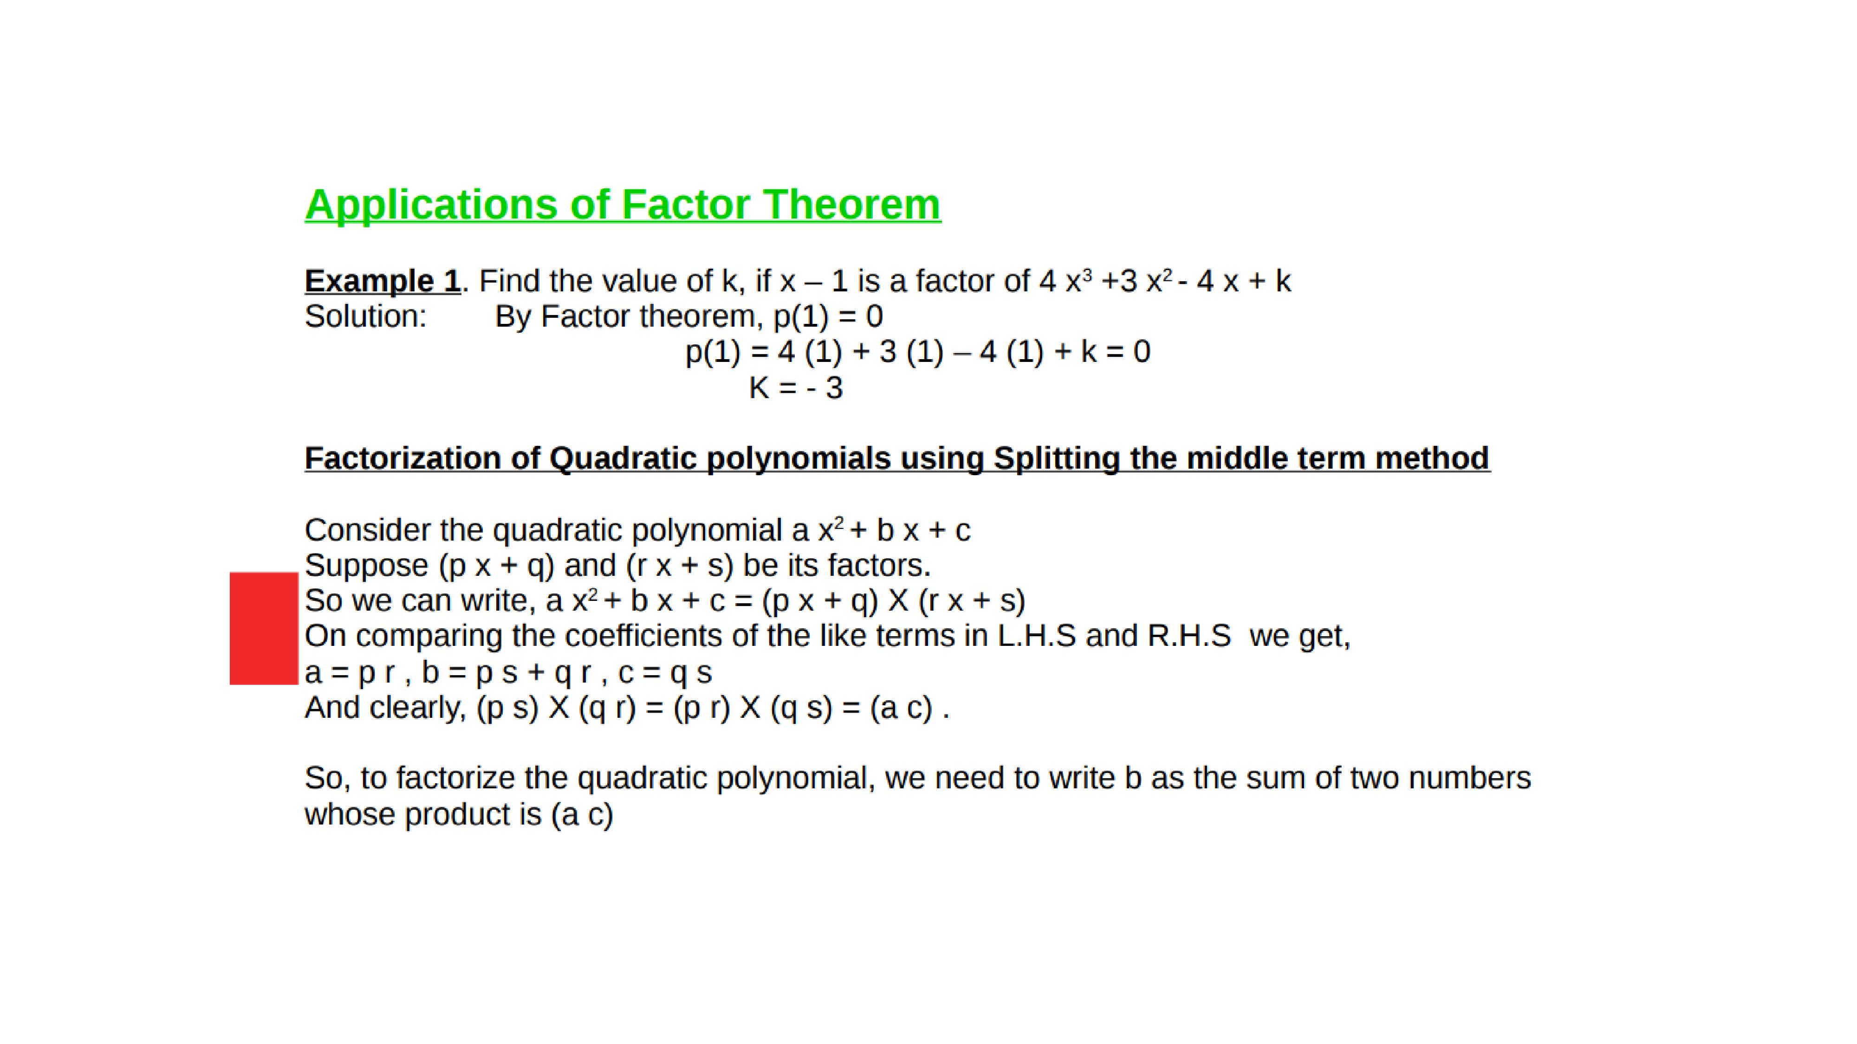

Slide 13
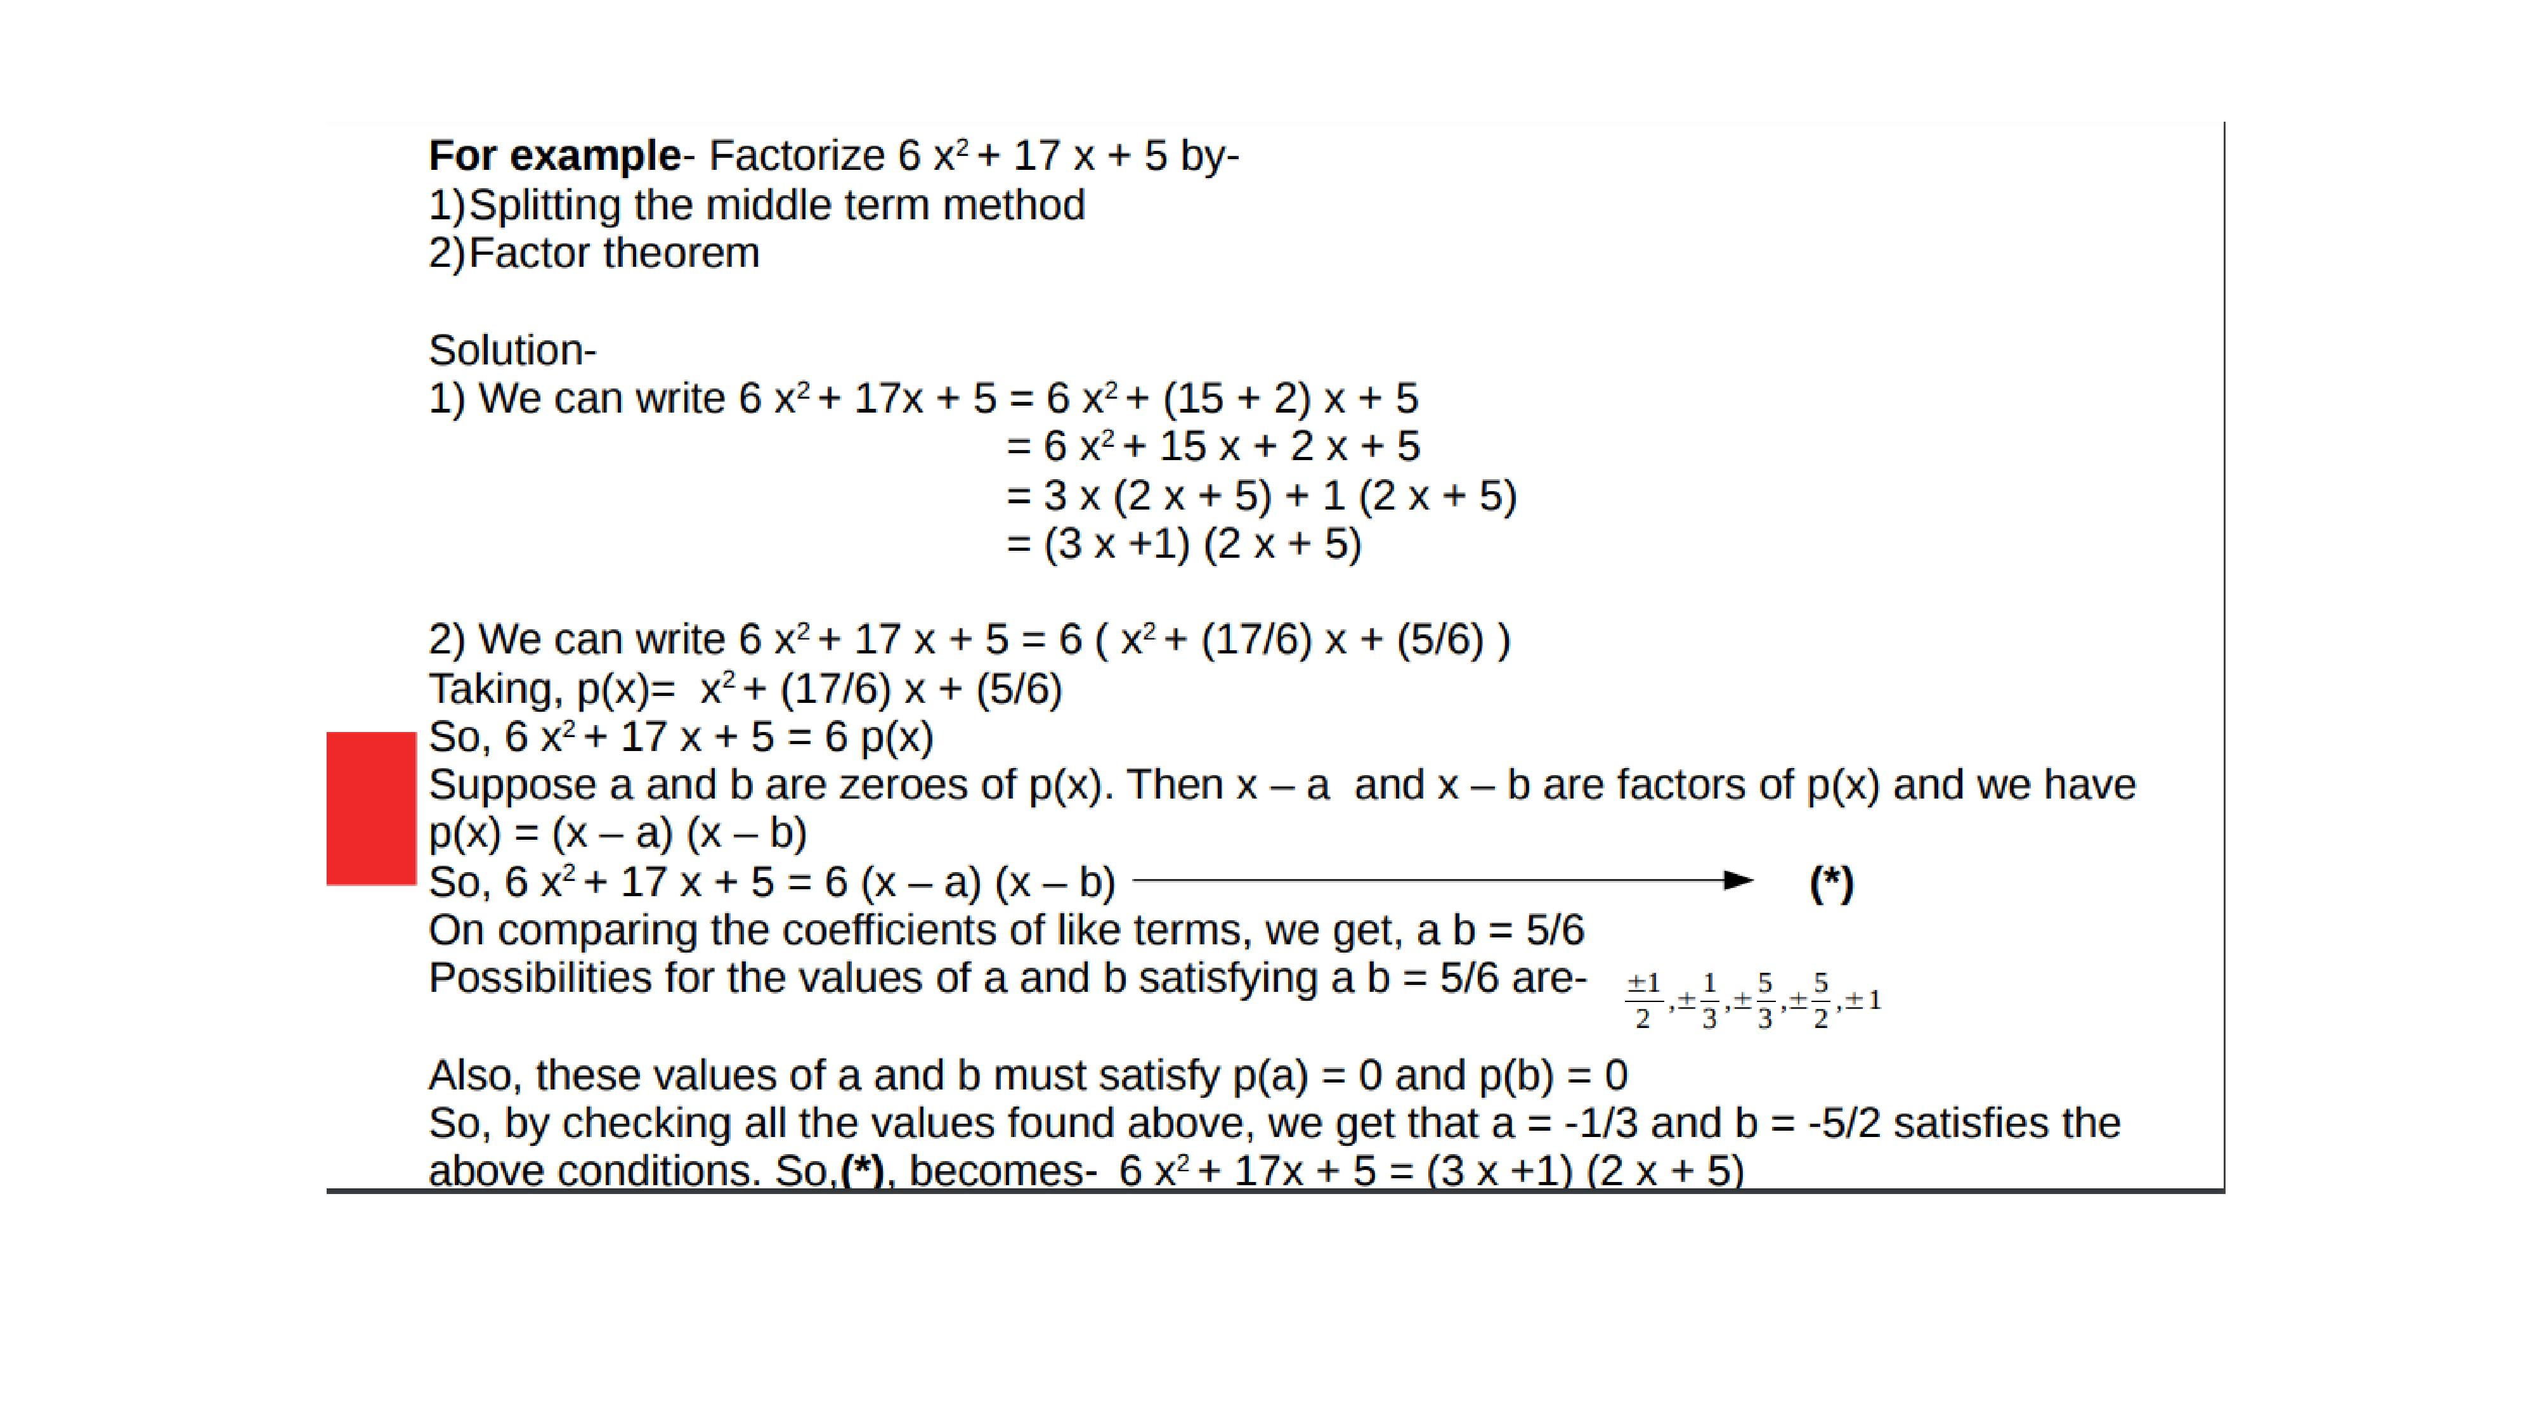

Slide 14
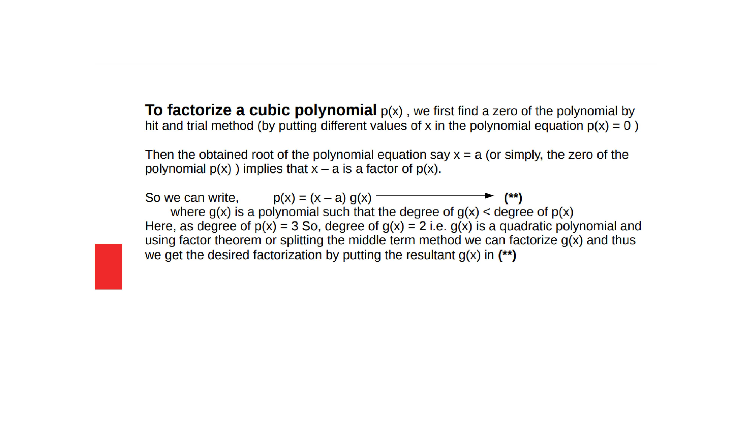

Slide 15

Evaluation:-
1. $Factorize:− y^{2}−5y+6$.
2. Factorize:- $2x^{2}+7x+3.$

Slide 16
Homework:-
Exercise - 2.4
QUESTION NUMBER-4,5

Slide 17

AHA:-
1. If $x^{2}−1 is a factor of ax^{4}+bx^{3}+cx^{2}+dx+c$
Show that a+c+e = b+d =0.
2. Without actual division , prove that $2x^{4}−5x^{3}+2x^{2}−x+2$ is actually divisible by $x^{2}−3x+2.$

Slide 18
THANKING YOU
ODM EDUCATIONAL GROUP

