Slide 1


MODEL LESSON
MATHEMATICS
CHAPTER NUMBER :~ 2
CHAPTER NAME :~ POLYNOMIALS
SUB TOPIC :~ FACTOR THEOREM

Slide 2

PREVIOUS KNOWLEDGE TEST
a) Find the remainder when $x^{4}+x^{3}−2x^{2}+x+1$is divided by x-1

Slide 3
LEARNING OUTCOME:-
Students will learn
a) factor theorem.

Slide 4
Question 2.
Find the remainder when x³ – ax² + 6x – a is divided by x – a.
Solution:
We have, p(x) = x³ – ax² + 6x – a and zero of x – a is a.
∴ p(a) = (a)³ – a(a)² + 6(a) – a
= a³ – a³ + 6a – a = 5a
Thus, the required remainder is 5a.

Slide 5
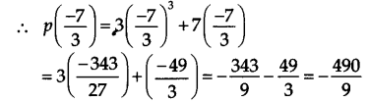
Question 3.
Check whether 7 + 3x is a factor of 3x3+7x.
Solution:
We have, p(x) = 3x3+7x. and zero of 7 + 3x is −73.
Since,( −4909) ≠ 0
i.e. the remainder is not 0.
∴ 3x3 + 7x is not divisib1e by 7 + 3x.
Thus, 7 + 3x is not a factor of 3x3 + 7x.

Slide 6
https://www.youtube.com/watch?v=4YXE7HDyInM
“As great a genius as Archimedes could not invent analytical geometry, for the algebraic knowledge necessary for such as achievement was not available in his time…”
-Nathan A. Court…

Slide 7
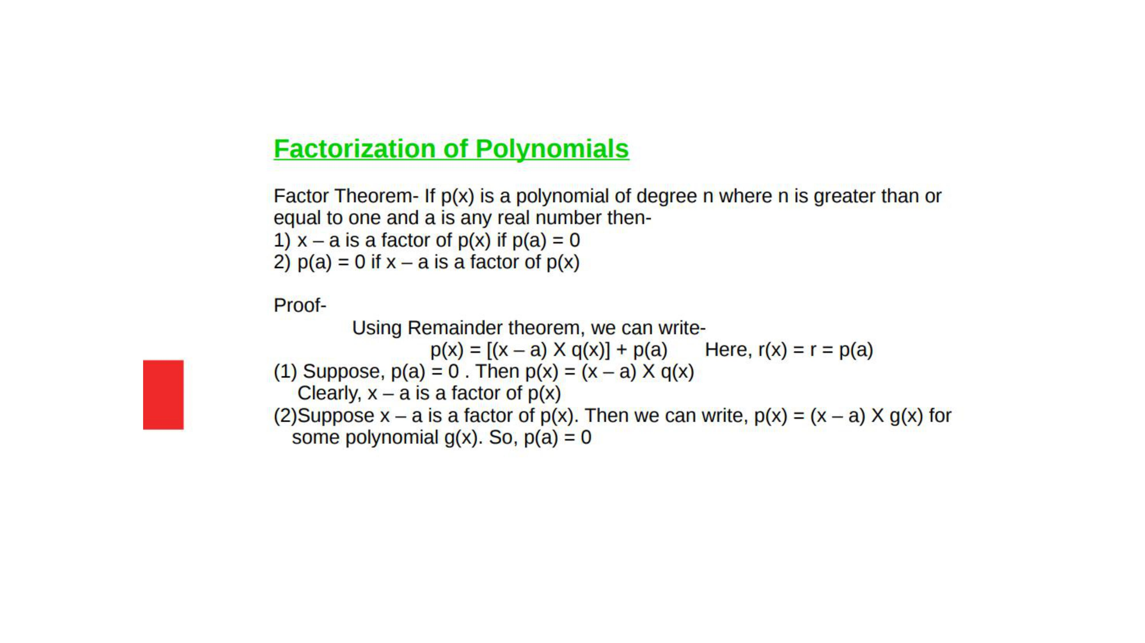

Slide 8
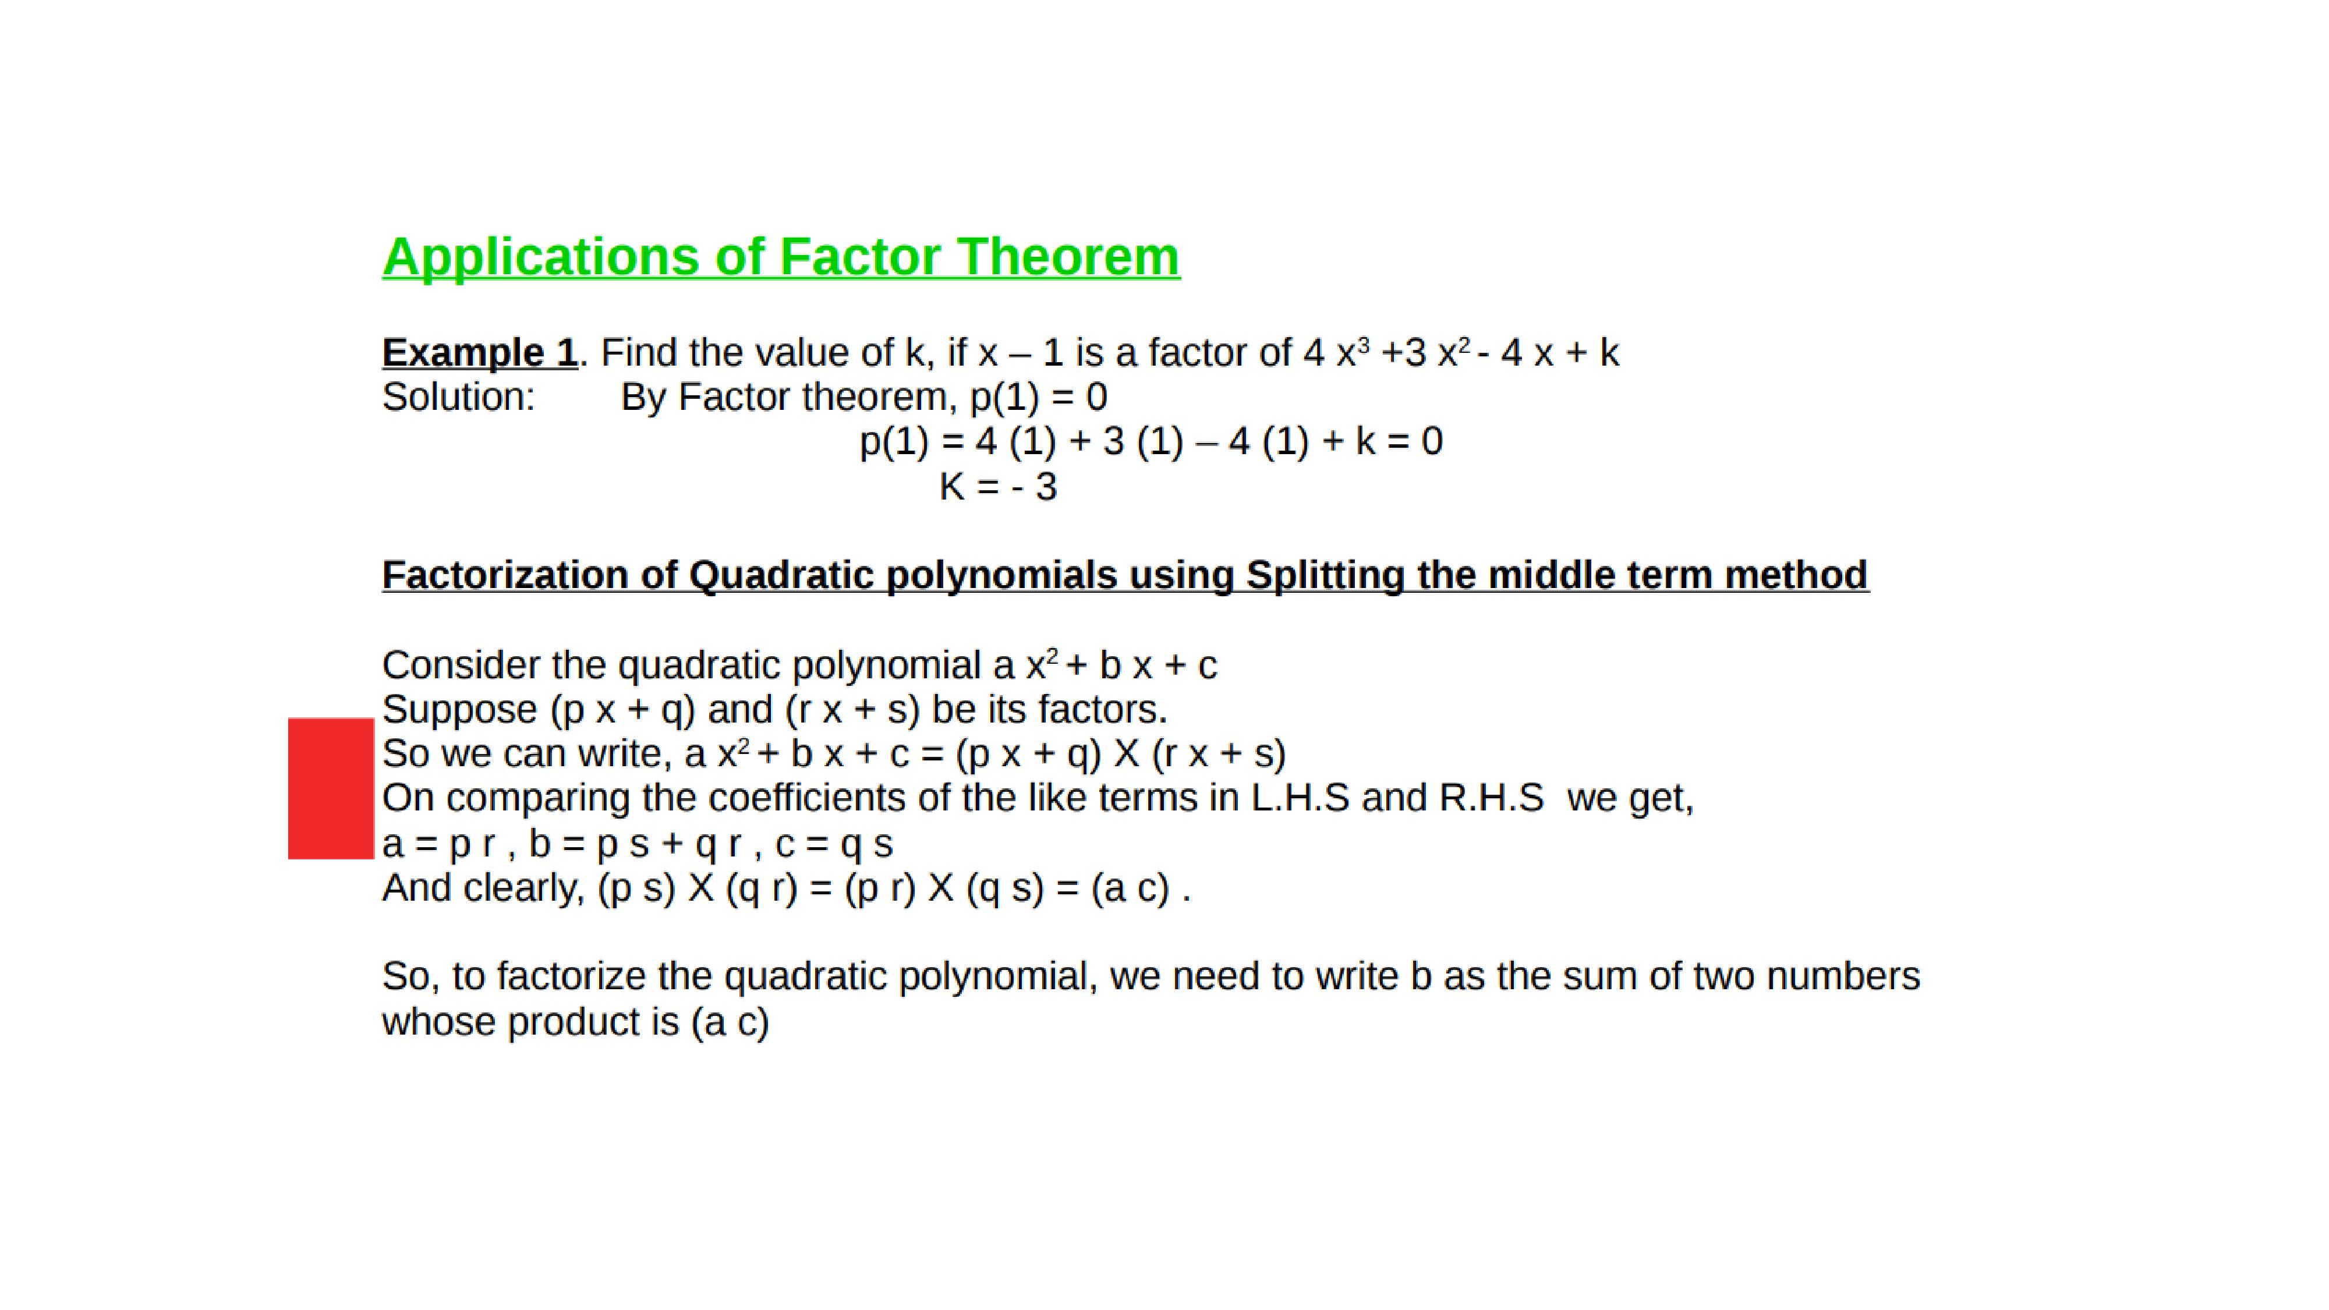

Slide 9
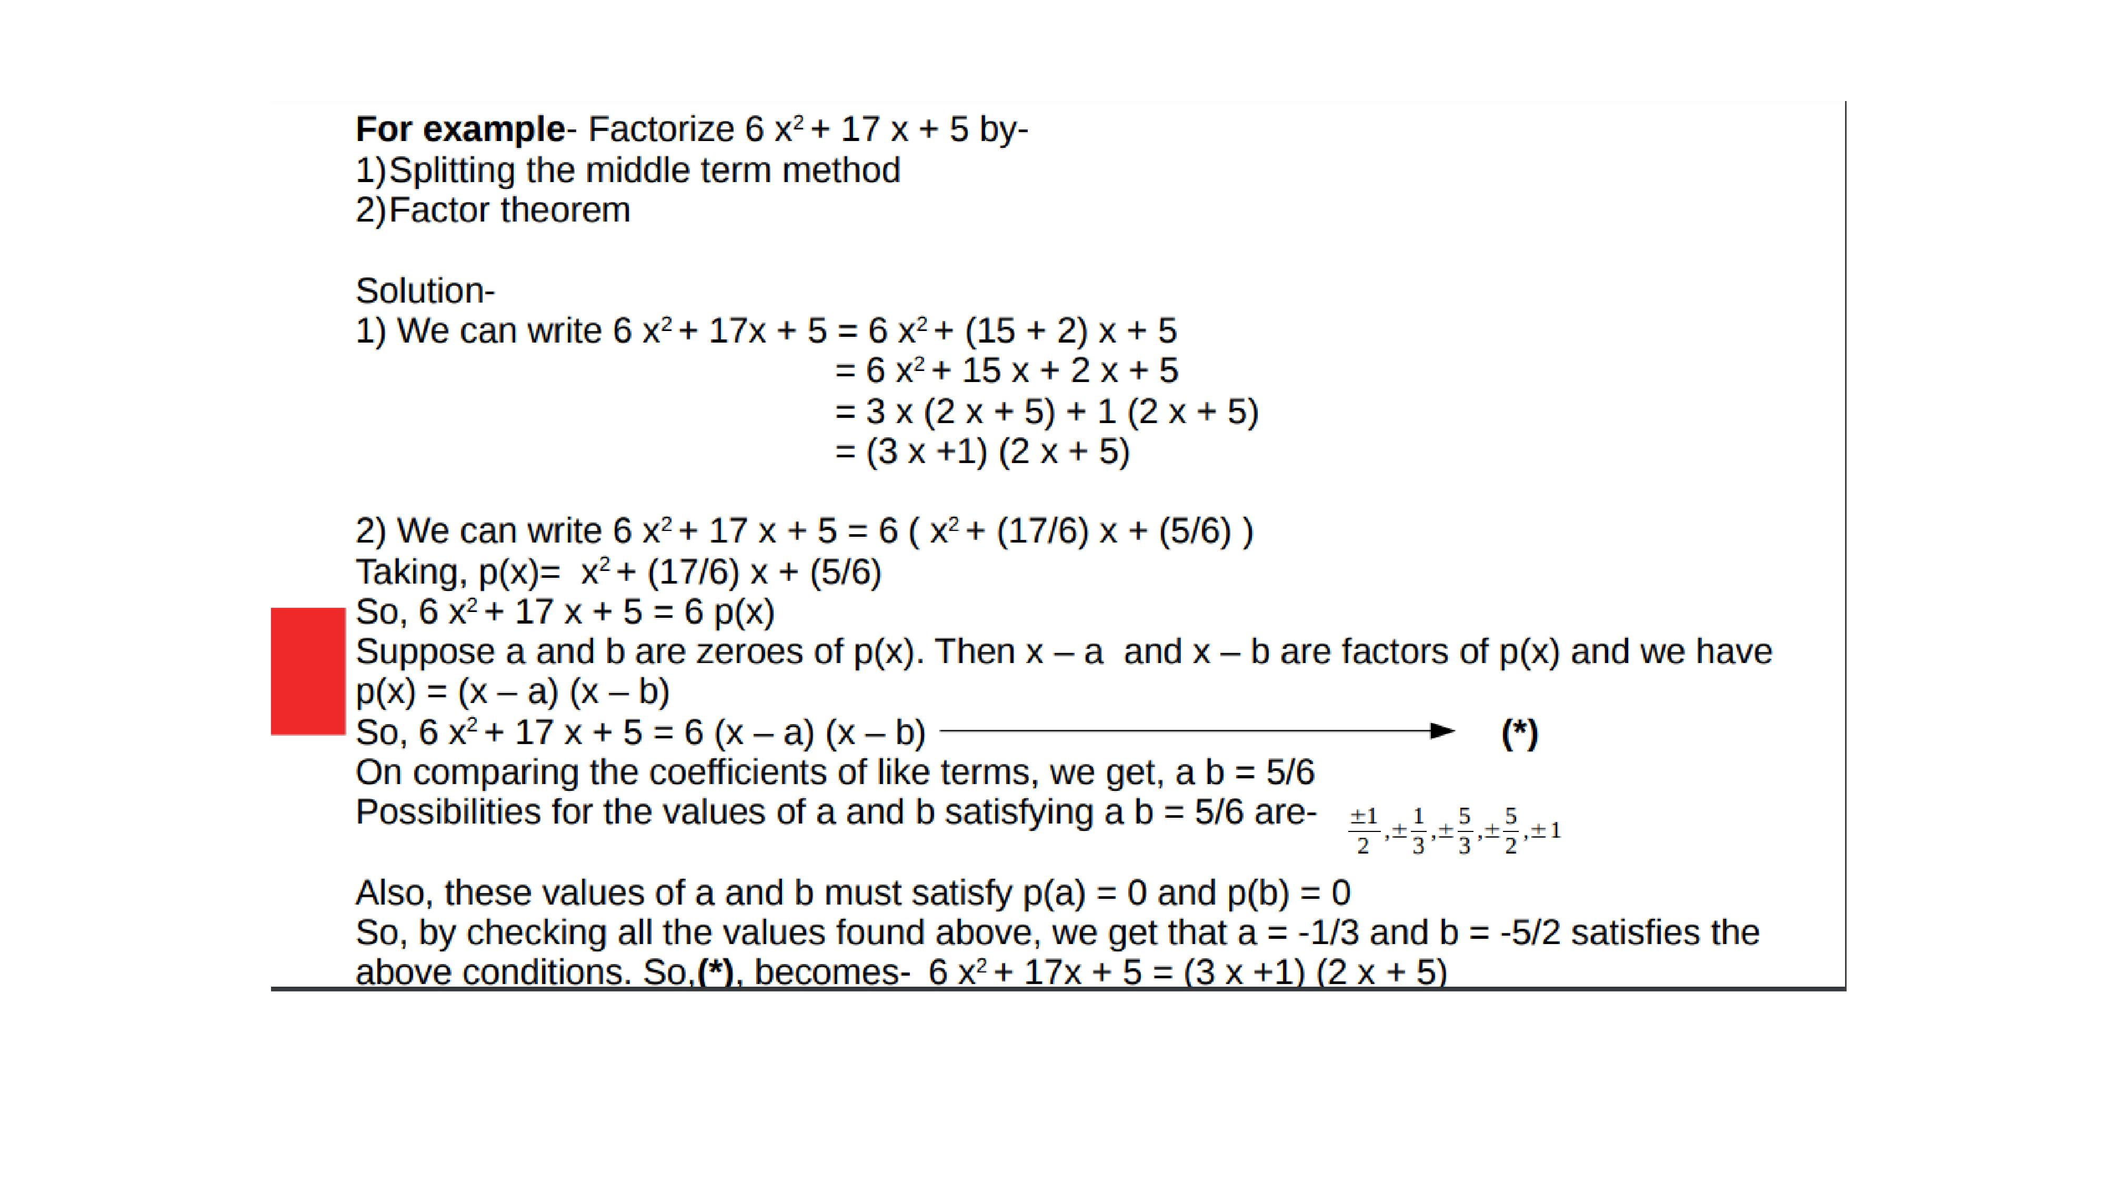

Slide 10
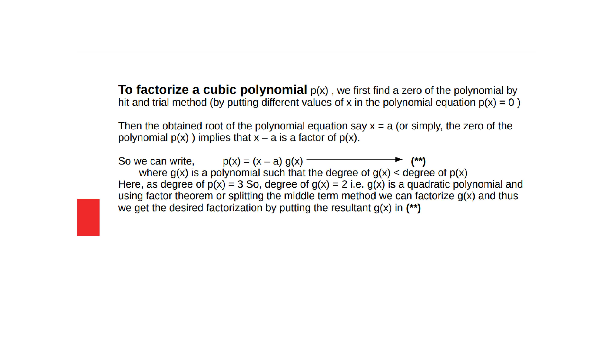

Slide 11

Evaluation:-
1. Find the value of ‘k’ if x-1is a factor of ${4x}^{3}+3x^{2}−4x−k$.
2. Factorize $6x^{2}+17x+5$ by splitting the middle term and by using factor theorem.

Slide 12
Homework:-Exercise - 2.4
QUESTION NUMBER-1,2,3

Slide 13
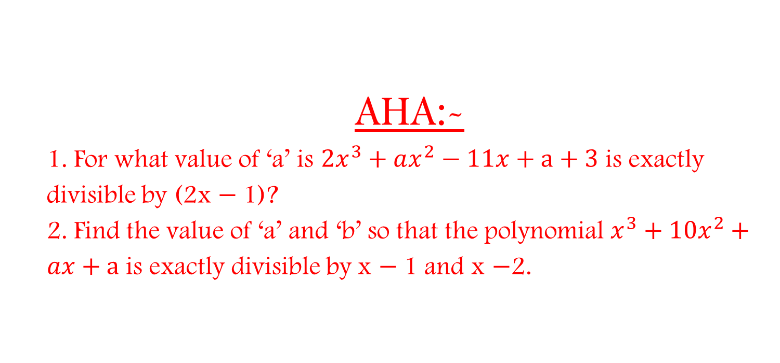
AHA:-
1. For what value of ‘a’ is ${2x}^{3}+ax^{2}−11x+a+3$ is exactly divisible by (2x $−$1)?
2. Find the value of ‘a’ and ‘b’ so that the polynomial $x^{3}+10x^{2}+ax+a$ is exactly divisible by x $−$1 and x $−$2.

Slide 14
THANKING YOU
ODM EDUCATIONAL GROUP

