Slide 1


MODEL LESSON
MATHEMATICS
CHAPTER NUMBER :~ 2
CHAPTER NAME :~ POLYNOMIALS
SUB TOPIC :~ REMAINDER THEOREM

Slide 2

PREVIOUS knowledge Test
Divide: $3x^{4}−4x^{3}−3x−1 by x−1$

Slide 3
LEARNING OUTCOME:-
Students will learn
a) Remainder theorem.

Slide 4
Exercise-2.3
Question 1. Find the remainder when x³ + 3x² + 3x + 1 is divided by
(i) x + 1
(iii) x
Solution: Let p(x) = x³ + 3x² + 3x +1 (i) The zero of x + 1 is -1. ∴ p(-1) = (-1)3 + 3(-1)2 + 3(-1) +1 = -1 + 3- 3 + 1 = 0 Thus, the required remainder = 0
(iii) The zero of x is 0. ∴ p(0) = (0)³ + 3(0)² + 3(0) + 1 = 0 + 0 + 0 + 1 = 1 Thus, the required remainder = 1.

Slide 5
(iv) x + π
The zero of x + π is -π.
p(-π) = (-π)3 + 3(- π)22 + 3(- π) +1
= -π3 + 3π2 + (-3π) + 1
= – π3 + 3π2 – 3π +1
Thus, the required remainder is -π3 + 3π2 – 3π+1.

Slide 6
https://www.youtube.com/watch?v=F6onUHbWCus
“As great a genius as Archimedes could not invent analytical geometry, for the algebraic knowledge necessary for such as achievement was not available in his time…”
-Nathan A. Court…

Slide 7
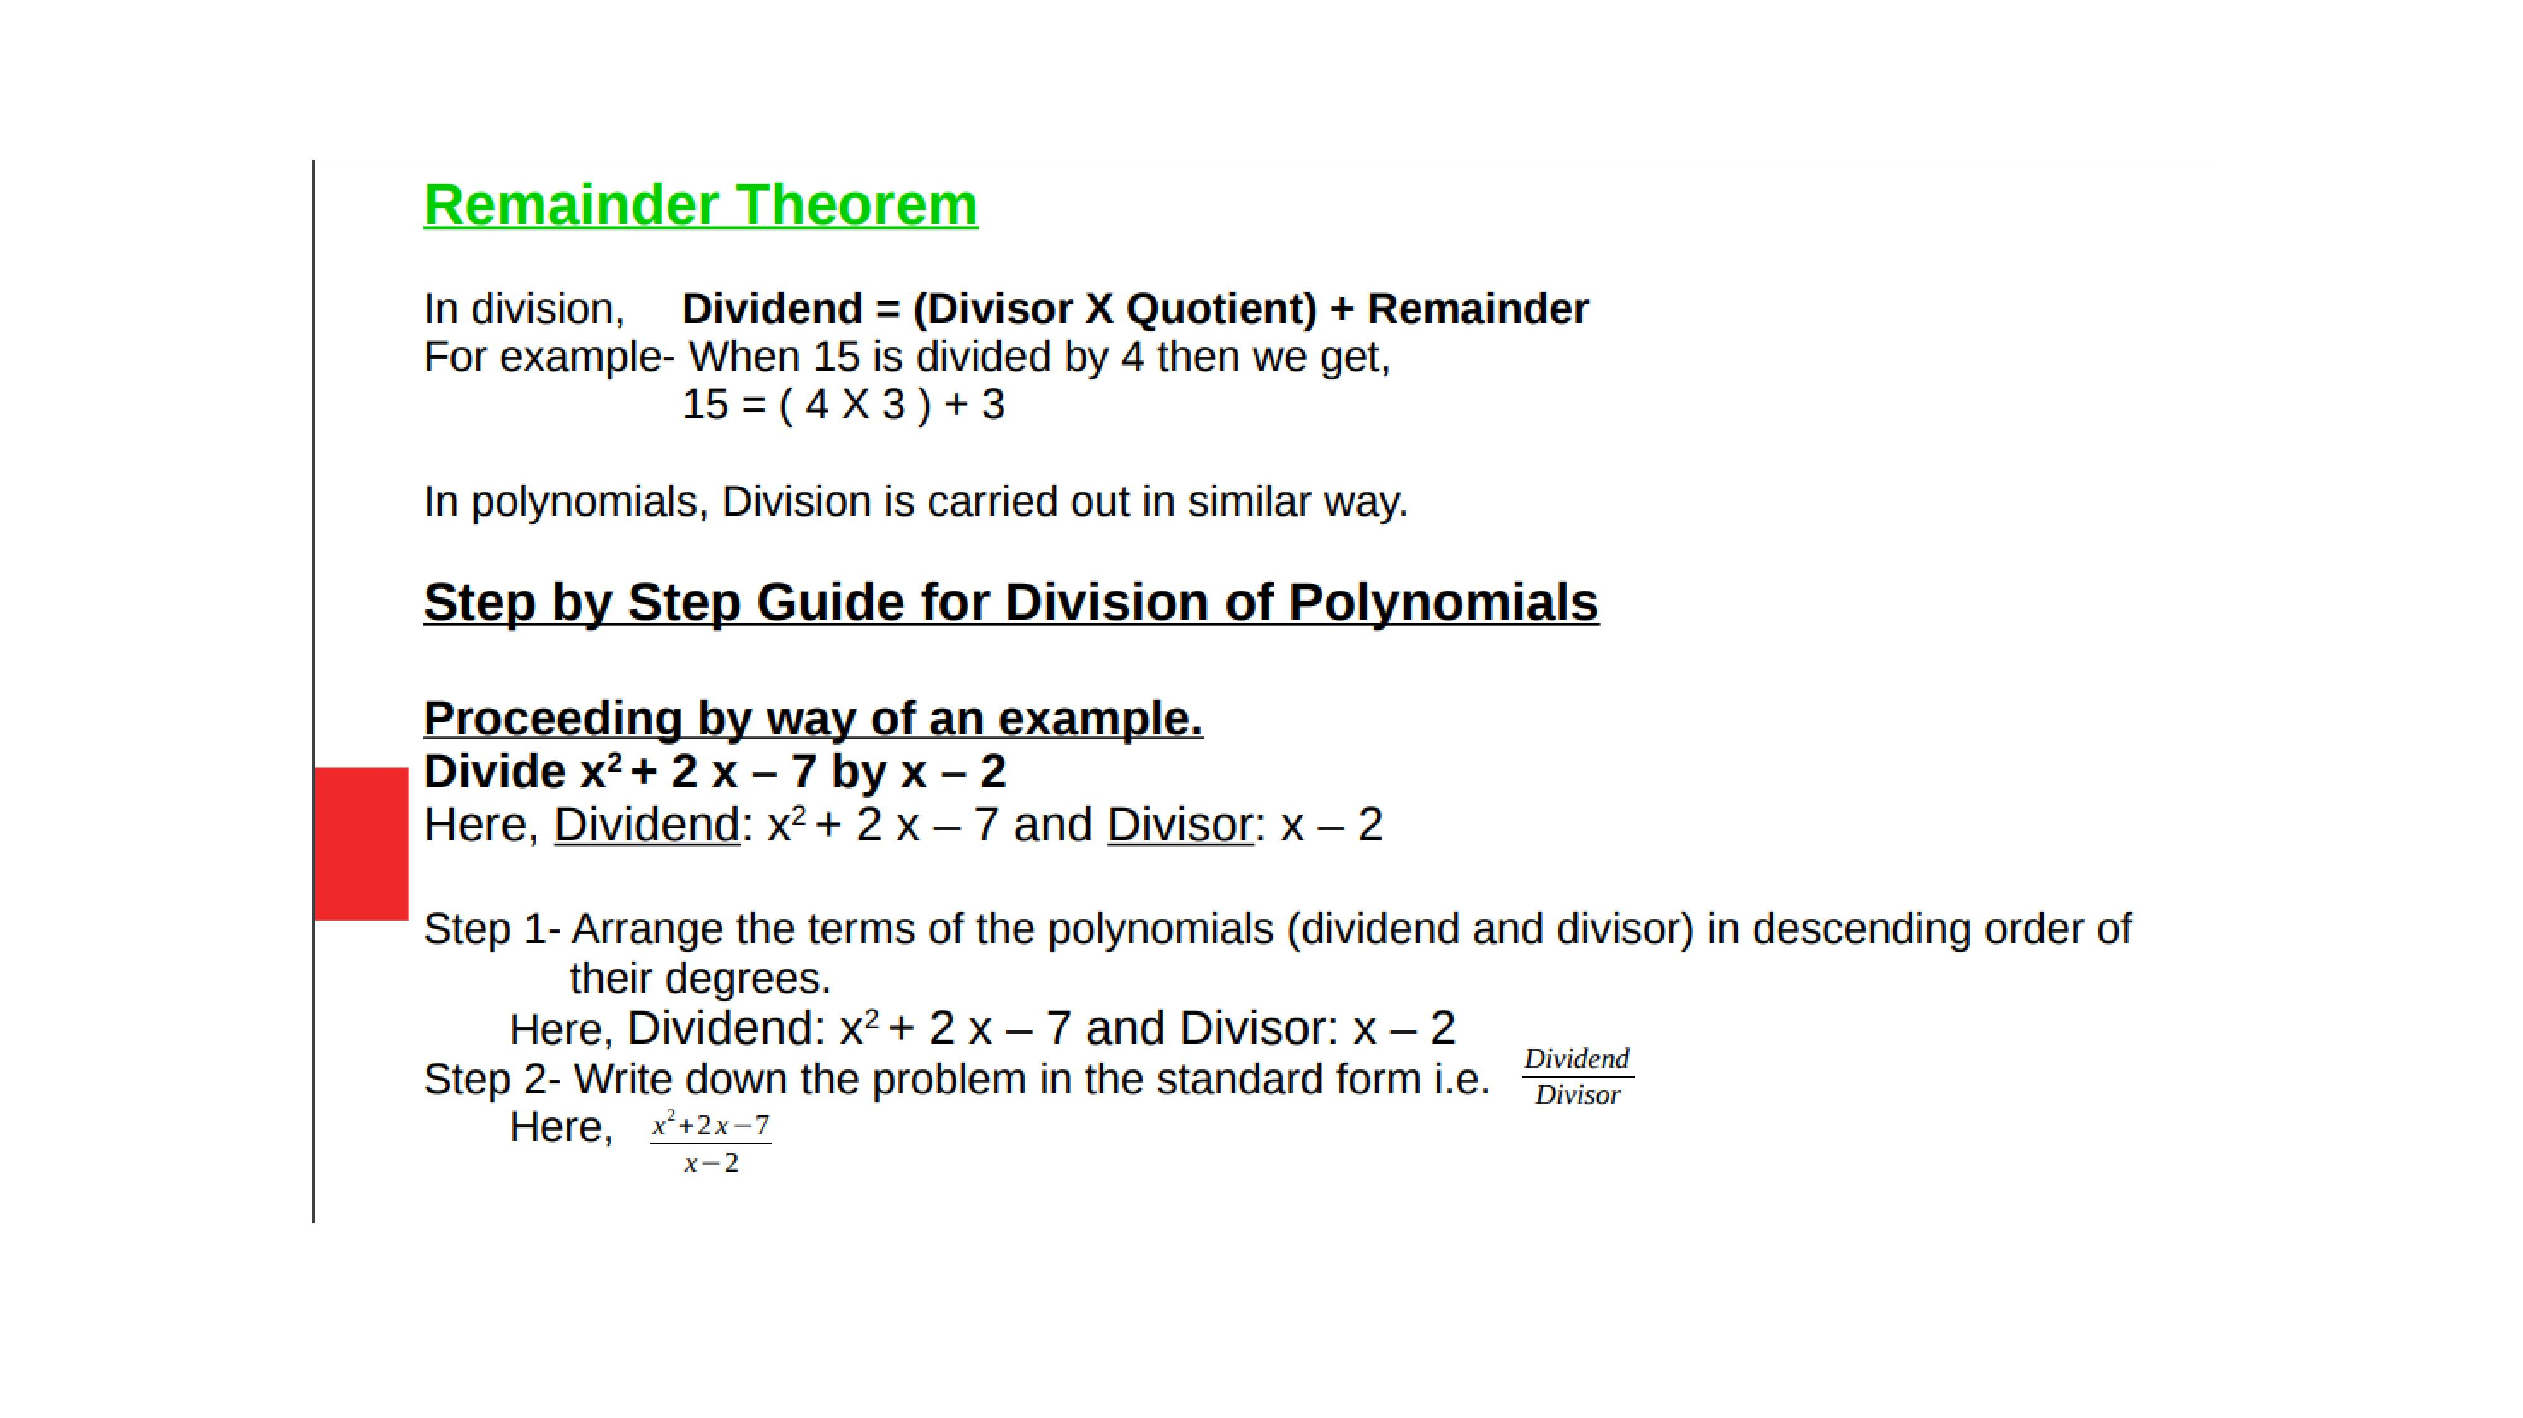

Slide 8
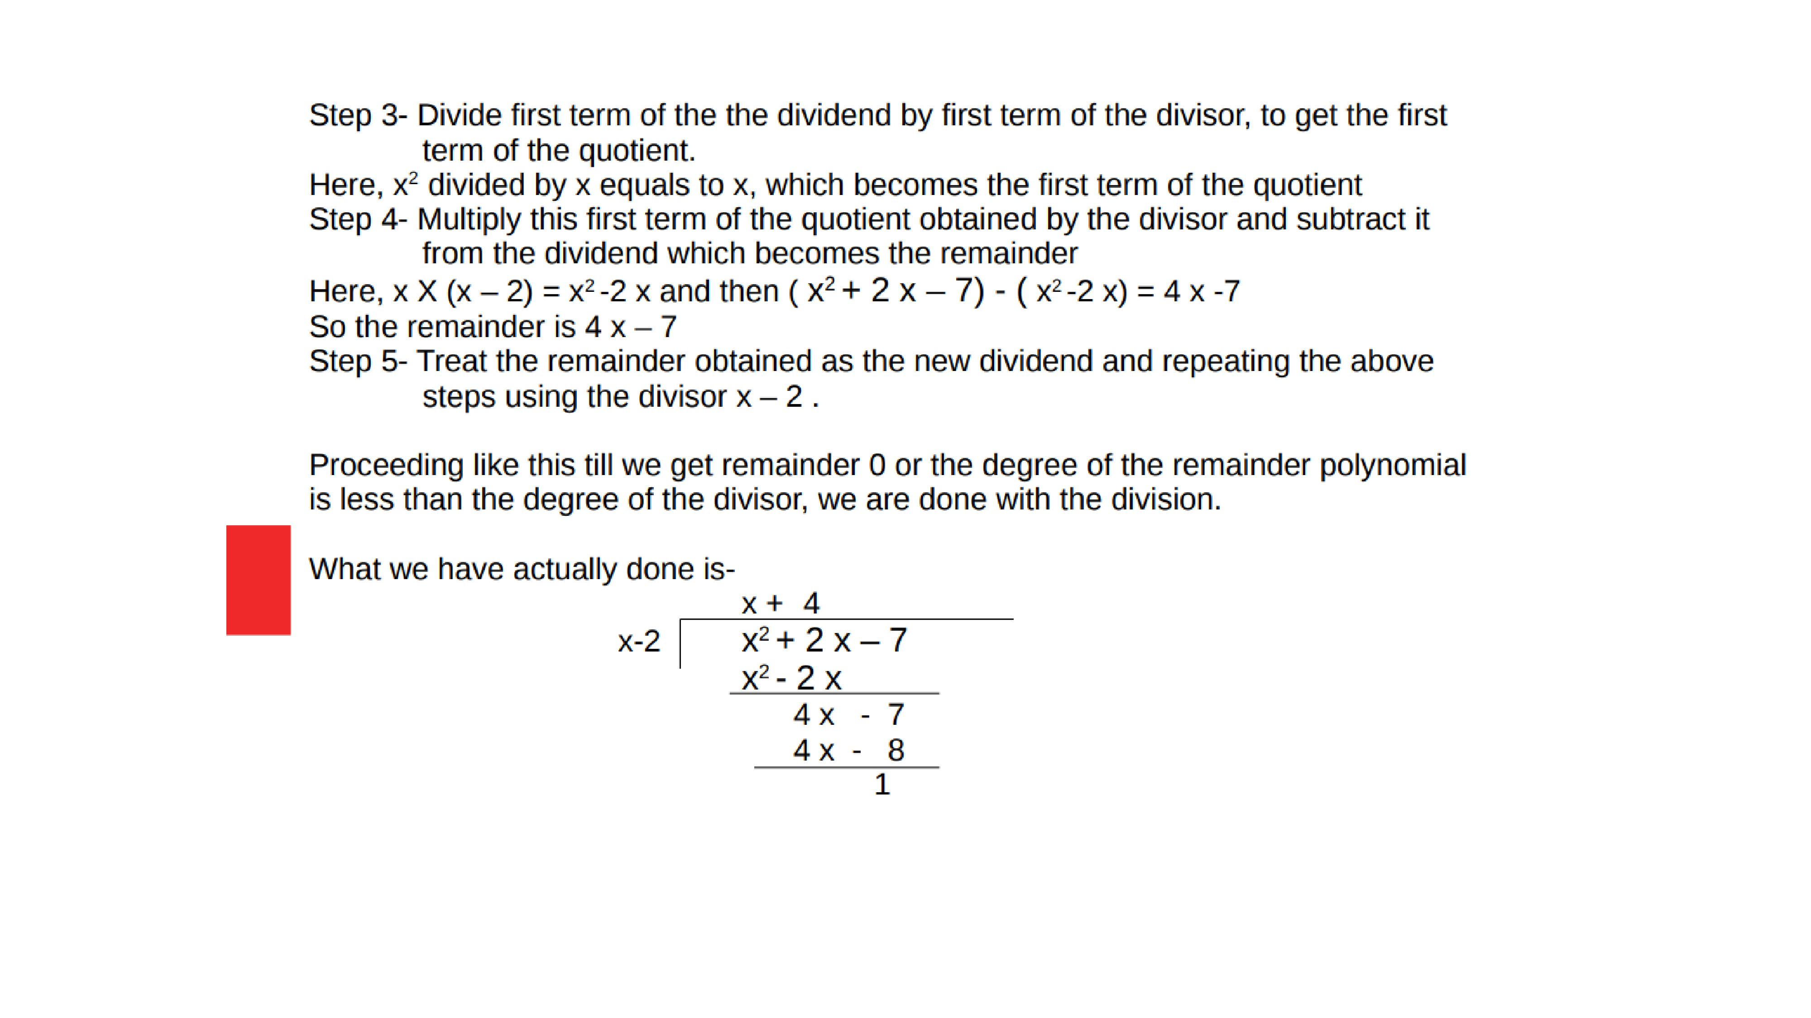

Slide 9
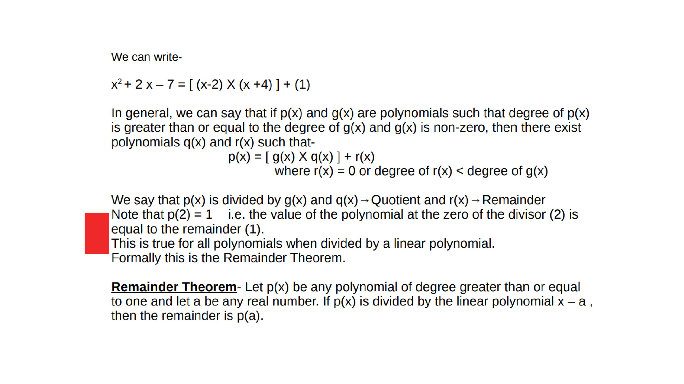

Slide 10
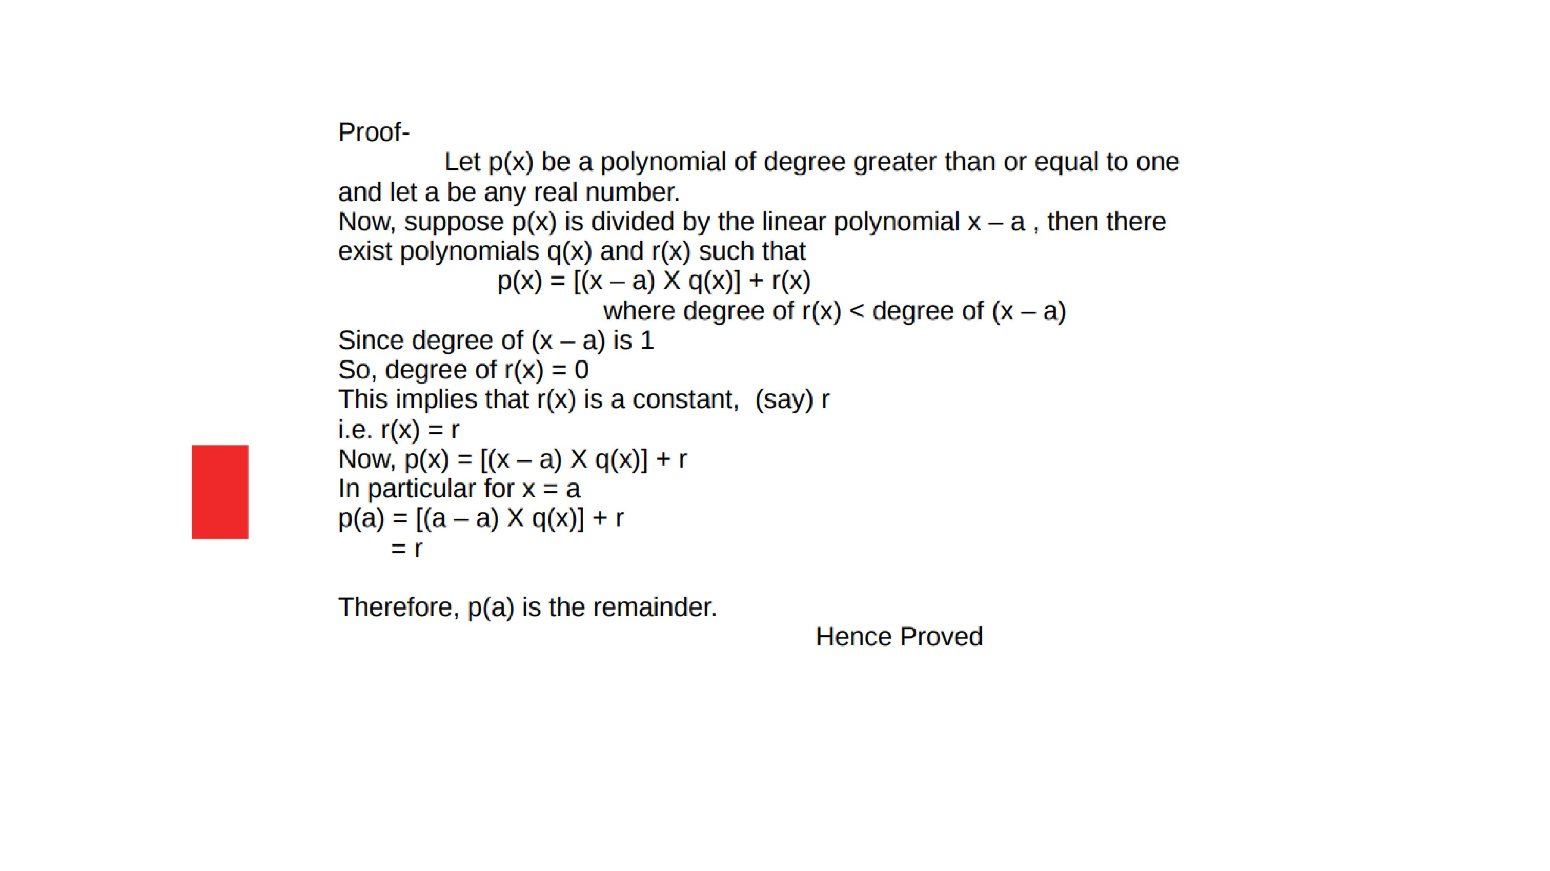

Slide 11

Evaluation:-
a) Find the remainder when $x^{4}+x^{3}−2x^{2}+x+1$is divided by x-1 .

Slide 12
Homework:-
Exercise - 2.3
QUESTION NUMBER-2,3

Slide 13

AHA:-
1.If the polynomials $ax^{3}+4x^{2}+3x−4anⅆx^{3}−4x+a$ leave the same remainder when divided by x-3, find ‘a’.
2.If the p(x)= $x^{3}+3x^{2}+3x+1$is divided by x+$π$, find the remainder.

Slide 14
THANKING YOU
ODM EDUCATIONAL GROUP

