Slide 1


MODEL LESSON
MATHEMATICS
CHAPTER NUMBER :~ 2
CHAPTER NAME :~ POLYNOMIALS
SUB TOPIC :~ ZEROES OF POLYNOMIAL

Slide 2
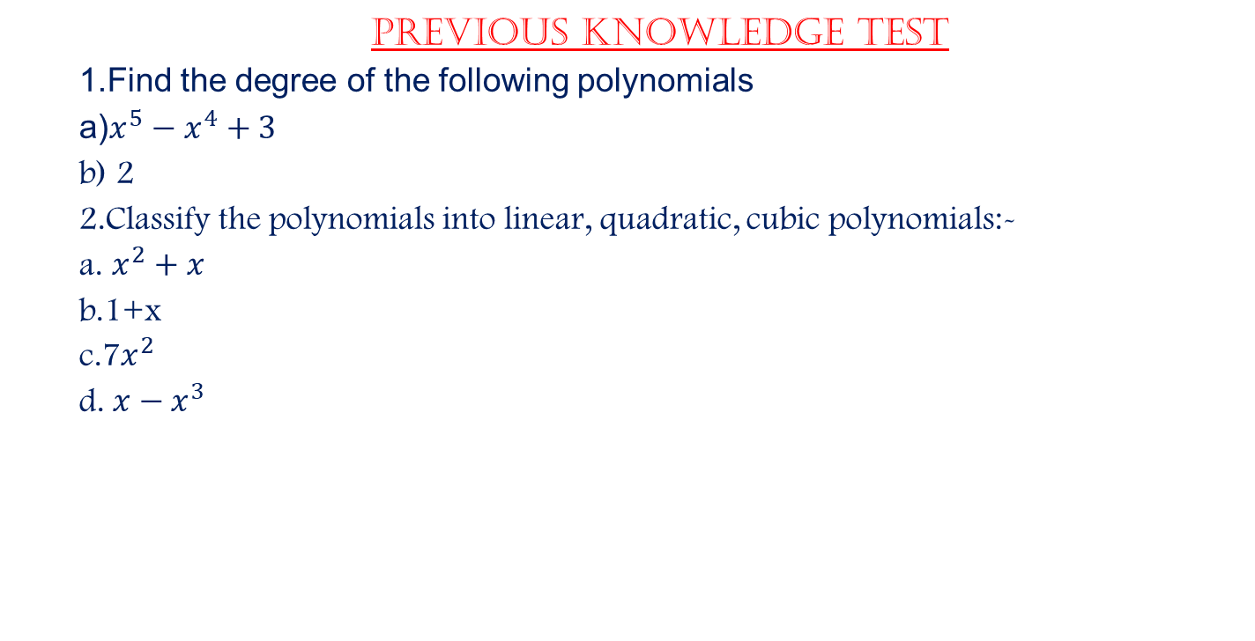
PREVIOUS knowledge Test
1.Find the degree of the following polynomials
a)$x^{5}−x^{4}+3$
b) 2
2.Classify the polynomials into linear, quadratic, cubic polynomials:-
a. $x^{2}+x$
b.1+x
c.7$x^{2}$
d. $x−x^{3}$

Slide 3
LEARNING OUTCOME:-
Students will learn
a)Zeroes of the Polynomials.

Slide 4
EXERCISE-2.1
Question 1.
Which of the following expressions are polynomials in one variable and which are not? State reasons for your answer.
(i) 4x² – 3x + 7
(ii) y² + √2
(iii) 3 √t + t√2
(iv) y+ 2y
(v) x¹⁰+ y³+t⁵⁰
Solution:
(i) We have 4x² – 3x + 7 = 4x² – 3x + 7x⁰
It is a polynomial in one variable i.e., x
because each exponent of x is a whole number.
(ii) We have y² + √2 = y² + √2y⁰
It is a polynomial in one variable i.e., y
because each exponent of y is a whole number.

Slide 5
(iii) We have 3 √t + t√2 = 3 √t^{1/2} + √2.t
It is not a polynomial, because one of the exponents of t is 12,
which is not a whole number.
(iv) We have y + y+2y = y + 2.y⁻¹
It is not a polynomial, because one of the exponents of y is -1,
which is not a whole number.
(v) We have x¹⁰+ y³ + t⁵⁰
Here, exponent of every variable is a whole number, but x¹⁰ + y³ + t⁵⁰ is a polynomial in x, y and t, i.e., in three variables.
So, it is not a polynomial in one variable.

Slide 6
Question 2.
Write the coefficients of x² in each of the following
(i) 2 + x² + x
(ii) 2 – x² + x³
(iii) π2 x² + x
(iv) √2 x – 1
Solution:
(i) The given polynomial is 2 + x² + x.
The coefficient of x² is 1.
(ii) The given polynomial is 2 – x² + x³.
The coefficient of x² is -1.
(iii) The given polynomial is π2x2 + x.
The coefficient of x² is π2.
(iv) The given polynomial is √2 x – 1.
The coefficient of x² is 0.

Slide 7
Question 3.
Give one example each of a binomial of degree 35, and of a monomial of degree 100.
Solution:
(i) Abmomial of degree 35 can be 3x³⁵ -4.
(ii) A monomial of degree 100 can be √2y¹⁰⁰.

Slide 8
Question 4.
Write the degree of each of the following polynomials.
(i) 5x³+4x² + 7x
(ii) 4 – y²
(iii) 5t – √7
(iv) 3
Solution:
(i) The given polynomial is 5x³ + 4x² + 7x.
The highest power of the variable x is 3.
So, the degree of the polynomial is 3.

Slide 9
(ii) The given polynomial is 4- y². The highest
power of the variable y is 2.
So, the degree of the polynomial is 2.
(iii) The given polynomial is 5t – √7 . The highest power of variable t is 1. So, the degree of the polynomial is 1.
(iv) Since, 3 = 3x° [∵ x°=1]
So, the degree of the polynomial is 0.

Slide 10
Question 5.
Classify the following as linear, quadratic and cubic polynomials.
(i) x²+ x
(ii) x – x³
(iii) y + y²+4
(iv) 1 + x
(v) 3t
(vi) r²
(vii) 7x³

Slide 11
Solution:
(i) The degree of x² + x is 2. So, it is a quadratic polynomial.
(ii) The degree of x – x³ is 3. So, it is a cubic polynomial.
(iii) The degree of y + y² + 4 is 2. So, it is a quadratic polynomial.
(iv) The degree of 1 + x is 1. So, it is a linear polynomial.
(v) The degree of 3t is 1. So, it is a linear polynomial.
(vi) The degree of r² is 2. So, it is a quadratic polynomial.
(vii) The degree of 7x³ is 3. So, it is a cubic polynomial.

Slide 12
https://www.youtube.com/watch?v=dnZqhZZivGs
“As great a genius as Archimedes could not invent analytical geometry, for the algebraic knowledge necessary for such as achievement was not available in his time…”
-Nathan A. Court…

Slide 13
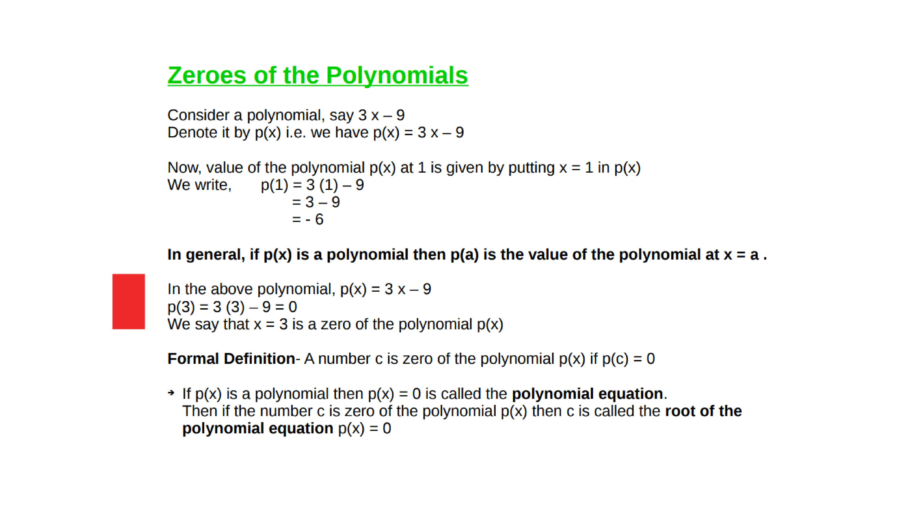

Slide 14
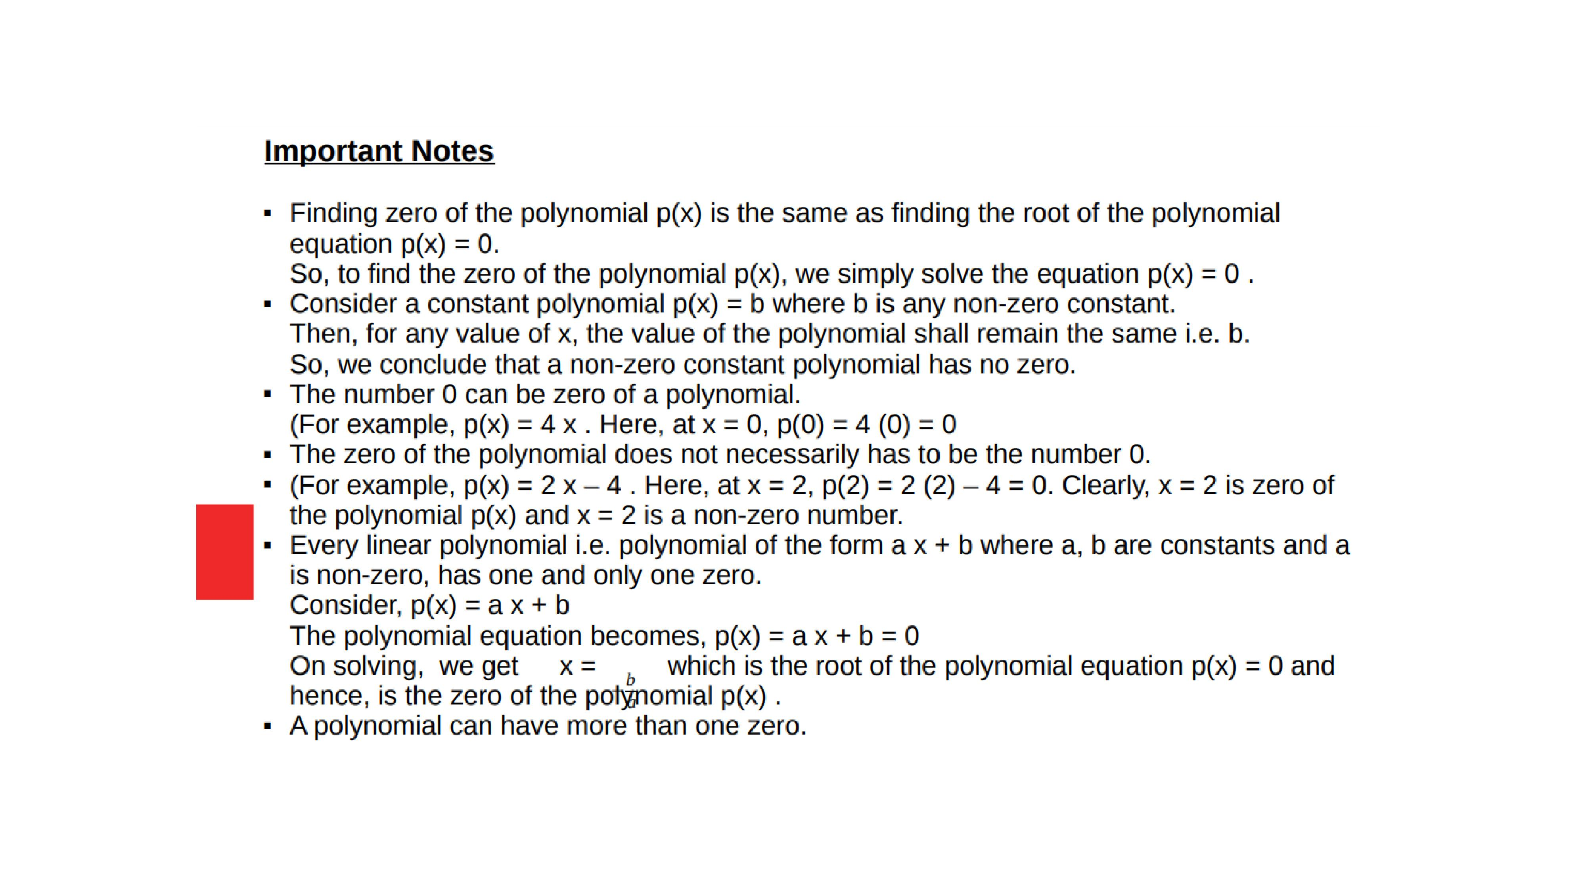

Slide 15

Evaluation:
1. Find the values of the polynomials if x=1 :-
a.${5x}^{2}+3x+7$ b.5$x^{3}−2x^{2}$ + 3x $−$ 2

Slide 16
Homework:-
Exercise - 2.2

Slide 17

AHA:-
1. If x=0 and x=1 are roots of the polynomial
f(x)=$2x^{3}−5x^{2}+ax+b find a and b.$
2. Find integral roots of the polynomial
$x^{3}−6x^{2}+11x−6$.
3. Find rational roots of the polynomial f(x)=
$2x^{3}+x^{2}−7x−6$

Slide 18
THANKING YOU
ODM EDUCATIONAL GROUP

