Slide 1


MODEL LESSON
MATHEMATICS
CHAPTER NUMBER :~ 4
CHAPTER NAME :~ LINEAR EQUATIONS IN TWO VARIABLES
SUB TOPIC :~ INTRODUCTION

Slide 2
LEARNING OUTCOME:-
Students will be able to learn
a.The general form of linear equations in two variables
b.The formation of linear equations when statements are given

Slide 3
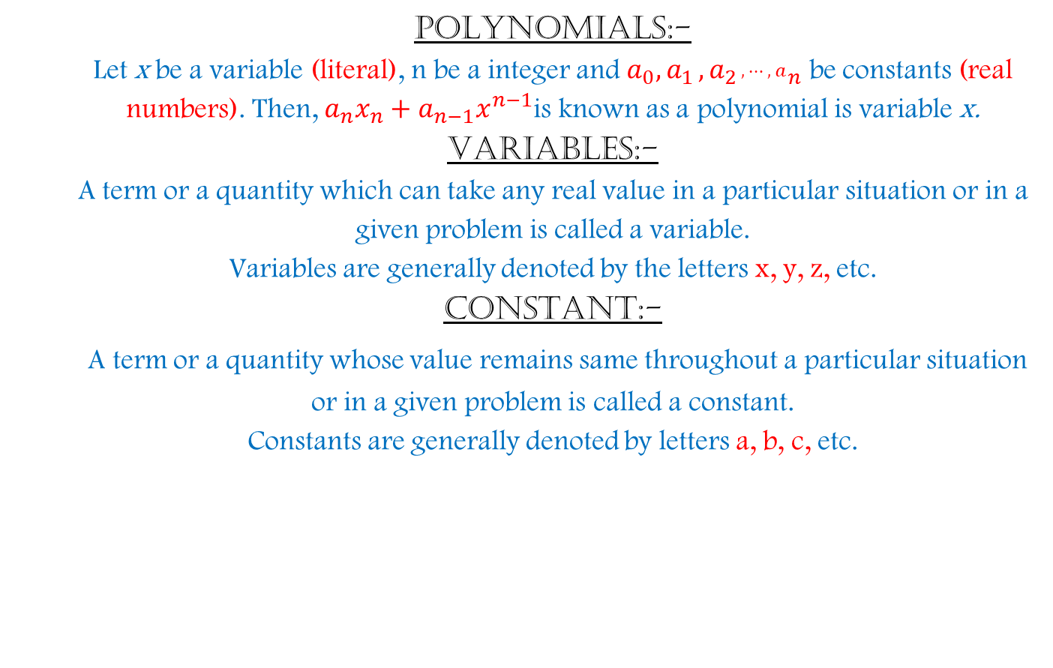
POLYNOMIALS:-
Let x be a variable (literal), n be a integer and $a_{0}{,a}_{1}{,a}_{{2 }^{, ⋯, a}n}$ be constants (real numbers). Then, $a_{n}x_{n}+a_{n−1}x^{n−1}$is known as a polynomial is variable x.
VARIABLES:-
A term or a quantity which can take any real value in a particular situation or in a given problem is called a variable.
Variables are generally denoted by the letters x, y, z, etc.
CONSTANT:-
A term or a quantity whose value remains same throughout a particular situation or in a given problem is called a constant.
Constants are generally denoted by letters a, b, c, etc.

Slide 4
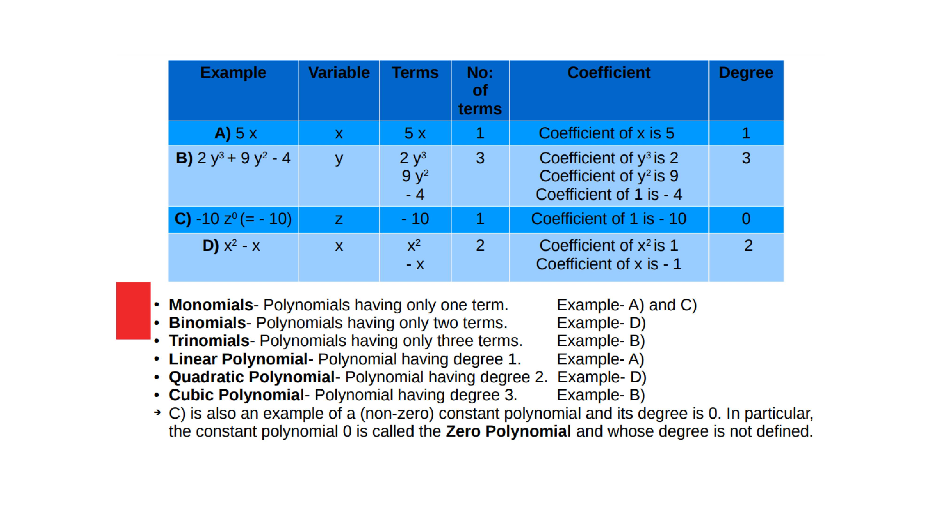

Slide 5
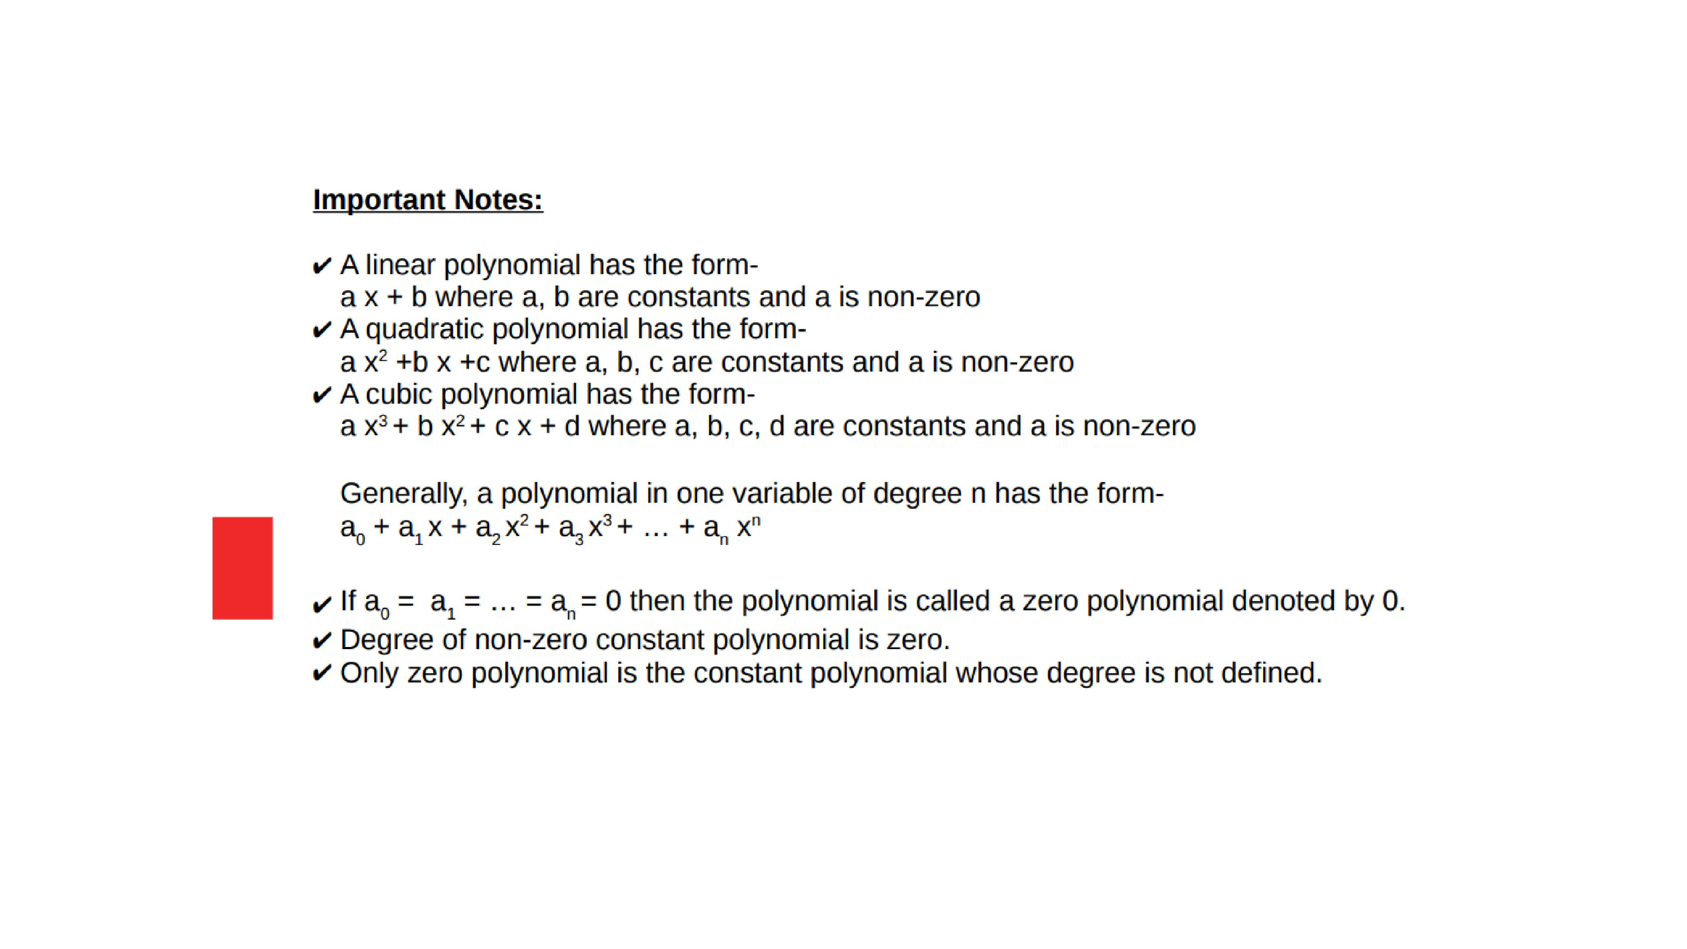

Slide 6

Evaluation:
Question:1.Find the degree of the following polynomials:-
a)$x^{5}−x^{4}+3$
b) 2
2. Classify the polynomials into linear, quadratic, cubic polynomials:-
a. $x^{2}+x$
b.1+x
c.7$x^{2}$
d. $x−x^{3}$

Slide 7
Homework:-
Exercise - 2.1

Slide 8
AHA:-
Give 2 examples of :
Linear polynomial
Quadratic polynomial
Cubic polynomial
Biquadratic polynomial

Slide 9
THANKING YOU
ODM EDUCATIONAL GROUP

