Slide 1

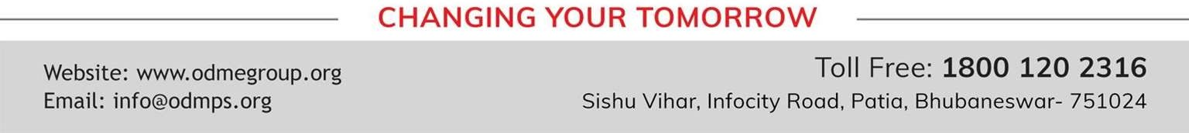
PHYSICAL QUANTITIES AND MEASUREMENT
CHAPTER NO.1 SUB: PHYSICS
STD- VII

Slide 2


LEARNING OBJECTIVE
Students will be able to
•Estimate the area of an object of irregular shape using a graph
paper .
•Measure the volume of an irregular object using a graduated cylinder

Slide 3
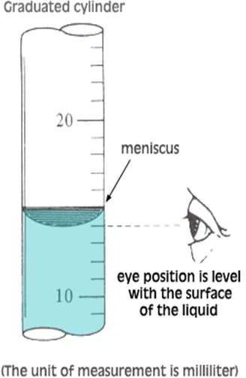

Measurement of volume of a liquid
By using a measuring cylinder
A measuring cylinder is used in a laboratory to measure the volume of a given liquid. For this, proceed as follows
Select a cylinder that is large enough to hold the volume of liquid being measured.
Steady the tube with one hand while pouring the liquid you are measuring into it from another container. Graduated cylinders are thin and can be tipped over easily, so take special care when working with noxious or volatile liquids.

Slide 4
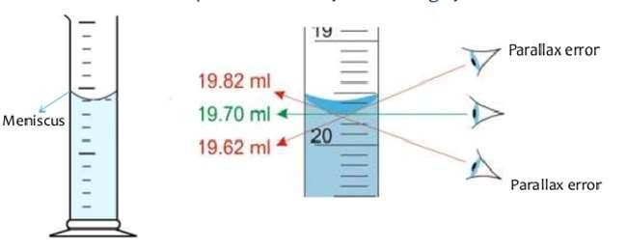
Hold the cylinder at eye level to take a reading. Ensure that it is hanging straight down. Avoid crouching to read the cylinder while it is resting on the table; if jostled, the container could tip over and pour liquid onto your face or torso.
Take the liquid measurement at the very bottom of the dip in the surface of the liquid. This dip is called the
meniscus; it forms because liquid molecules are more attracted to the glass than they are to each other.
Look at the horizontal lines on the side of the cylinder. Ascertain to which line the meniscus is closest.
Determine the increments of measurement on the tube. For example, if the area between the 40ml mark and the
50ml mark is divided into ten segments, each segment represents 1ml.
Locate the closest whole measurement below the surface of the liquid.
Count the number of segments up to the line nearest the meniscus. Calculate the volume of the liquid by adding the
whole measurement to the sum of the segments

Slide 5
BY USING A MEASURING BEAKER
A measuring beaker is used to measure a fixed volume of liquid from a large volume.
A measuring beaker is used to measure a fixed volume
Suppose it is required to measure 500 Ml of milk from the milk contained in a bucket.
For this, take the measuring beaker of capacity 500 Ml. Wash it and dry it.
Then immersed the measuring beaker from the bucket gently so that no milk splashes out and then pour the milk from the measuring beaker in to another empty vessel.

Slide 6
Measurement of volume of regular object
For the calculation of the volume of regular solids, various formula is used which are given below,
Volume of a cuboid (V)= length(l) × breadth (b) × height(h)
∴ V= l × b × h
Volume of a cube (V)= (length)³
∴ V= l³
Volume of sphere (V)= 4/3π(radius)³
∴ V=4/3πr³
Volume of cylinder (V)=π × (radius)² × height (h)
∴ V=πr²h

Slide 7
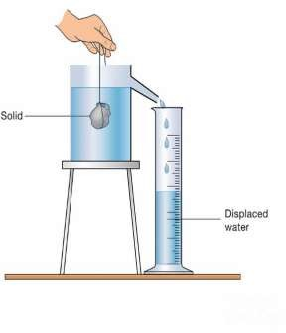
Measurement of volume of irregular object
We can measure the area of irregular bodies by using graph paper. But it is impossible to measure the volume of irregular bodies by using graph paper. We can measure the volume of irregular bodies by using measuring cylinder.
This method is based on the fact that the volume of an irregular solid is equal to the volume of water displaced by it when it is immersed in water. When we immerse an irregular body in water, it displaces some amount of water.
The volume of displaced water is equal to the volume of an irregular body that displace water. This method can be used to calculate the volume of those irregular bodies which sink in water and do not dissolve in water.

Slide 8
Area
The total space occupied by the plane surface of the object is known as the area of that object. The SI unit of area is the square metre (m²). Other similar units of area are mm², cm², km², etc.
Measurement of area of regular object
There are various formulae used for the measurement of the area of the regular plane surface. Some of them
are given below,
Area of a rectangular object (A) = length(l) × breadth(b)
∴ A= l × b
Area of a circle (A)=π × (radius)²[ π = 22/7 ]
∴ A=πr²
Area of a square (A)= (length)²
∴ A= l²

Slide 9
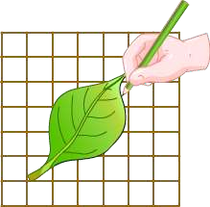
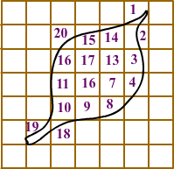
Measurement of Area of Irregular Surfaces
There are no exact formulae for the measurement of the area of irregular surfaces.
But we can measure the area of irregular surfaces by using graph paper.
A graph paper is divided into equal- sized squares of side 1 cm and 1 mm.
At first, the irregular object is placed on the graph paper. Then the outline of the
object is drawn on the graph paper.
After this, the number of squares covered by the outline is counted.
The number of squares that are more than half is also counted but the squares
less than half are not counted.
Then by adding two numbers, the area of the given irregular object is calculated.

Slide 10

Measurement of Area of Irregular Surfaces https://www.youtube.com/watch?v=YQT_mI9r6dw

Slide 11
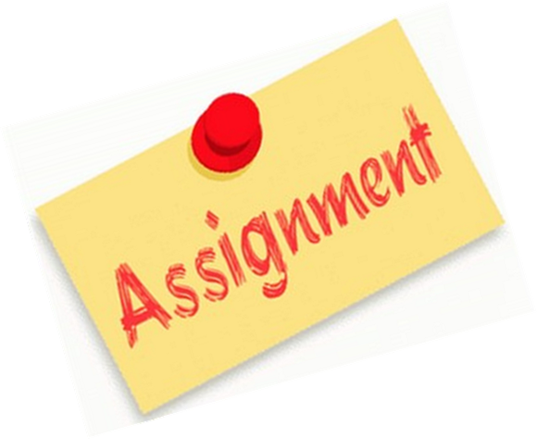
HOME ASSIGNMENT
How will you determine the volume of a cuboid ?
Name the two device used to measure the volume of liquid ?
How you can determine the volume of an irregular solid ?

Slide 12
THANKING YOU
ODM EDUCATIONAL GROUP

