Slide 1

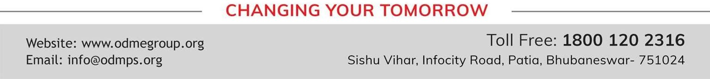
PHYSICAL QUANTITIES AND MEASUREMENT
CHAPTER NO.1 SUB: PHYSICS
STD- VII

Slide 2

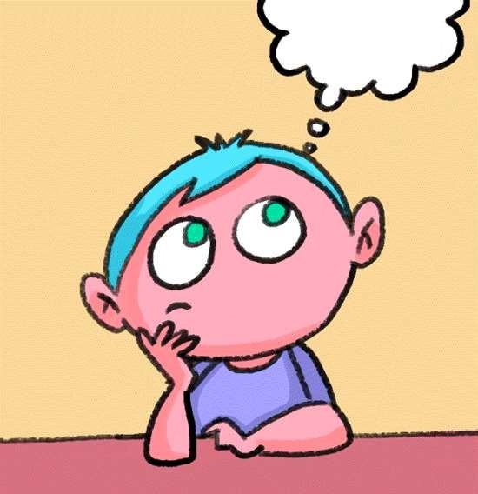
LEARNING OBJECTIVE
Students will be able to define measurement.
Students will learn what is unit.
Students will learn about length, time, volume, temperature
Students will learn to express volume of an object in a proper unit with proper symbols

Slide 3
Physical Quantities:
A physical quantity is a quantity that can be measured.
Length, time, mass and temperature are the fundamental physical quantities.
A physical quantity can be expressed as the combination of a numerical value and a unit. For example, the
physical quantity mass can be quantified as n kg, where n is the numerical value and kg is the unit.

Slide 4
Measurement
Comparing an unknown quantity with some known quantity is called measurement.
Result of Measurement: The result of measurement has two parts; one part is the number and another part is the unit.
The known quantity which is used in measurement is called a unit.
For example; when you say that your height is 150 cm then the measurement of your height is being expressed in a number, i.e. 150 and a unit, i.e. centimetre.

Slide 5
Length
It is the distance between two points
Its SI unit is metre (symbol m)
It is measured with the help of a metre ruler or a measuring tape.
Mass
It is the quantity of matter contained in the body.
Its SI unit is kilogram (symbol kg)
It is measured using a beam balance or an electronic balance

Slide 6
Temperature
It is a quantity which measures the hotness and coldness of a body
Its SI unit is Kelvin (symbol K)
It is measured using a thermometer.
Time
It is the interval of occurrence of an event.
Its SI unit is second (symbol s)
It is measured with the help of a pendulum clock or a watch

Slide 7
Measurement of Volume
Volume
The space occupied by an object is called its volume.
SI Unit of Volume
The SI unit of volume is cubic meter(m³)
One cubic meter is the volume of a cube with each side 1m long
1m³=1m*1m*1m

Slide 8
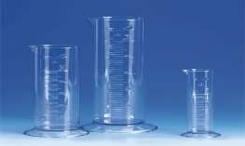
Vessels for measuring the volume of liquids
To measure the volume of liquid such as water, milk, oil etc., We generally use the following two kinds of vessels:
Measuring cylinders
Measuring beakers
Measuring cylinders
Measuring cylinder is a common piece of laboratory equipment used to measure the volume of a liquid.
Each marked line on the graduated cylinder represents the amount of liquid that has been measured.

Slide 9
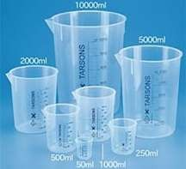
Measuring beakers
A measuring beaker is used generally to measure fixed volume of a liquid such as milk, oil etc.
They are available in different capacities such as 50 mL, 100 mL,500 mL,1000mL.

Slide 10
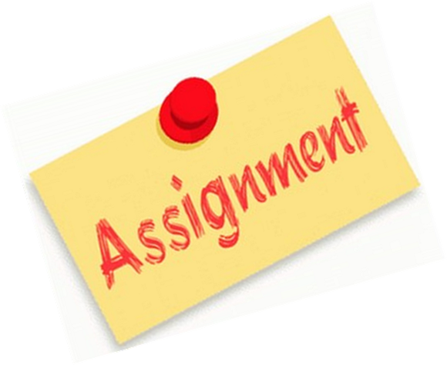
HOME ASSIGNMENT
Define the term volume of an object .
State and define the S.I. unit of volume .
State the two smaller units of volume .How are they related to the S.I. unit ?

Slide 11

THANKING YOU
ODM EDUCATIONAL GROUP

