Slide 1


ANIMAL KINGDOM
CLASS-AVES & MAMMALS
SUBJECT : BIOLOGY
CHAPTER NUMBER: 4
CHAPTER NAME : ANIMAL KINGDOM

Slide 2
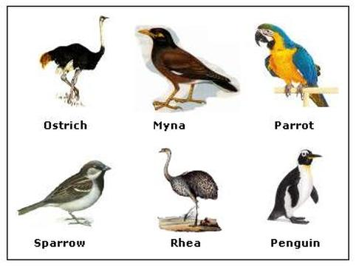
Aves
The Aves belong to the phylum Chordata of the animal kingdom. It has about 9,000 species.
Aves are adapted to fly.
All the birds come in the class Aves.
Members of this class exhibit one of the most beautiful and visually stunning features such as bright and contrasting colours, unique patterns and a wide variety of striking poses.
They show courtship, parental care, nest building, and territorial behaviour.

Slide 3
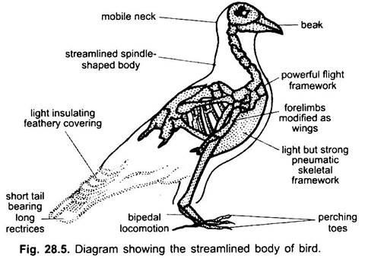
Characteristics of Aves
Birds are warm-blooded animals. Their forelimbs are modified into wings.
The hind limbs are adapted for walking, perching, and swimming.
There is no skin gland except the oil gland.
The upper and lower jaws are modified into a beak. They have no teeth.
Legs are modified for walking, hopping, grasping, perching, wading and swimming. There are epidermal scales on their legs.
The alimentary canal has a crop and a gizzard. The crops help in softening food, and the gizzard helps in crushing the food.
Some seed-eating birds do not have a gall bladder.

Slide 4
Contd ..
They have a spindle-shaped body to minimize resistance to the wind.
The feathers allow the air to pass and reduce friction to a minimum.
They have well-developed flight muscles that help during flight.
They have spongy and elastic lungs for respiration.
The voice is produced by a special organ, the syrinx.
The heart is four-chambered. The RBCs are nucleated, oval, and biconvex.
They have 12 pairs of cranial nerves.
They have a sharp sight.
The endoskeleton is bony with long hollow bones filled with air cavities.
They have a single ovary and oviduct on the left side
All the birds are oviparous and exhibit sexual dimorphism. The eggs have four embryonic membranes- chorion, amnion, allantois, and yolk sac.

Slide 5
Flight Adaptations in Class Aves
Spindle-Shaped Body: It is designed to offer minimum resistance to the wind.
2. Feathers : They provide the passage for air and reduce friction to minimum. They also prevent loss of heat and help to maintain a constant temperature.
3. Wings: Fore-limbs are modified into wings, which help during flight.
4. Beak: Besides procurement of food, the beak is also used for nest-building.
5. Neck and Head: Mobile neck and head are very useful for feeding, nest building, offence and defense.
6. Flight Muscles: The flight muscles on the breast are greatly developed which help in flight.
7. Hind Limbs (Legs):They are well suited for perching.
8. Endoskeleton: Most of bones are pneumatic and filled with air instead of bone marrow. It makes the body light. Most of bones are firmly fused together, which help in flight.
9. Air Sacs : These are attached to lungs which serve as reservoirs of air. They may also aid as cooling devices in regulation of the temperature of the body.

Slide 6
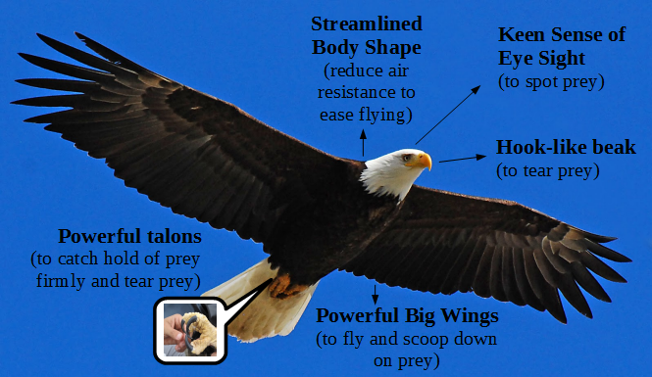
Contd ..
10. Warm-Bloodedness:Birds are warm-blooded animals which is necessary for flight.
11. Circulatory System:A large oxygen supply is required for rapid metabolism and warm-bloodedness. It is done by an efficient circulatory system.
12. Absence of Urinary Bladder:Except Rhea, urinary bladder is absent in birds. Excreta are passed out at once. This helps in reducing the weight of the body.
13. Brain and Eyes:Brain and eyes are well developed. Equilibrium is maintained by well developed cerebellum of the brain.
14. Single Ovary:Presence of a single functional ovary on the left side in the female bird also leads to reduction of weight which is so essential for flight.

Slide 7
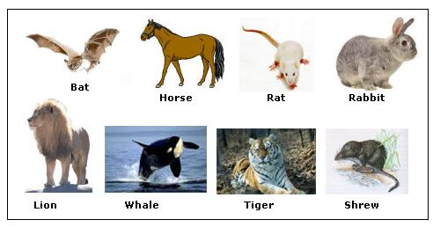
Mammalia
Animals belonging to class Mammalia are referred to as mammals. Mammals are one of the most evolved species in the animal kingdom categorized under vertebrate.
They exhibit advanced characteristics which set them apart from all other animals. They are characterized by the presence of mammary glands through which they feed their younger ones.
They are distributed worldwide and have adapted well to their surroundings – from oceans, deserts and polar regions to rainforests and rivers etc.

Slide 8
Characteristics Of Mammals
Following are a list of distinct characteristics of mammals that separates them from other classes:
Mammals are warm-blooded animals who give birth to their younger ones.
They are the most dominant form of animals found in almost all types of habitats.
They have mammary glands that help them produce milk to feed their younger ones
Their skin possesses oil glands (sebaceous glands) and sweat glands (sudoriferous glands).
The fur of hair throughout the body which helps animals adapt to their environment.
They are heterodont , i.e., possess different types of teeth.
Mammals also possess cervical vertebrae.
The skull is dicondylic .
The trunk is divided into thorax and abdomen.

Slide 9
Characteristics Of Mammals
The mammals respire through lungs.
Good sense of hearing as mammals are aided with 3 middle ear bones
Mammals have a four-chambered heart. The sinus venous and renal portal system are absent.
Presence of single-boned lower jaws.
The brain is well developed divided into cerebrum, cerebellum and medulla.
They possess 12 pairs of cranial nerves.
The mammals can lay eggs also. They are known as viviparous.

Slide 10
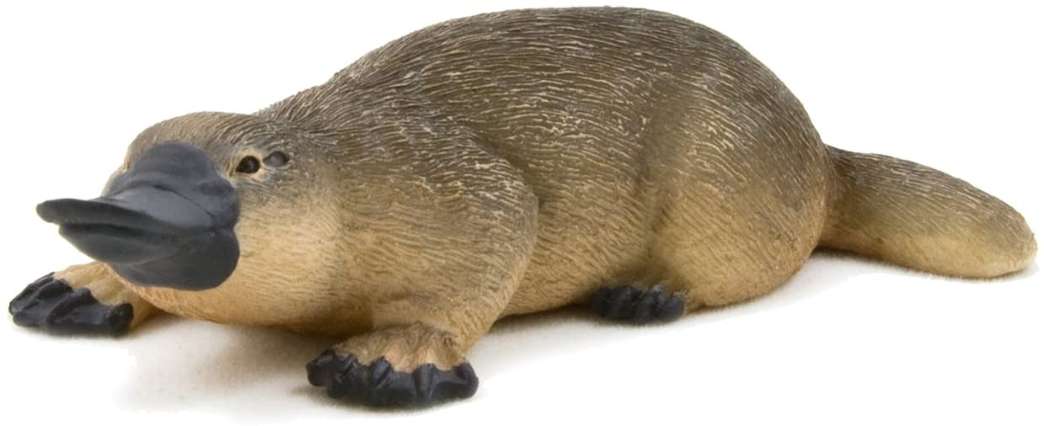
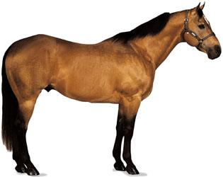
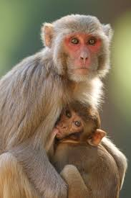
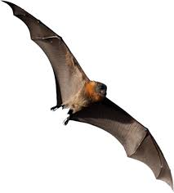
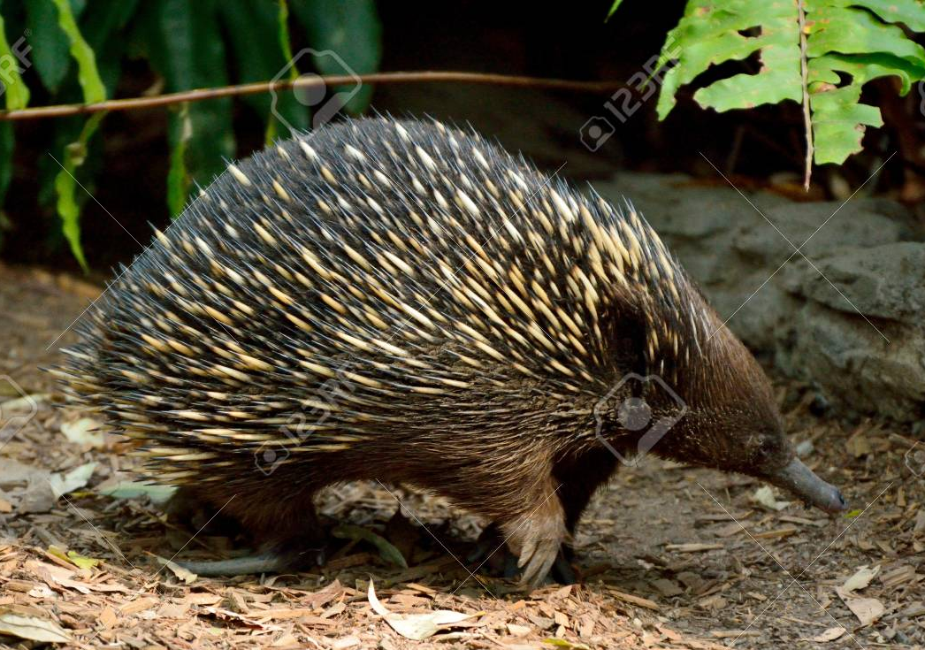
Examples
Oviparous – Omithorhynchus (Duck Billed Platypus), Tachyglossus = Echidna (Spiny Anteater).
Viviparous — Macropus (Kangaroo), Pteropus (Large bat), Camelus (Camel), Macaca (Monkey), Rattus (Rat), Canis (Dog), Elephas (Elephant), Felis (Cat) Delphinus (Common dolphin), Equus (Horse), Balaenoptera (Blue whale), Panthera tigns (Tiger), Panthera leo (Lion).
Duck Billed Platypus
Equus
Pteropus
Macaca
Echidna

Slide 11
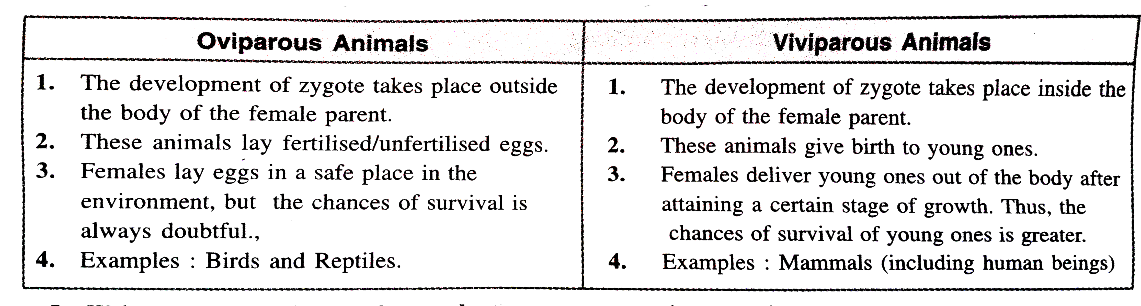
Oviparous vs viviparous animals

Slide 12
THANKING YOU
ODM EDUCATIONAL GROUP

