Slide 1


ANATOMY OF COCKROACH
COCKROACH: MALE AND FEMALE REPRODUCTIVE SYSTEM
SUBJECT : BIOLOGY
CHAPTER NUMBER: 07
CHAPTER NAME : STRUCTURAL ORGANISATION IN ANIMALS

Slide 2
MALE REPRODUCTIVE SYSTEM OF COCKROACH
The male reproductive system of cockroach consists of a pair of testes.
The testes lie on each lateral side in the 4th – 6th abdominal segments.
A thin vas deferens arises from each testis.
It opens into ejaculatory duct through seminal vesicle.
The ejaculatory duct opens into male gonopore which is situated ventral to anus.
A typical mushroom-shaped gland is present in the 6th-7th abdominal segments.
It is an accessory reproductive gland.

Slide 3
Male gonapophysis or phallomeres represent the external genitalia.
These are made up of chitin.
They are asymmetrical structures and surround the male gonopore.
The sperms are stored in the seminal vesicles.
The sperms are glued together in the form of bundles called spermatophores.
Spermatophores are discharged during copulation.

Slide 4
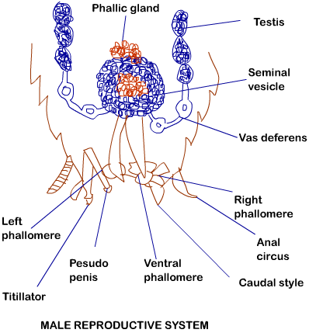

Slide 5
FEMALE REPRODUCTIVE SYSTEM OF COCKROACH
The female reproductive system of cockroach consists of two large ovaries.
The ovaries lie laterally in the 2nd – 6th abdominal segments.
Each ovary is formed of a group of eight ovarian tubules or ovarioles.
They contain a chain of developing ova.
Oviducts from each ovary unite into a single median oviduct.
This is also called vagina and it opens into the genital chamber.
A pair of spermatheca is present in the 6th segment which opens into the genital chamber.

Slide 6
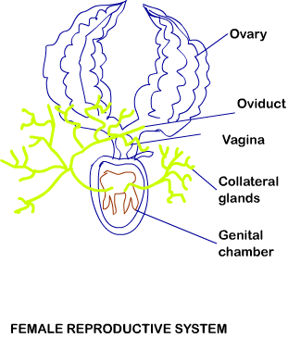

Slide 7
FEMALE REPRODUCTIVE SYSTEM OF COCKROACH
Fertilization
Sperms are transferred through spermatophores.
The fertilized eggs are encased in capsules called ootheca.
An ootheca is a dark reddish to blackish brown capsule.
It is about 8 mm long.
The ootheca are dropped or glued to a suitable surface usually at a place with high relative humidity or near a food source.
On an average, 9 – 10 ootheca are produced by a female.
.

Slide 8
POST FERTILIZATION DEVELOPMENT
Each ootheca contains 14 – 16 eggs.
Development is indirect and is paurometabolous.
Development through nymph stage is called paurometabolous.
The nymph resembles the adults.
The nymph grows by moulting about 13 times to reach the adult form.
Wing pads are seen in the penultimate stage of development but wings are present only in adults

Slide 9
ECONOMIC IMPORTANCE OF COCKROACH
Many species of Cockroaches are wild and are of no known economic importance yet.
A few species thrive in and around human habitat.
They are pests because they spoil food and contaminate it with their smelly excreta.
They can transmit a variety of bacterial diseases by contaminating food material.

Slide 10
THANKING YOU
ODM EDUCATIONAL GROUP

