Slide 1


ANIMAL KINGDOM
CLASS-AMPHIBIA,REPTILIA
SUBJECT : BIOLOGY
CHAPTER NUMBER: 4
CHAPTER NAME : ANIMAL KINGDOM

Slide 2
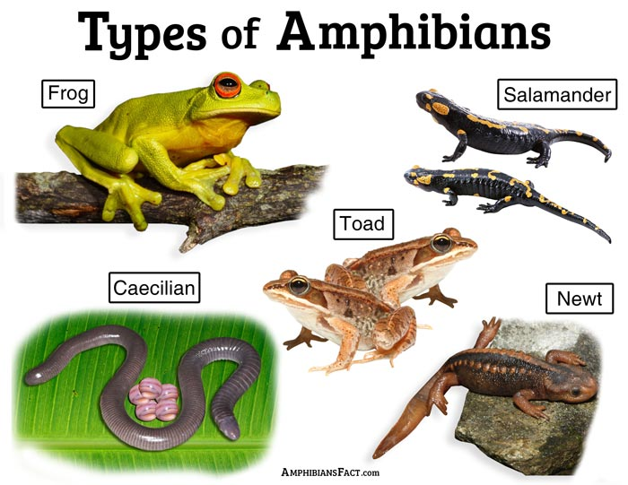
Amphibia
The organisms belonging to the class Amphibia fall under the Chordata phylum of the kingdom Animalia.
These are multicellular vertebrates that live both on land and water.
This class includes about 3000 species.
They are the first cold-blooded animals to have appeared on land.

Slide 3
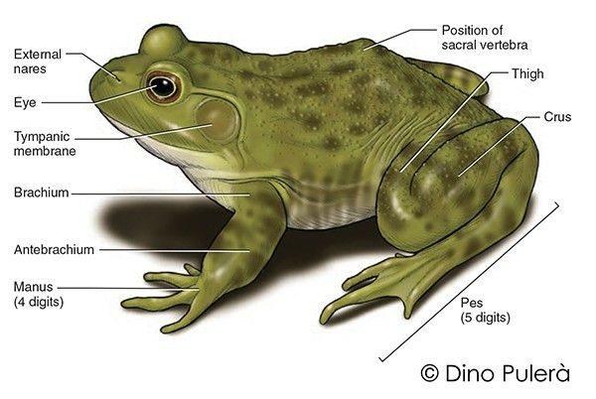
General characters of Amphibians
1) Amphibians are cold blooded vertebrates which can hue on land and in water.
2) Amphibians show four limbs with which they can swim in water and jump or walk on the land, (But In apoda limbs are absent.)
3) In Amphibians animals exoskeleton is absent. But in apoda animals small cycloid scales are present.
4) In Amphibians the adult animals lungs are present. Gills are absent. But In some the gills are present.
5) Amphibians Skin is a respiratory organ.
6) The Amphibians skull is dicondylic.
7) Amphibians Ribs are absent.
8) In Amphibians The body divisible into head and trunk Tail is present in, urodela animals.
9) Amphibians Digestive system is well developed. A well developed liver Is present

Slide 4
Contd ..
10) External ear is absent. Middle and inner ears are present.
11)Amphibians Heart is 3 chambered with 2 auricles and 1 ventricle The blood contains R.B.C. They are nucleated. They contain hemoglobin.
12) Blood vascular system contain hepatic and renal portal systems.
13) Amphibians Kidneys are mesonephric. Urinary bladder is present. It stores urine.
14) Central nervous system is well developed. The brain occupies completely the cranial cavity. The brain is divided into fore, mid and hind brains. Brain continuous as spinal cord.
15)10 pairs of cranial nerves will arise.
16) Sexes are separate.
17) Male and female can be indentified - Sexual dimorphism.
18) In Amphibians the life history a larva stage may be present.
19)Examples: Bufo (Toad), Rana (Frog), Hyla (Tree frog), Salamandra (Salamander), Ichthyophis (Limbless amphibia)

Slide 5
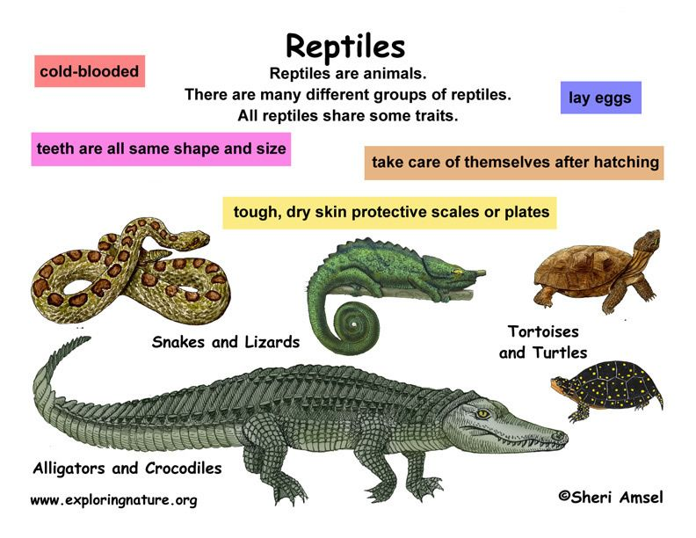
Reptilia
These were the first class of organisms to adapt to life on land.
They are believed to have evolved from the amphibians millions of years ago.
There are about 10000 different species of reptiles on earth.
They are cold-blooded animals belonging to the phylum Chordata of Animal kingdom.
The skull of the reptiles is modified that gives the reptiles an efficient and powerful jaw action. The modification also makes the skull light.

Slide 6
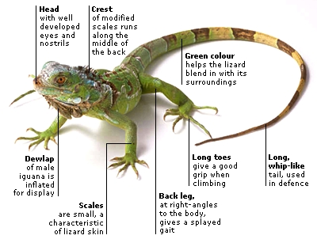
Characteristics of Reptilia
Following are the important characteristics of the animals belonging to Class Reptilia:
These are creeping and burrowing terrestrial animals with scales on their body.
They are cold-blooded animals found in most of the warmer regions of the world.
Their skin is dry, and rough, without any glands.
The body is divided into head, neck, trunk, and tail.
Few of these shed the scales on their skin as skin cast.
The respiration takes place with the help of the lungs.
The skull is monocondylic.
They have two pairs of pentadactyl limbs, each bearing claws. Snakes are an exception.

Slide 7
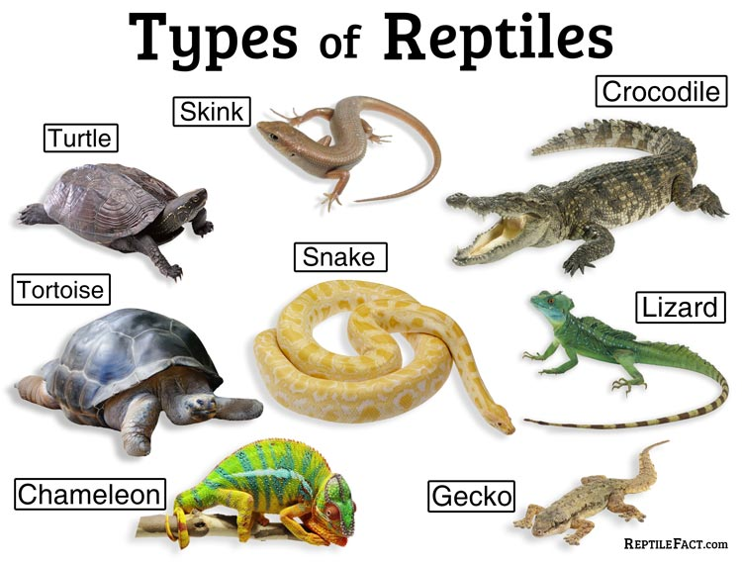
Characteristics of Reptilia
Following are the important characteristics of the animals belonging to Class Reptilia:
The heart is 3 chambered. However, crocodiles have a 4-chambered heart.
The nervous system comprises of 12 pairs of cranial nerves.
The lateral line system is absent in reptiles.
Except for snakes, all the reptiles have well-developed ears.
They possess a typical cloaca .
Reptiles are ureotelic , uricotelic , and ammonotelic .
Fertilization is internal.
They are oviparous and the eggs are very yolky.
Eg., Poisonous snakes – Naja (Cobra), Bangarus (Krait), Vipera (Viper), Turtles, Lizards, Crocodiles

Slide 8
THANKING YOU
ODM EDUCATIONAL GROUP

