Slide 1


ANIMAL KIGDOM
CLASS-CYCLOSTOMATA,SUPER CLASS-PISCES
SUBJECT : BIOLOGY
CHAPTER NUMBER: 4
CHAPTER NAME : ANIMAL KINGDOM

Slide 2
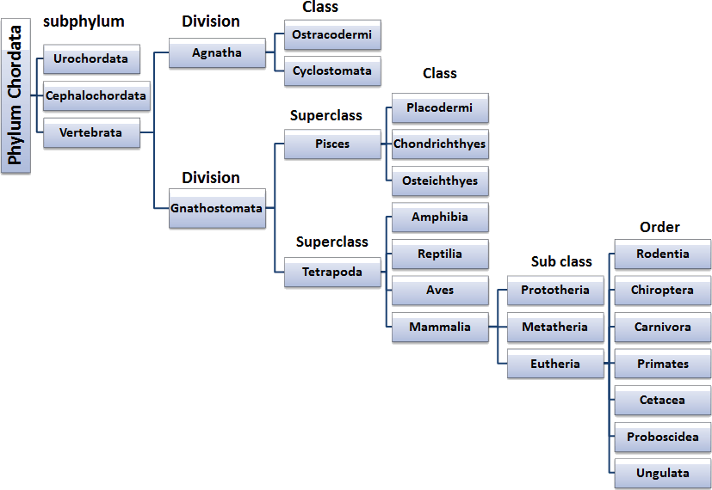

Slide 3
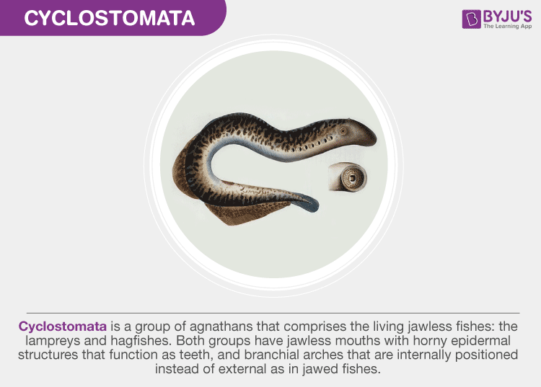
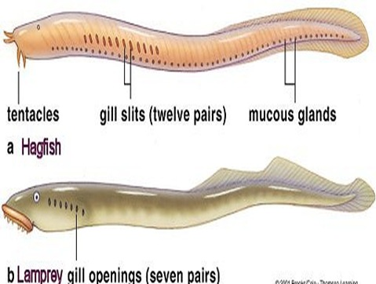
Cyclostomata
The Cyclostomata are the modified and degenerate offshoot of the primitive vertebrate stalk. Due to their circular mouth, they are named Cyclostomata.
They are parasitic, usually feeding on fish in their adult stage. Morphologically, they resemble eels. They are known to be the only living vertebrates without true jaws, hence called Agnatha. Cyclostomata includes hagfishes and lampreys.

Slide 4
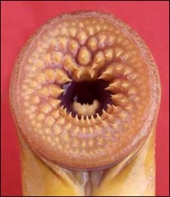
Characteristics of Cyclostomata
Following are the characteristics of cyclostomata :
The body is round and elongated like an eel.
The paired fins are absent, median fins with cartilaginous fin rays.
No paired appendages.
The skin is soft and smooth, devoid of any scales.
The exoskeleton is absent. The endoskeleton is cartilaginous with no bones.
The notochord is present throughout their lives..
The gills are five to sixteen in pairs.
The heart is two-chambered.
The brain is visible.The lateral line acts as a sense organ.About ten pairs of cranial nerves are present.
The sexes are separate. Some hagfish species are believed to be hermaphrodite.
The middle stage of their life is spent in the saltwater of the ocean or in a large freshwater lake. Then they return as breeding adults to spawn in the freshwater streams and rivers, and die shortly after spawning. Catadromous fish migrate from fresh water down into the sea to spawn.
Development may be direct or indirect.
Eg., Petromyzon and Maxine.

Slide 5
Pisces
These are true, jawed vertebrates with specific organs for respiration, excretion and blood circulation. The organisms belonging to this class are poikilotherms, meaning that they cannot regulate their own body temperature. Essentially, all the fish come in this category.
Characteristics of Pisces
They are found in fresh, marine, and brackish water.
The body is usually streamlined. Some have a spindle-shaped or elongated body as well.
Their body is distributed into a head, trunk and tail.
They swim with the help of their tail.
Paired and unpaired fins represent the appendages. These help the fish to balance while swimming.
The lateral line system functions as a sensory organ to sense the disturbances in the nearby environment.
The body is covered with scales, which helps by providing protection to the internal organelles.
The gills help in respiration.
Closed type blood circulation is observed.
The internal skeleton is bony or cartilaginous.
These are cold-blooded organisms.
They may be herbivores or carnivores, oviparous or ovoviviparous.
The sexes are separate.Fertilization may be external or internal.
The digestive system is well-developed.
The nervous system comprises of the brain and ten pairs of the cranial nerves.

Slide 6
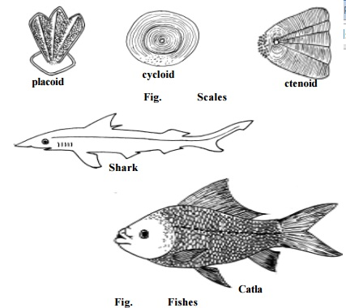
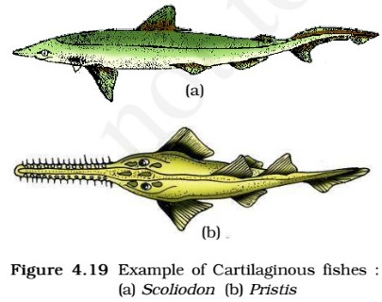
Classification of Pisces
Pisces are classified into three categories:
Chondrichthyes
Osteichthyes
Placodermi (extinct)

Slide 7
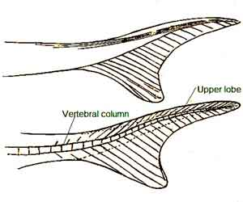
General Characteristics of Chondrichthyes
The body is covered by tough skin with minute placoid scale and mucous glands.
They have jaws and paired appendages.
They lack the air-filled swim bladder.
They have median and paired fins which are supported by cartilaginous fin rays.
The mouth is ventrally placed with rows of teeth.
Their jaws are very powerful. These animals are predaceous.
They have heterocercal type caudal fin.
They have a well-developed electroreceptive system.
They have 5-7 pairs of gills for performing respiration with no operculum.
The male members of Chondrichthyes have specialized paired reproductive organs at the inner edge of the pelvic fins which is known as clasper.

Slide 8
Contd..
They may be oviparous (egg layers), viviparous (live-bearer) or some species are ovoviviparous (mother carry eggs in her body).
They produce large-sized yolky eggs and their fertilization is internal with direct development.
The digestive system consists of a j-shaped stomach and short intestine with a spiral valve.
The fish bears one or two nostrils which never opens in the mouth cavity.
They have typically paired gonads and gonoducts which open into the cloaca.
Most Chondrichthyes exhibit a massive growth with up to 21.5 tonnes in weight (whale shark).
Examples: Scoliodon (Dog fish), Pristis (Saw fish), Carcharodon (Great white shark), Trygon (Sting ray).

Slide 9
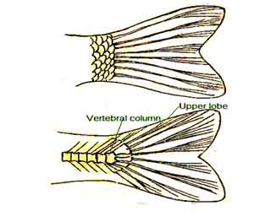
General Characteristics of Osteichthyes
The body is rounded and tapered at the ends (fusiform body).
They bear paired (pectoral and pelvic fins) and unpaired fins (dorsal, anal, and tail fins).
The endoskeleton is made up of bones.
They are found in either marine or freshwater habitats.
The caudal or tail fin is homocercal type.
They have 4 pairs of gills or breathing organs.
The gill covered by the operculum on each side.
They have sac-like outgrowth which is known as swim bladder or air bladder that also acts as a hydrostatic organ. It arises from the dorsal wall of the esophagus which is used to maintain balance and to swim up and down.
The exoskeleton is dermal in origin if present which is composed of cycloid, ctenoid or ganoid scales.
They possess a terminal mouth which is located at the anterior tip of the body.

Slide 10
Contd ..
They have well developed lateral line system which runs through the body and consists of a series of sensory organs that help to sense both water pressure and vibrations.
Digestive tract leads into the anus with no cloaca.
They have well-developed eyes with the nictitating membrane.
Generally, their fertilization is external with direct development. Most of the fishes are oviparous but some are ovoviviparous.
Examples: Marine – Exocoetus (Flying fish), Hippocampus (Sea horse); Freshwater – Labeo (Rohu), Catla (Katla), Clarias (Magur); Aquarium – Betta (Fighting fish), Pterophyllum (Angel fish).

Slide 11
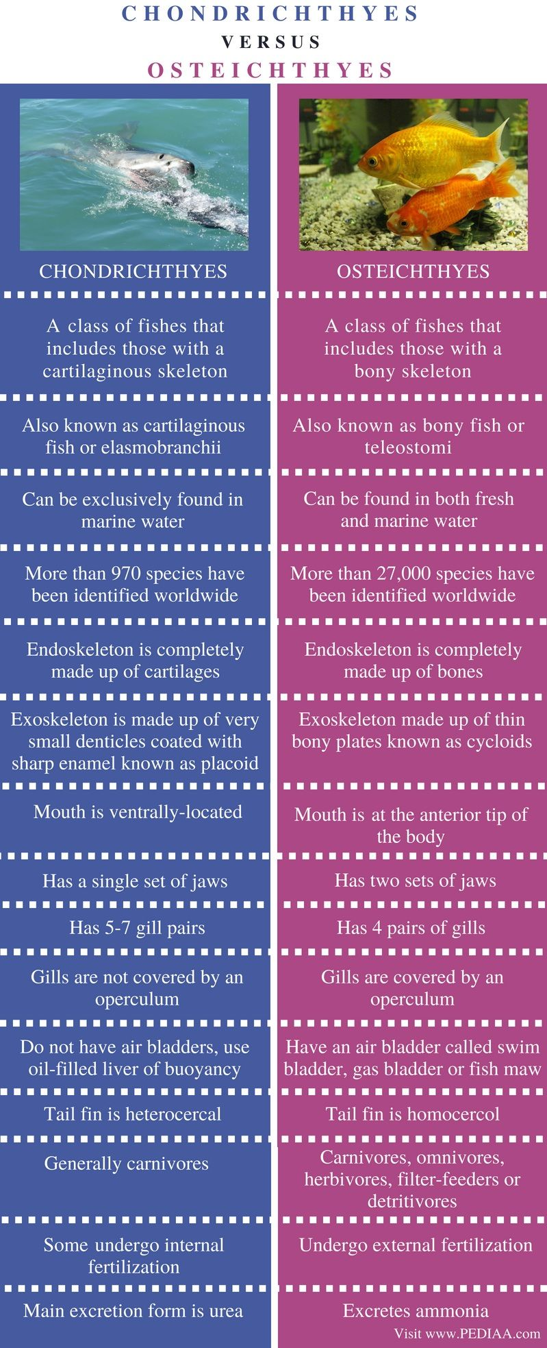
Chondrichthyes vs Osteichthyes

Slide 12
Chondrichthyes vs Osteichthyes

Slide 13
THANKING YOU
ODM EDUCATIONAL GROUP

