Slide 1


BIOLOGICAL CLASSIFICATION
VIRUS,VIROIDS,LICHENS
SUBJECT : BIOLOGY
CHAPTER NUMBER:2
CHAPTER NAME : BIOLOGICAL CLASSIFICATION

Slide 2
Virus
The viruses are non-cellular organisms that are characterised by having an inert crystalline structure outside the living cell. Once they infect a cell they take over the machinery of the host cell to replicate themselves, killing the host.
The name virus that means venom or poisonous fluid was given by Pasteur. D.J. Ivanowsky (1892) recognised certain microbes as causal organism of the mosaic disease of tobacco. These were found to be smaller than bacteria because they passed through bacteria-proof filters.
M.W. Beijerinek (1898) demonstrated that the extract of the infected plants of tobacco could cause infection in healthy plants and called the fluid as Contagium vivum fluidum (infectious living fluid).
W.M. Stanley (1935) showed that viruses could be crystallised and crystals consist largely of proteins. They are inert outside their specific host cell.
Viruses are obligate parasites.

Slide 3
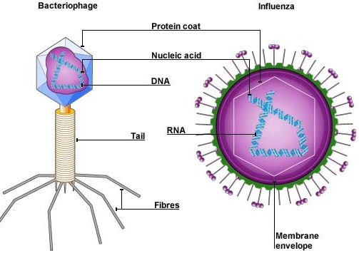
Virus
In addition to proteins viruses also contain genetic material, that could be either RNA or DNA.
No virus contains both RNA and DNA.
A virus is a nucleoprotein and the genetic material is infectious. In general, viruses that infect plants have single stranded RNA and viruses that infect animals have either single or double stranded RNA or double stranded DNA.
Bacterial viruses or bacteriophages (viruses that infect the bacteria) are usually double stranded DNA viruses.
The protein coat called capsid made of small subunits called capsomeres , protects the nucleic acid. These capsomeres are arranged in helical or polyhedral geometric forms.
Viruses cause diseases like mumps, small pox, herpes and influenza. AIDS in humans is also caused by a virus.
In plants, the symptoms can be mosaic formation, leaf rolling and curling, yellowing and vein clearing, dwarfing and stunted growth.

Slide 4
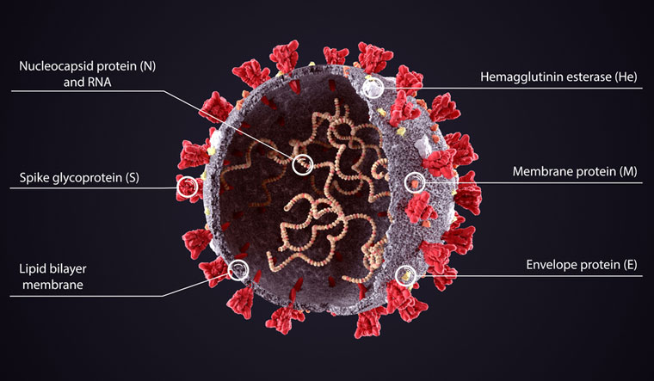
Corona virus

Slide 5
Viroids
In 1971 T.O. Diener discovered a new infectious agent that was smaller than viruses and caused potato spindle tuber disease.
What are Viroids?
Viroids are infectious pathogens that affect only plants, therefore are also called as the plant pathogens. Structurally, viroids are smaller than viruses and possess circular strands of ribonucleic acids (RNA’s) , it lacked the protein coat that is found in viruses, hence the name viroid.
These entities hijack the cellular machinery present in plant cells to replicate new copies of itself. It primarily affects all forms of higher plants.
The RNA of the viroid was of low molecular weight.
Characteristic Features Of Viroids :
Some of the characteristic features of viroids are given below-
Viroids contain only RNA.
These are known to be smaller in size and infect only the plants.
These are among the smallest known agents causing infectious disease.
Viroids are the species of nucleic acid with relatively low molecular weight and a unique structure.
They reproduce within the host cell which they affect in and cause variations in them causing death.

Slide 6
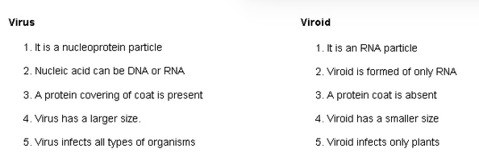
Virus vs Viroids

Slide 7
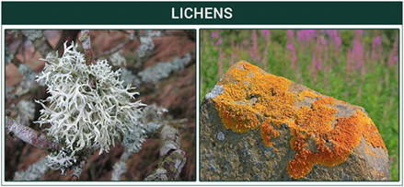
Lichens
Lichens are symbiotic associations i.e, mutually useful associations, between algae and fungi.
The algal component is known as phycobiont and fungal component as mycobiont , which are autotrophic and heterotrophic, respectively.
Algae prepare food for fungi and fungi provide shelter and absorb mineral nutrients and water for its partner.
Lichens are very good pollution indicators - they do not grow in polluted areas.

Slide 8
THANKING YOU
ODM EDUCATIONAL GROUP

