Slide 1


CHEMICAL CONTROL AND INTEGRATION
MECHANISM OF HORMONE ACTION
SUBJECT : BIOLOGY
CHAPTER NUMBER: 22
CHAPTER NAME : CHEMICAL CONTROL AND INTEGRATION

Slide 2
MECHANISM OF HORMONE ACTION
Hormones produce their effects on target tissues by binding to specific proteins called hormone receptors located in the target tissues only.
Hormone receptors present on the cell membrane of the target cells are called membrane-bound receptors and the receptors present inside the target cell are called intracellular receptors, mostly nuclear receptors (present in the nucleus).
Binding of a hormone to its receptor leads to the formation of a hormone-receptor complex. Each receptor is specific to one hormone only and hence receptors are specific.
Hormone-Receptor complex formation leads to certain biochemical changes in the target tissue. Target tissue metabolism and hence

Slide 3
MECHANISM OF HORMONE ACTION
Physiological functions are regulated by hormones. On the basis of their chemical nature, hormones can be divided into groups :
(i) Peptide, polypeptide, protein hormones (e.g., insulin, glucagon, pituitary hormones, hypothalamic hormones, etc.)
(ii) Steroids (e.g., cortisol, testosterone, estradiol and progesterone)
(iii) Iodothyronines (thyroid hormones)
(iv) Amino-acid derivatives (e.g., epinephrine).

Slide 4
MECHANISM OF HORMONE ACTION
Hormones which interact with membrane-bound receptors normally do not enter the target cell, but generate second messengers (e.g., cyclic AMP, IP 3 , Ca++ etc) which in turn regulate cellular metabolism.

Slide 5
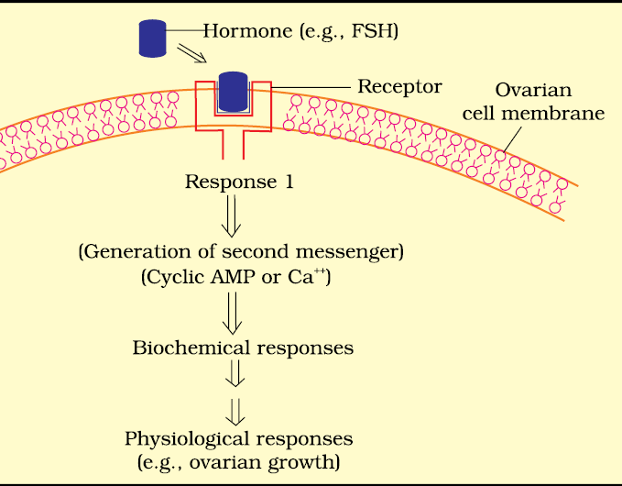

Slide 6
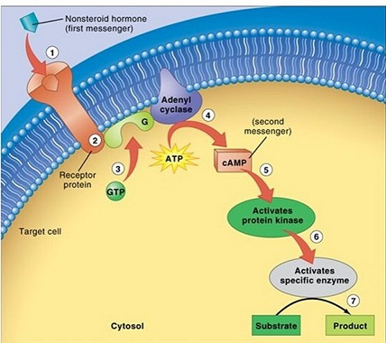
MECHANISM OF HORMONE ACTION

Slide 7
MECHANISM OF HORMONE ACTION
Hormones which interact with intracellular receptors (e.g., steroid hormones, iodothyronines, etc.) mostly regulate gene expression or chromosome function by the interaction of hormone-receptor complex with the genome.
Cumulative biochemical actions result in physiological and developmental effects.

Slide 8
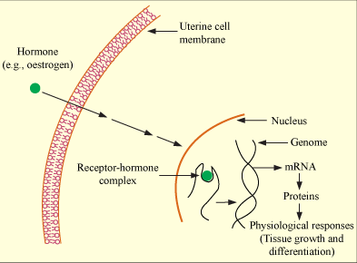
MECHANISM OF HORMONE ACTION

Slide 9
THANKING YOU
ODM EDUCATIONAL GROUP

